Slide 1
Combine semicontinuous and interrupted sutures for hepatic arterial microvascular anastomosis
Fu-Yin Hsiao, Tien-Hsiang Wang
Division of Plastic and Reconstructive Surgery, Department of Surgery, Taipei Veterans General Hospital, Taipei, Taiwan

Slide 2
Disclosure
This study is support by “Taipei Veterans General Hospital-National Yang-Ming University Excellent Physician Scientists Cultivation Program, No. 104-V-B-097.

Slide 3
Posterior Wall Vascular Anastomosis
Current Methods
Turn-over | Time consuming Difficult in short vascular pedicle and small field
One way up | Time consuming Technical depending
Coupler Device | Cost Difficult for arterial anastomsis

Slide 4
Material and Methods
Including criteria: Patients received living donor liver transplantation in Taipei Veterans General Hospital.
Surgical Technique: Combine semicontinuous and interrupted sutures were applied for hepatic arteries anastomosis
Intraoperative Doppler examination to evaluate the flow of hepatic arteries.

Slide 5
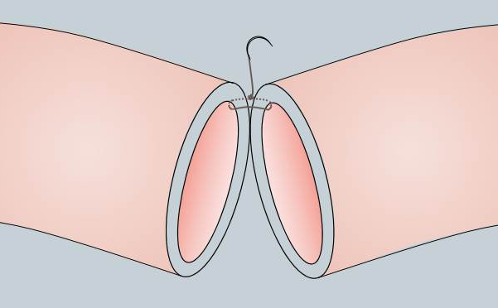
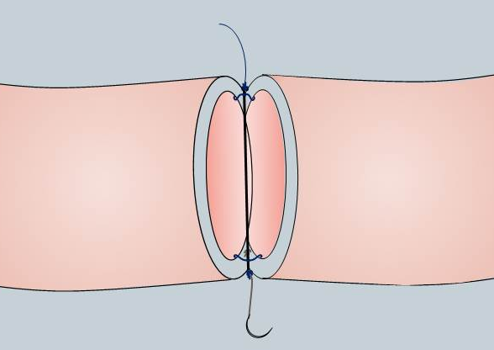
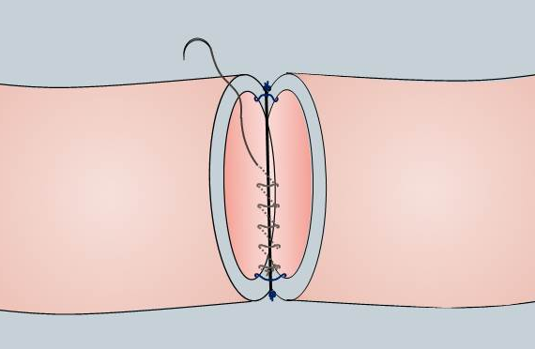
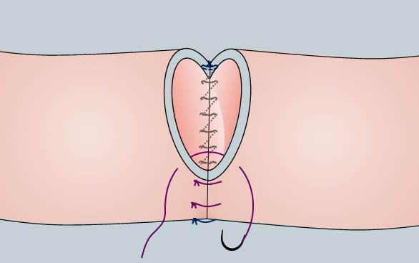
Combine semicontinuous and interrupted sutures

Slide 6
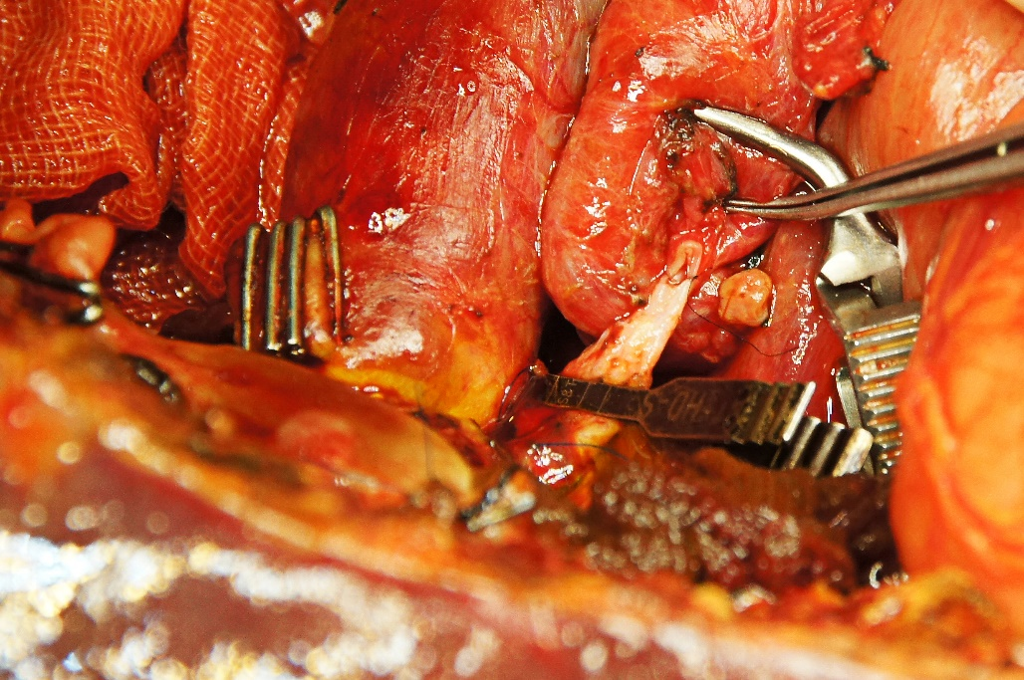
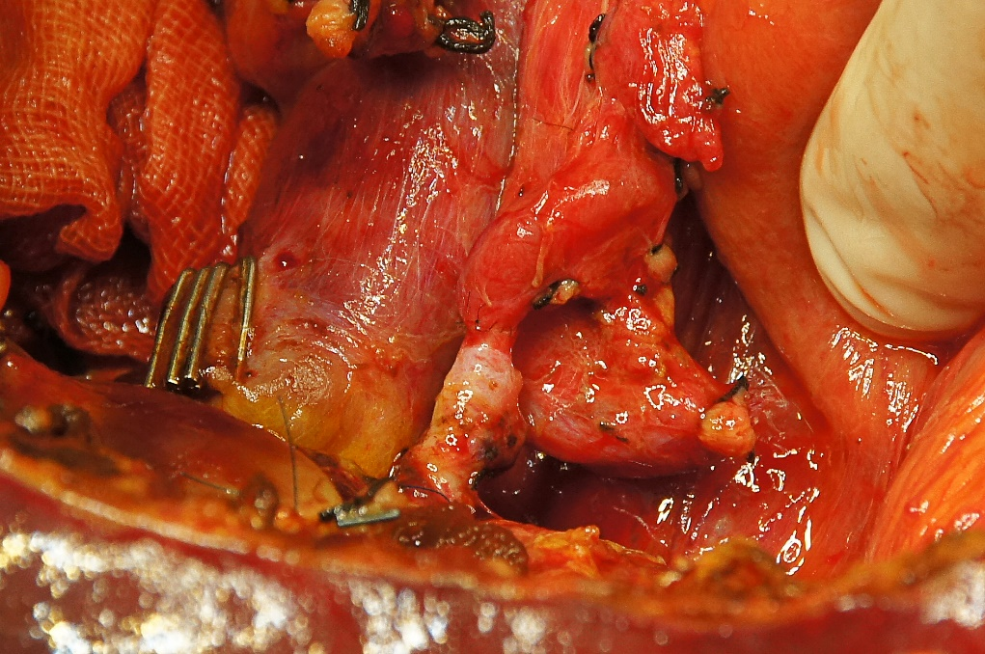
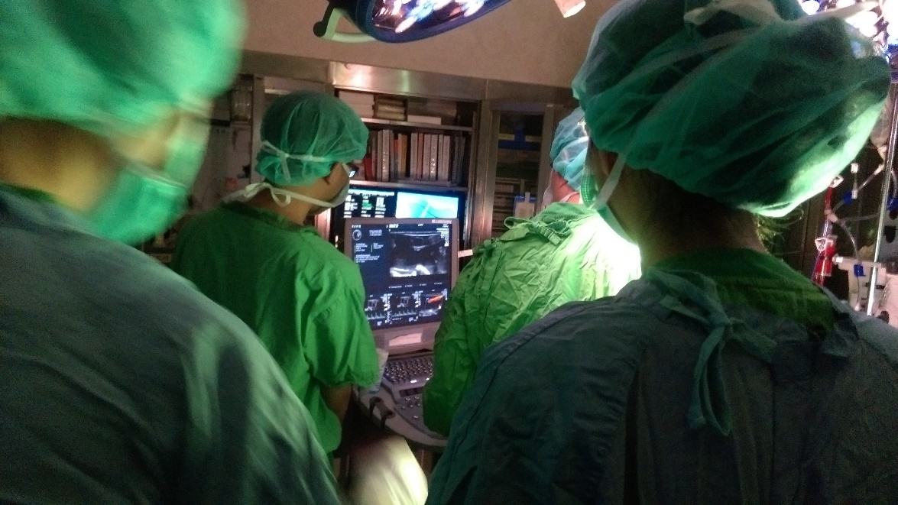
Anastomosis of posterior wall with continuous sutures
Anastomosis of anterior wall with interrupted sutures
Intra-operative Doppler examination

Slide 7
Results
Total 4 patients underwent combine semicontinuous and interrupted sutures.
All artery anastomoses were completed successfully and the postoperative courses were smooth.

Slide 8
Discussion
Methods of Anastomosis | Advantages | Disadvantages
Interrupted sutures | Easily adjustment of lumen size | Time consuming
Continuous sutures | Safe time More hemostatic | Possible purse string constriction of the lumen
Hybrid sutures | Safe time Easily adjustment of lumen size

Slide 9
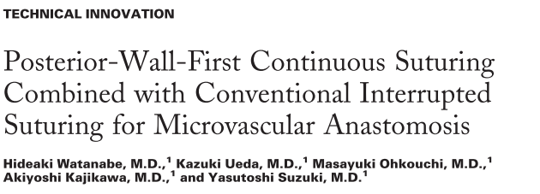
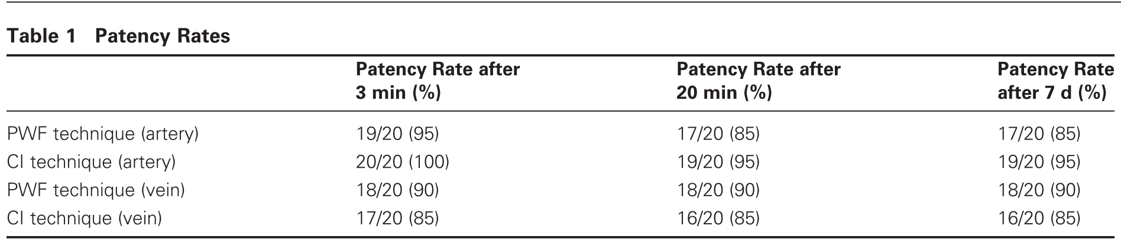
J Reconstr Microsurg. 2006 Nov;22(8):617-23.

Slide 10
Safe
Semicontinuous and interrupted hybrid suture
Easy
Fast

