Slide 1
Triple Rhomboid Flap for Large Skin Defects

Slide 2
Larissa Daroda, MD
Romeu Daroda, MD
Carlos Eduardo Cruz, MD
Eduardo Carvalho, MD
Andressa Barra, MD
NOTHING TO DISCLOSURE

Slide 3
Objective
To demonstrate the applicability and results of the triple rhomboid flap when used to cover large skin defects.

Slide 4
Materials and Methods
Retrospective analysis of seven patients between 2010 and 2014
Large skin defects following oncological resections
Skin defects converted into an hexagon with 120 degrees angles
Three of its vertex originated three flaps, then transposed into the defects

Slide 5
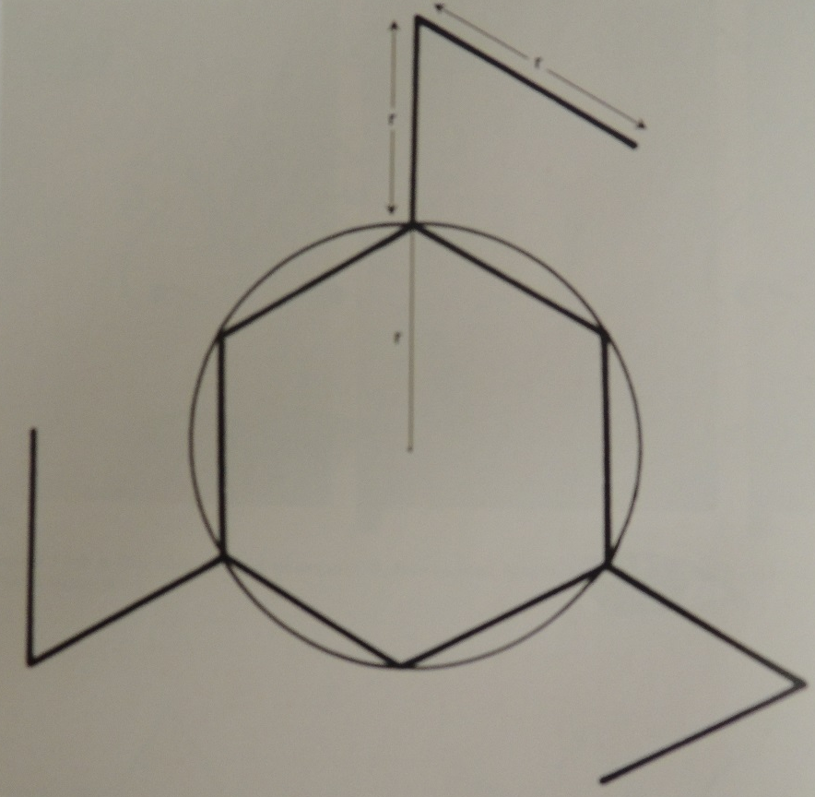
Materials and Methods
Figure 1 – Flap design
Extracted from Baker, SR. Local Flaps in Facial Reconstruction. Elsevier, 2007

Slide 6
Results
Seven patients:
4 basall cell carcinomas on the scalp
2 squamous cell carcinomas on the scalp
1 metastatic colon adenocarcinoma on the abdominal wall (8cm-diameter defect)

Slide 7
Results
In two cases, small areas were not completely closed at first, but healed properly after 2-3 weeks.
No infection cases or alopecia areas were found in this series.
Satisfatory aesthetic results.

Slide 8
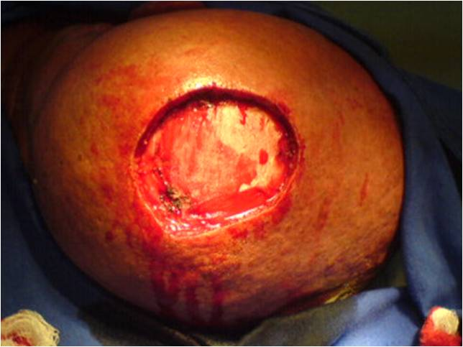
Results
Figure 2 – Scalp defect (7cm)

Slide 9
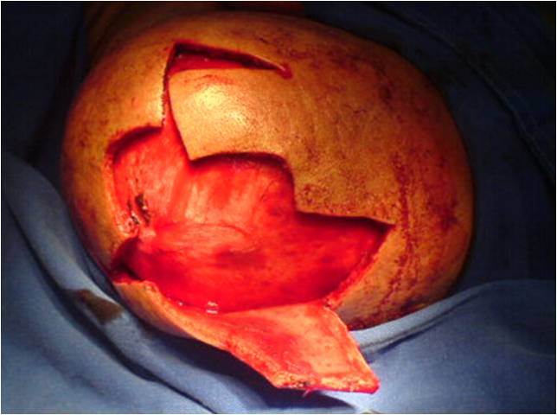
Results
Figure 3 – Flap design and undermining

Slide 10
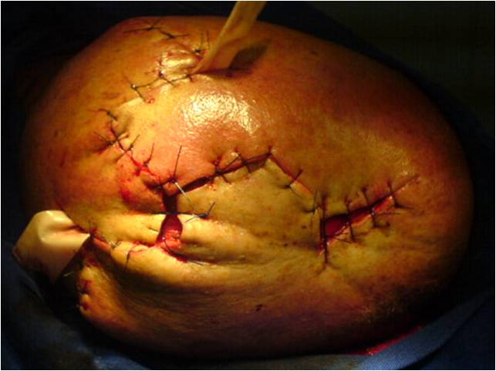
Results
Figure 4 – Immediate post operative result

Slide 11
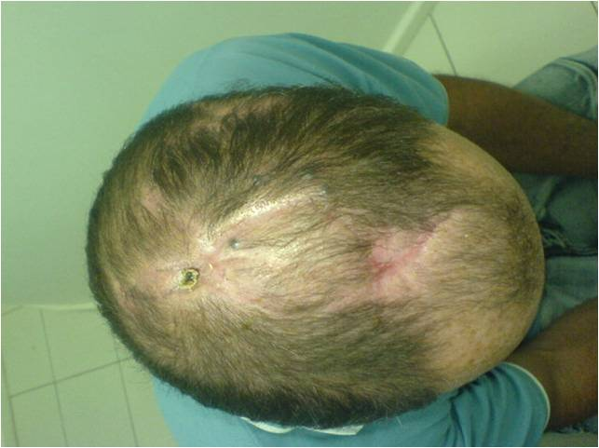
Results
Figure 5 – 3-month post operative result

Slide 12
Discussion
The triple rhomboid flap has been used since its initial report as an effective means of covering local defects.

Slide 13
Discussion
One aesthetic advantage, when compared to skin grafts, is lack of alopecia and skin tone alterations.
Furthermore, the flap is designed to avoid scar contracture and to enable coverage of larger defects than it would be possible with a single rhomboid flap.

Slide 14
Significance
The triple rhomboid flap is an useful flap for large skin defects, with adequate aesthetic outcomes and few scar revisions.

