Slide 1


WOUND HEALING GROWTH FACTORS META-ANALYSIS
Do they work?
YO KOK¹, C LOH¹, ZC LIANG², SS TAN¹, T GOH¹
¹Department of Plastic, Reconstructive and Aesthetic Surgery, Singapore General Hospital
²Dept of Orthopedics, National University of Singapore Hospital
Notes:
Font size 44, 32, 25

Slide 2
Disclosure of Relevant Financial Interests for All Authors
Nothing to Disclose

Slide 3
Objectives
Growth Factors (GFs) are important future pillars in wound healing but have limited evidence based literature. Meta-analysis of human RCTs in relevant growth factors was performed according to Cochrane principles.

Slide 4
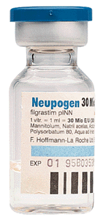
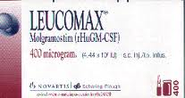
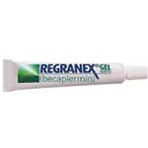

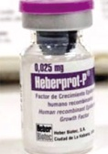
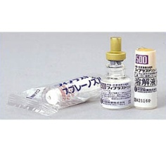
Introduction
Table 1: Growth Factors in human RCTs
Growth Factor in RCTs | Endogenous Source | Function | Status (FDA/sales) | Cost | Notable Adverse Side effects
GCSF (Neupogen) -Granulocyte Colony-Stimulating Factor | Endothelium, macrophages, | Stimulates granulocyte production, survival, proliferation, differentiation, of neutrophils | FDA Approved 1991 $4 billion a year Topical: -GeneScience, China -Leucomax, Schering-Plough , Ireland | USD $300 per shot, variable | Generally well tolerated
PDGF (Regranex) Becaplermin -Platelet Derived Growth Factor | Platelet, macrophages, endothelial cells, keratinocytes | Chemotactic for neutrophil; mitogenic for fibroblasts | FDA Approved 1997 for non ischemic DM wounds $40 million per annum | 1 tubes USD$40 -645, variable | >3 tubes malignancy RR 5.2 , 1 tube RR1.2
KGF (Palifermin) -Keratinocyte Growth Factor | Fibroblast, keratinocytes | Chemotactic and mitogenic for keratinocytes, stimulate differentiation | FDA approved Treat oral mucositis | USD$ 7500 per treatment, variable | Rash cough
EGF -Epidermal Growth factor | Platelet, macrophages, keratinocytes | mitogenic for keratinocytes, fibroblasts, chemotactic for keratinocytes | Heber Biotec, Havana | Insufficent data, variable | Insufficent data
FGF -Fibroblast growth factor | Macrophages, mast cells, lymphocytes, endothelial fibroblasts | Chemotactic and mitogenic for keratinocytes, fibroblasts, proliferation, angiogenesis, matrix deposition. | -Fiblast Spray, Japan -Torita Biopharma, China | Insufficent data, variable | Insufficient data
Table 1: Growth Factors in human RCTs
Growth Factor in RCTs | Endogenous Source | Function | Status (FDA/sales) | Cost | Notable Adverse Side effects
GCSF (Neupogen) -Granulocyte Colony-Stimulating Factor | Endothelium, macrophages, | Stimulates granulocyte production, survival, proliferation, differentiation, of neutrophils | FDA Approved 1991 Amgen Patent expires 2013 $4 billion a year Topical: -GeneScience, China -Leucomax, Schering-Plough , Ireland | USD $300 per shot, variable | Generally well tolerated
PDGF (Regranex) Becaplermin -Platelet Derived Growth Factor | Platelet, macrophages, endothelial cells, keratinocytes | Chemotactic for neutrophil; mitogenic for fibroblasts | FDA Approved 1997 for non ischemic DM wounds $40 million per annum | 1 tubes USD$40 -645, variable | >3 tubes malignancy RR 5.2 , 1 tube RR1.2
KGF (Palifermin) -Keratinocyte Growth Factor | Fibroblast, keratinocytes | Chemotactic and mitogenic for keratinocytes, stimulate differentiation | FDA approved Treat oral mucositis | USD$ 7500 per treatment, variable | Rash cough
EGF -Epidermal Growth factor | Platelet, macrophages, keratinocytes | mitogenic for keratinocytes, fibroblasts, chemotactic for keratinocytes | Not FDA approved Heber Biotec, Havana | Insufficent data, variable | Insufficent data
FGF -Fibroblast growth factor | Macrophages, mast cells, lymphocytes, endothelial fibroblasts | Chemotactic and mitogenic for keratinocytes, fibroblasts, proliferation, angiogenesis, matrix deposition. | Not FDA approved -Fiblast Spray, Japan -Torita Biopharma, China | Insufficent data, variable | Insufficient data

Slide 5
Material and Methods
Protocol | According to Cochrane and PRISMA⁵ guidelines
Eligibility/ Inclusion Criteria | Patient: Humans with wounds Intervention- clinical randomised control trials (RCTs) of growth factors in wound healing Control-Placebo or standard care Outcome-Percentage healed wound areas and time taken. Studies of all languages considered Exclusion criteria: animal trials, non-RCTs
Search | Three independent authors independently searched Cochrane Wounds Group Specialised Register, the Cochrane Central Register of Controlled Trials (CENTRAL), Ovid MEDLINE, EMBASE and Pubmed (up to 07/07/2012) using combinations keywords “randomized, wound, growth factor, FGF, EGF, GCSF, PR, KGF, VEGF before compilation.
Data Collection Process | Three independent authors independently assessed trial eligibility, methodological quality and extracted data from eligible studies
Data Items | Study Information extracted included PICOs (Patient characteristics, Wound type, Intervention type, Comparison/Control and outcome measures)
Risk of bias in studies | Three independent authors assessed adequacy of randomization, concealment of allocation, blinding of patients, health care providers, data collectors, outcome assessors and loss to follow up
Summary measures | Risk ratio of percentage of Wounds completely healed by trial endpoint was the primary measure of treatment effects. Others included mean difference in mean days to complete wound healing and risk ratio of Median wound area healed by trial endpoint
Synthesis of results/ Risk of bias across studies | Heterogeneity was tested using measure of Inconsistency I² and publication bias via funnel plots. We reported risk ratio (RR) for dichotomous outcomes and mean differences (MD) for continuous outcomes, with 95% confidence intervals (CI). In low or no heterogeneity: a fixed-effect model. In cases of heterogeneity: random effects model
Additional analyses | Sensitivity, subgroup analysis, meta-regression were not performed to avoid over interpretation in view of limited studies.

Slide 6
Figure 1: Flow Diagram for Studies Inclusion
PRISMA Guideline (Preferred Reporting Items for Systematic Review and Meta- Analyses)⁵
Lit Search (Databases Pudmed EMBASE Cochrane)
Included (n=54)
Excluded (n=183)
Not RCTs
Not human trials,
Laboratory studies
Manuscript review and application of inclusion criteria
Excluded (n=5)
-High risk of bias
-Insufficient clarification of data
-Repeated study data
Included (n=49)
PR
EGF
GCSF
Others (KGF VEGF)
PDGF
FGF
Meta-analysed (n=8)
Excluded* (n=4)
Meta-analysed (n=3)
Excluded* (n=6)
Meta-analysed (n=9)
Excluded* (n=1)
Meta-analysed (n=5)
Excluded* (n=4)
Meta-analysed (n=3)
Excluded* (n=5)
Meta-analysed (n=0)
Excluded* (n=1)
*Excluded as outcomes non comparable or single RCT with no other fellow RCT for comparison
PR: Platelet releasate VEGF (Vascular Endothelial Growth Factor)

Slide 7
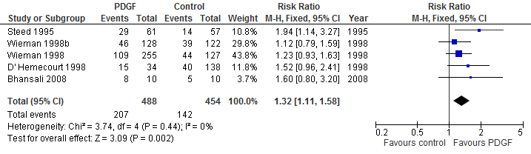
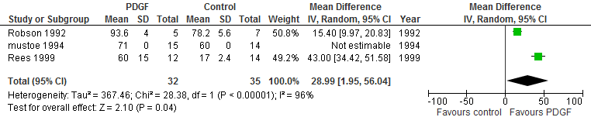
Results
Figure 2: Forest Plots of Percentage Completely Healed OR Mean/Median Days to complete healing
in Wound groups vs. Growth Factor Types

Slide 8
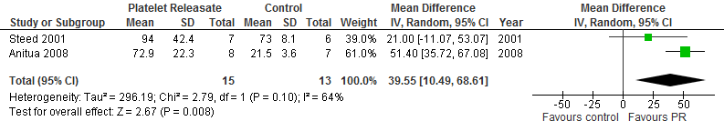
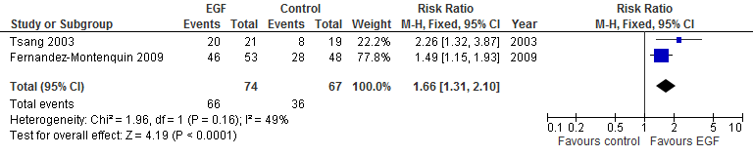

Slide 9
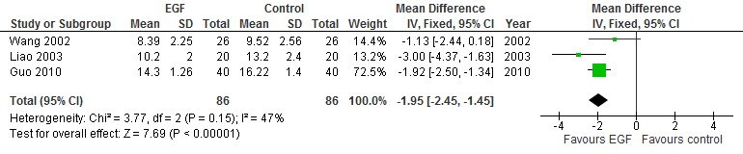
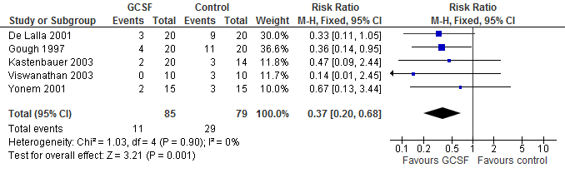

Slide 10
Table 2: Summary of Meta-Analysis Data (Forest Plots, RR) in Wound groups vs. Growth Factor Types
 | Diabetic Ulcer | Burns | Pressure Ulcers | Venous Ulcers
PDGF * | RR 1.32 [1.11,1.58] (n=942) | no RCT available | 28.99 [1.95, 56.04] MD% wound area (n=67) | no RCT available
PR | 39.55 MD% wound area [10.49,68.51] (n=28) | no RCT available | Equivocal 2.50 [0.67,9.31] (Single RCT) (n=16) | Equivocal (RR approx 1) (n=86)
EGF | RR 1.66 [1.31,2.10] (n=141) | -1.95 [-2.45,-1.45] MD DTCH (n=172) | no RCT available | Equivocal RR 3.18 [0.74,13.63] (Single RCT) (n=35)
FGF | Equivocal (RR 1.00 [00.39,2.59] (n=117) | RR 1.32 [1.04,1.67](n=143) -3.82[-5.62,-2.01] days MD DTCH (n=584) | RR 1.79 [1.25,2.58] (n=107) | RR 2.55[1.05,6.18] (Single RCT) (n=93)
GCSF | RR0.37 [0.20,0.68] for % wounds requiring surgery (n=164) | Equivocal RR 1.67[0.99,2.83] (n=392) | no RCT available | RR 3.23 [p1.29-8.07] (Single RCT) (n=60)
Key: Bold:>1 RCT exist for forest plot analysis MD: Mean Difference DTCH: Days to complete healing RCT: Randomized control trial
*: Margolis et al. Retrospective database analysis of 24898 patients: RR of healing with PDGF = 1.32 (1.22,1.38) Relative risk of amputation =0.65 (0.54,0.78)

Slide 11
Table 3: Cost Effectiveness of Growth Factors
in human RCTs
Growth Factor | Cost effectiveness
GCSF (Neupogen) | -cost savings ranged from 3129 to 155 GBP compared to standard therapy⁶
PDGF (Regranex) Becaplermin | -Reduce 26 ulcer-days per patient ($6 per day saved) -net cost saving in Sweden, Switzerland and UK. In France, the addition of becaplermin was estimated to add $US19 (1999 values) for each additional ulcer-free month gained⁷
KGF Palifermin | Insufficient data, not FDA approved yet
EGF | Insufficient data, not FDA approved yet
FGF | Insufficient data, not FDA approved yet

Slide 12
Discussion
Limitations
1.RCT Heterogeneity in terms of variable patient population (age, gender, comorbidities, race), trial endpoint given for wounds to heal (4-20weeks), dosing, frequency, form of growth factor used, wound size measurement method (visual, acetate tracing, mold volumetry)
2.Lack of uniform standard reported outcomes which reduced the number of inter study comparison possible. Not all studies used wound healing percentage, other outcomes include resolution of cellulitis, earlier eradication of bacteria from repeat swabs, risk of amputation. These were not analyzed as wound healing was main outcome of interest.

Slide 13
Future Research
Head to head Comparative and combination trials that differentiate GFs efficacies
New growth factors such as Vascular Endothelial Growth Factor (VEGF) (currently being tested).
Health-related quality of life (HRQoL) studies instead of assuming complete ulcer healing is the only outcome of value (poorly correlate with patients’ perceived health.)
Cochrane reviews, economic cost analyses for firm clinical adoption. (We are currently doing this.)

Slide 14
Conclusions
Global wound epidemic, poor wound healing is an important dilemma.
A multidisciplinary approach is paramount to overcome complex multi-factorial healing barriers. GFs is part of an armentarium (patient education, nutrition, glycemic control, offloading, debridement , antimicrobial therapy, state of art dressings etc.)
Clinical use of PDGF, PR, FGF, EGF and GCSF holds promise, with statistically significant rates of healing, higher chances of complete healing and possible better scar profiles. PDGF, GCSF appears to be cost effective.

Slide 15
Conclusions
Adverse risks of malignancy should be noted and more research is needed. Detractors say GFs are limited because of plasticity and redundancy with endogenous wound repair process and rapid degradation at the wound site.
There is potential in strongly recommending GFs, possibly in combination therapies. The holy grail would probably be a combination seed and soil therapy (administration of stem cells that elaborate full complexity of biological signalling, together with environmental cues/therapy)³

