Slide 1




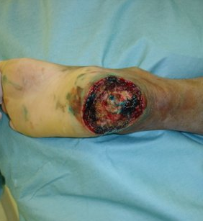
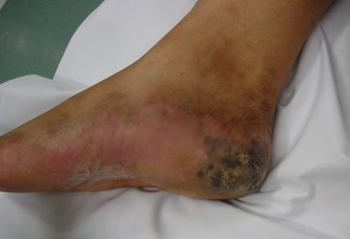
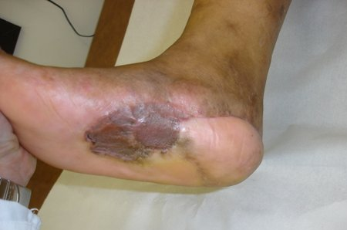
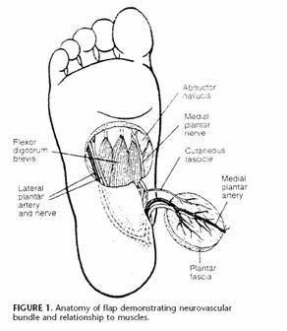
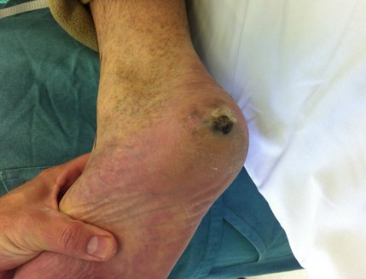
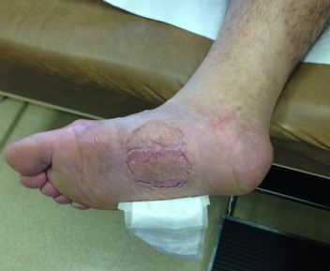
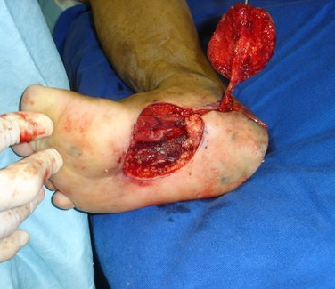
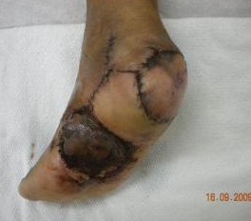
Weight-bearing plantar reconstruction after resection of melanoma using the medial plantar flap
Kharmandayan V, Harada MN, Anacleto ACF, Sobral CS, Brechtbuhl ER, Duprat Neto JP
São Paulo / Brazil
Introduction
Anatomy of flap
Melanomas:
  Less frequently in the heel than other areas of the body
  Often diagnosed at a later age.
  Plantar heel: over 50% of plantar foot locations (mainly acral lentiginous melanoma)
Heel fat pad: Challenges in reconstruction
  The individuality of the plantar skin
  Historically, different surgical methods have been used (from skin grafting to local flaps and free flaps)
The plantar medial artery flap:
  provides a composite of tissues very similar to that of the plantar heel, with the donor site being relatively expendable
Abductor
hallucis
Flexor
digitorum
brevis
Medial
plantar
nerve
Cutaneous
fascicle
Medial
plantar
artery
Lateral
plantar
artery
and nerve
Pre-operative
Post-operative
Plantar
fascia
Objective
Pre-operative
Post-operative
Conclusions
To report our experience with the use of the medial plantar artery-based flap for coverage of tissue defects around the heel caused by wide excision of melanomas
The instep flap represents a good option:
  Provides tissue to the plantar skin with a similar texture, sensate and bear out the pressure better
  Less risk of functional donor site morbidity
  High flap survival rate
  No special surgical training are required comparing with free flaps techniques
Results
Materials and Methods
Eleven medial plantar artery flaps were performed.
Five were male and six were female
They ranged in age from 27 to 58 years
Flap size varied from 4x4 cm to 6x7 cm
The donor site was covered with a split-thickness skin graft and all patients discharged in the day after
Complete Flap Survival: 90,9%
Complications:
  partial flap loss in one case but no revision or grafting was necessary
  hyperkeratosis: in eight cases.
An 8-year retrospective review (2006 – 2014)
All acral melanomas of the weight-bearing area of the foot submitted to reconstruction after resection using the medial plantar flap
The same surgeon at A.C. Camargo Cancer Center Hospital (São Paulo, Brazil) performed all the procedures
Examined variables included: gender, age, size of the flap, ethnic distribution and Clark and Breslow’s level
All the flaps were raised as fasciocutaneous pedicled flap based on the medial plantar artery
References
Kato T, Suetake T, Tabata N, Takahashi K, Tagami H. Epidemiology and prognosis of plantar melanoma in 62 Japanese patients over a 28-year period. Int J Dermatol. 1999 Jul; 38(7): 515-9
Jahss MH, Michelson JD, Desai P et al. Investigations into the fat pads of the sole of the foot: anatomy and histology. Foot Ankle. 1992 Jun; 13(5): 233-42
Bibbo C. Plantar Heel Reconstruction with a Sensate Plantar Medial Artery Musculocutaneous Pedicled Island Flap after Wide Excision of Melanoma. J Foot Ankle Surg. 2012 Jul-Aug; 51 (4): 504-8
Siddiqi MA, Hafeez K, Cheema TA, Rashid HU. The Medial Plantar Artery Flap: A Series of Cases over 14 Years. J Foot Ankle Surg. 2012 Nov-Dec; 51(6): 790-4
Oh SJ, Moon M, Cha J, Koh SH, Chung CH. Weight-bearing plantar reconstruction using versatile medial plantar sensate flap. J Plast Reconstr Aesthet Surg. 2011 Feb; 64(2): 248-54
Chaudhry ZA et al. Heel coverage with medial plantar artery flap. Pakistan J Med Heath Sci. Retrieved from http://pjmhsonline.com/heel_coverage_with_medial_planta.htm

