Slide 1
Medial Sural Artery Perforator Flap:
A Practical Way of Optimizing the Harvesting Procedure
Hsiang-Shun Shih, MD.
Effrosyni Kokkoli, MD, PHD.
Seng-Feng Jeng, MD.
Department of plastic surgery, E-Da hospital, Kaohsiung City, Taiwan

Slide 2
Nothing to disclose

Slide 3
Introduction
Medial sural artery perforator (MSAP) flap:
a versatile reconstructive option.
tedious intramuscular preparation of the minute perforators
inconvenient surgeon’s position during the harvesting.

Slide 4
Introduction
Medial sural artery perforator (MSAP) flap:
We present an advantageous modification of the standard positioning.
Our modification leads to a favorable engorgement of the flap pedicle and perforators,
Without the need of a tourniquet and also improves the surgical field accessibility for the surgeon.

Slide 5
Modification
The patient is positioned supine on the surgical bed, with the knee flexed and the hip joint in abduction.
We suggest a modification of the standard positioning, by further introducing several folded surgical towels, as a bulky support, under the calf, so as to push the calf medially as much as possible.
The dissection is undertaken firstly in a subfascial plan to identify the perforators, and then intramuscularly in a retrograde fashion to the medial sural artery.
No tourniquet is applied in our method.

Slide 6
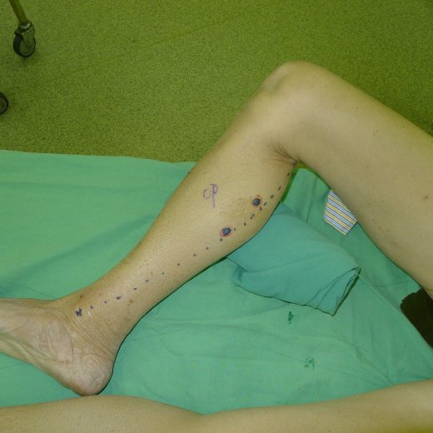
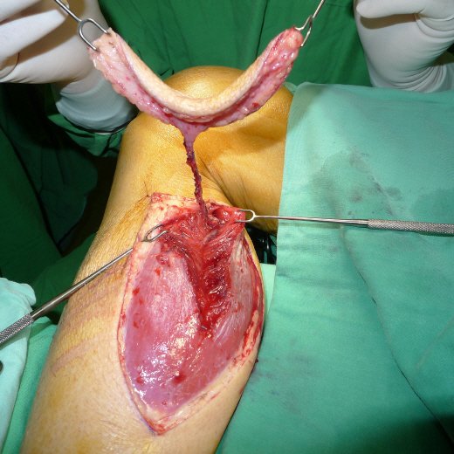
Modification
Put towels under calf and push the calf medially as much as possiible
No tourniquet
Notes:
My way of MSAP harvest have a little different from literatures prescribed. When I harvesting a MSAP flap, I will put several folded towels under calf, and push the calf medially as much as possible. By doing this, I found that the concomitant veins of perforator or pedicle, will slightly congested. This congestion will make you easier to identified the perforator, also, the caliber of pedicle will increased, makes it easier to be trace. The other difference is that, I don’t use tourniquet when harvesting the flap. My reasons are, first, without tourniquet, you can see the site of bleeding exactly and stop it immidiately. If you use the tourniquet, when you break a vessel, it may bleed at beginning but stop soon, then you may not ligate the break point exactly, it would cause vessel spasm after microanstomosis of pedicles and jeopardize the flap. You can see the picture, without tourniquet control, you can harvest the flap nicely with minimal bleeding. Without using tourniquet, the viability of flap can be checked all the time during harvesting.

Slide 7
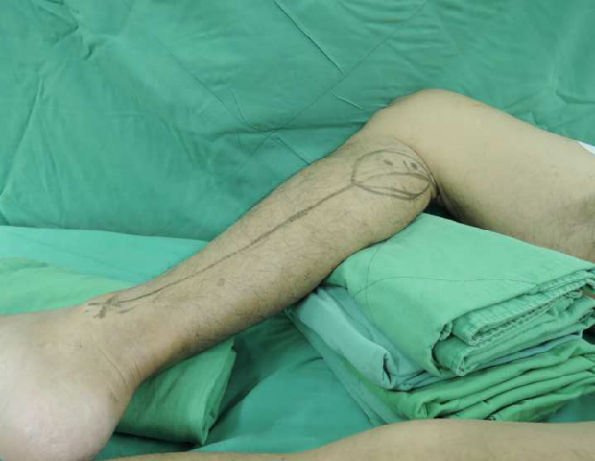
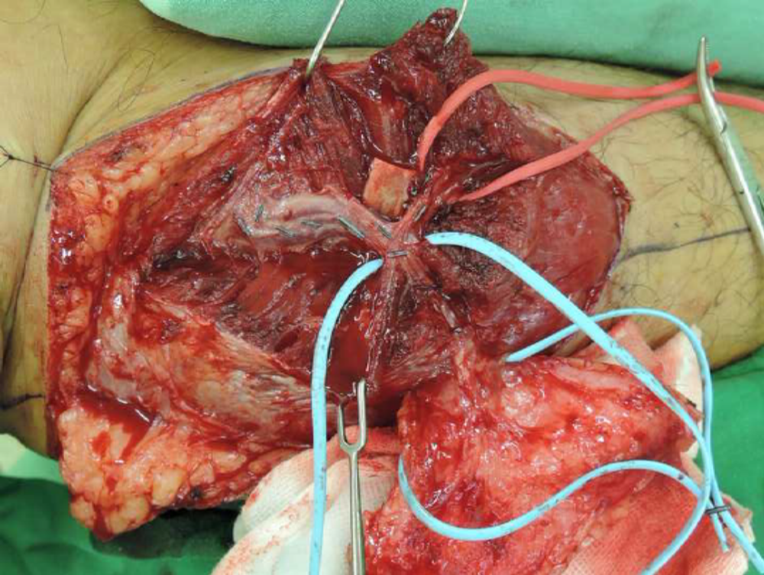
Modification
Obvious engorgement of the pedicle after the insertion of the folded towels under the calf in our method

Slide 8
Patients and Methods
During 2012-2014, 31 MSAP flap in 30 patients.
The dissection is undertaken by our suggested modification

Slide 9
Results
All our flaps were successfully harvested
As free flap in 26 cases, or as pedicled flap, in 5 cases.
At least one perforator was inspected and dissected in every case.
No complications associated with damage of the perforators or the pedicle of the flap during the harvesting procedure.
A sole flap failure occurred due to a late thrombosis, after the 3rd postoperative day, and was attributed to mechanical pressure of the pedicle. Another MSAP was finally successfully used in that case.

Slide 10
Discussion
- An important factor in determining the value of a flap as a reconstructive option should be its safe and reliable harvesting.
- In the dissection of the MSAP flap, the golden standard has been considered the supine one, with the hip joint abducted and the knee flexed.
-We also prefer the supine positioning, since an intraoperative repositioning of the patient could be spared in the majority of the cases.

Slide 11
Discussion
- However, in the standard supine position, the calf muscles are pulled downwards by the gravity, hindering the dissection of the pedicle, unless a strong assistant maintains the knee flexion throughout the procedure.
- In our suggested method, no assistance is required, since the underlying towels support the surgical field in an optimal position, easily and comfortably accessible to the surgeon.
- Moreover, we observed that our modification leads to a favorable engorgement of the vena comitantes and the perforators, simplifying both their recognition and their following retrograde intramuscular dissection.

Slide 12
Discussion
- It has been suggested by some authors that some muscle fibers should be preserved attached to the pedicle of the flap, in order to make the intramuscular perforator dissection safer. These muscle fibers, however, might lead to increased bleeding especially after the tourniquet release, which would be a risk factor for a vasospasm of the pedicle artery.

Slide 13
Discussion
- Applying our method, the pedicle can be safely and easily skeletonized from the adjacent muscle fibers.
- the positioning of the calf against the support has been shown to be sufficient in providing an optimally bloodless field without a tourniquet. This could be attributed to the engorgement of the pedicle and perforators, which allows a better visualization of the bleeding branches. An immediate and precise ligation of them is a mandatory action, otherwise they could lead to a bleeding after the microanastomosis, even jeopardizing the flap.
without a tourniquet, the perfusion of the flap can be checked out at any time during the dissection. We should also mention the possibility to observe the perforator pulsation without the tourniquet, which is the most reliable practical method to ensure the viability of the flap, and also to control the sufficiency of each perforator separately, before deciding upon the most suitable one or ones.

Slide 14
Conclusion
The MSAP flap is a valuable, advantageous in many cases, reconstructive option in the armamentarium of the plastic surgeon. By applying our suggested modification, the surgeon could harvest with ease and comfort this flap, overcoming its main drawbacks. It is an easily applicable and effective method, which could potentially reduce both operating time and overall complication rates and increase the preference of more surgeons for the MSAP flap in the future, turning it into a workhorse flap in specific reconstructive fields.

Slide 15


