Slide 1
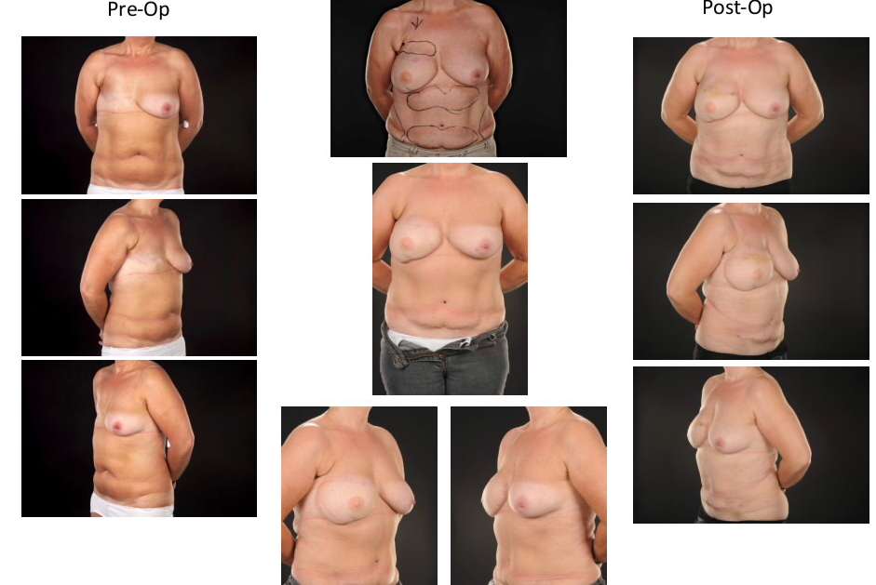
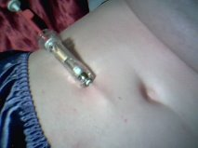

Perforator Injury from Therapeutic Injections Limiting Breast Reconstructive Options
Kamil Asaad, MB ChB MRCS;
William E Beswick, MB ChB, BSc (Hons)
Pirana Vigneswaran, MB ChB;
Diana E Slade-Sharman, FRCS (Plast)
Nothing to Disclose

Slide 2
Introduction
The Deep Inferior Epigastric Perforator (DIEP) free flap offers the gold standard in breast reconstruction following mastectomy
A variety of drugs in breast cancer patients are administered subcutaneously
The abdomen is a popular recipient site for these injections owing to the volume of subcut fat & administration guidelines

Slide 3
Aims
We report a series of 3 patients pursuing delayed breast reconstruction in whom therapeutic injections have either eliminated the choice of DIEP flap or compromised a perforator in the DIEP flap
We review potential therapeutic agents which can affect our flap choices

Slide 4
Patients & Methods
3 patients attended for delayed free flap breast reconstruction by the senior author
They had received Low Molecular Weight Heparin or Gonadotropin releasing hormone (GnRH) agonist
We reviewed the pharmaceutical recommended administration methods for 4 low molecular weight heparin brands, 2 GnRH agonists, 1 PDGF

Slide 5
Results
All 3 patients had hematoma & fat necrosis in the injection sites
2 patients had Extended Latissimus Dorsi (ELD) flap and lipotransfer due to unsuitable quality of DIEP donor
1 patient was able to undergo DIEP flap reconstruction, as there was still a suitable perforator
Certain manufacturer supplied literature indicates injection sites in direct vicinity of DIEP perforators

Slide 6
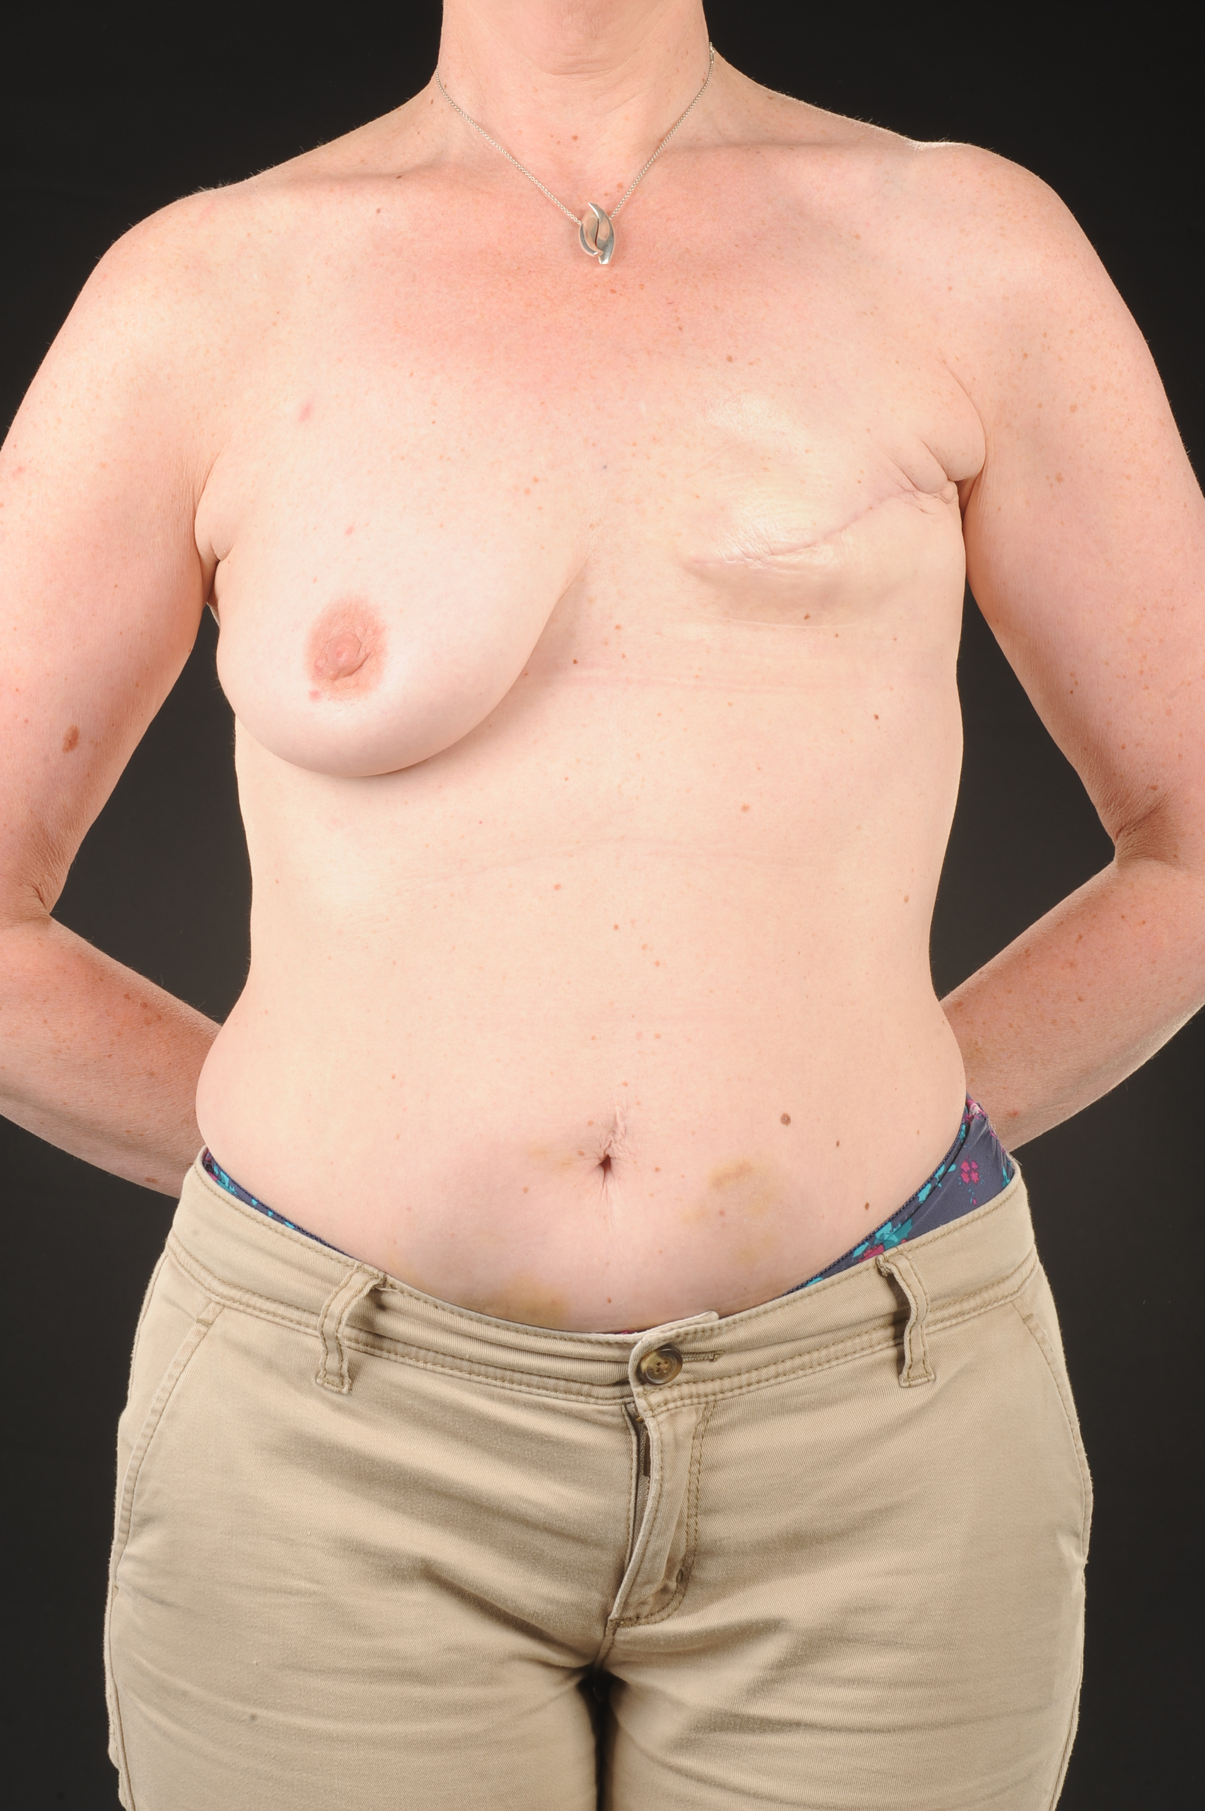
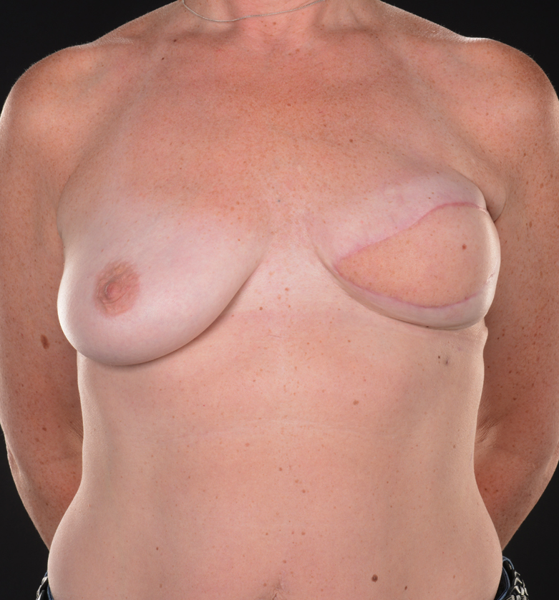
Case 1
A 45 year old female underwent left mastectomy & chemoradiotherapy
She received Dalteparin injections for a thrombosis in her PICC line
She had a strong preference for DIEP flap reconstruction
Bruising & fat necrosis present inferolateral to umbilicus bilaterally, still present after 8 months
A significant amount of the necrotic fat incorporated in zone I of a DIEP flap
We performed an ELD flap & lipotransfer

Slide 7
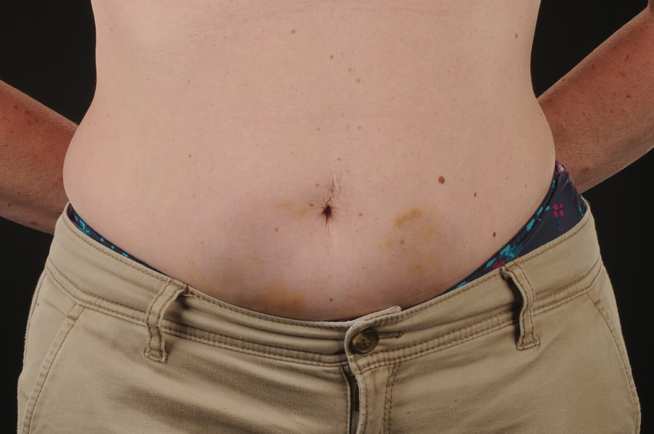
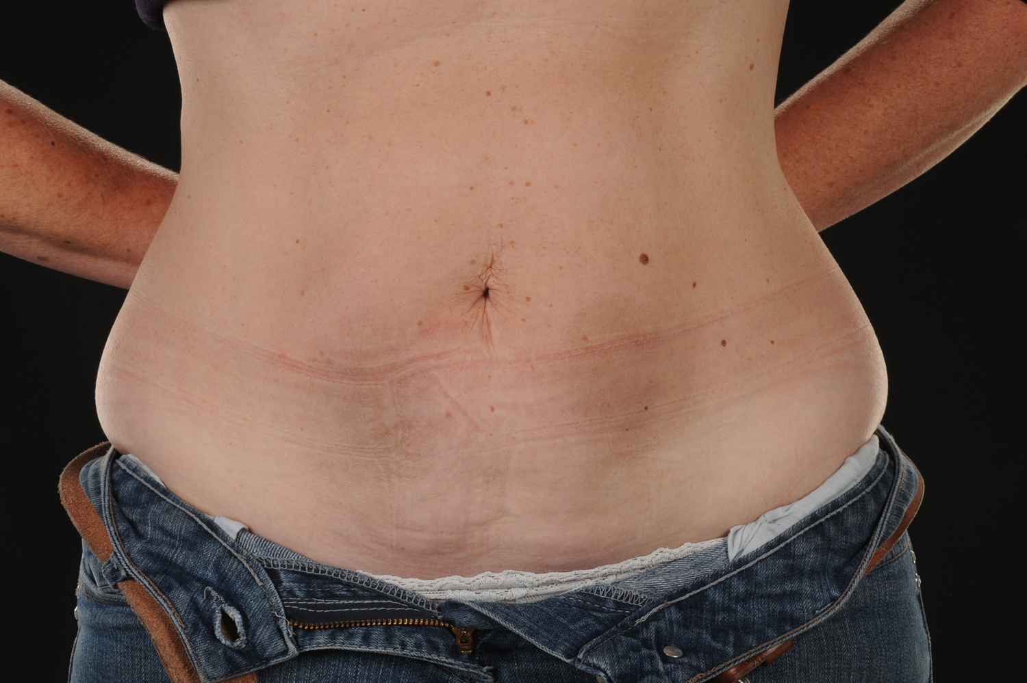
Case 1
A
B
Bruising caused by Dalteparin injections present in central abdomen even after several months (B)

Slide 8
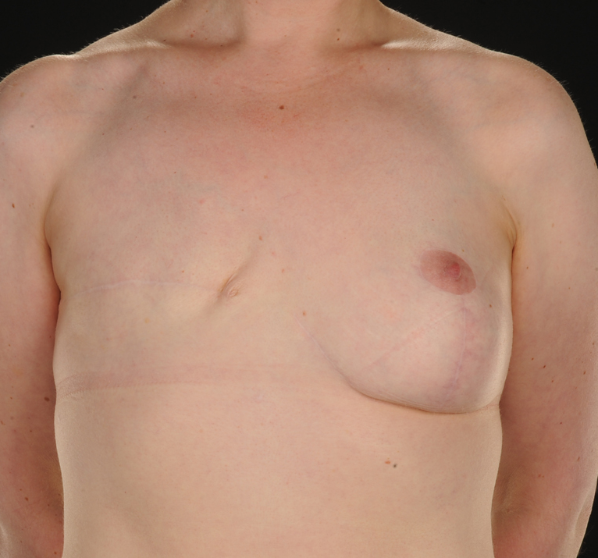
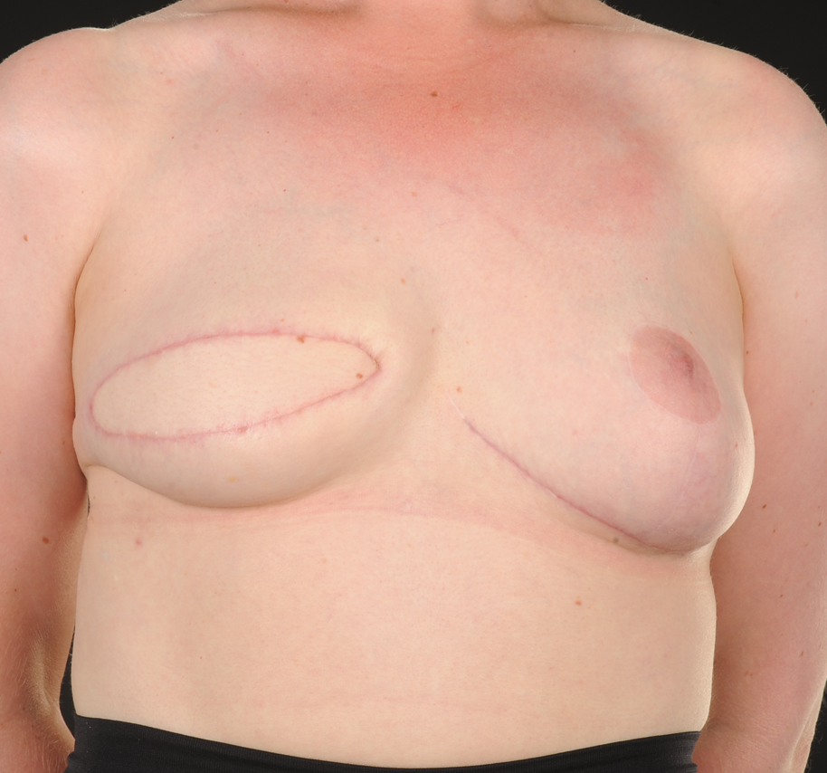
Case 2
A 39 year old female underwent right mastectomy, chemotherapy & previous breast reduction
She was receiving monthly subcut GnRH injections
Bruising & hematoma in upper abdomen within the DIEP donor site
Strong preference for autologous breast reconstruction
We opted to perform an ELD flap

Slide 9
Case 3
A 48 year old lady underwent left mastectomy, & chemotherapy & Chemotherapy
She was receiving subcut GnRH agonist injections
CT angiogram showed the dominant perforator below umbilicus on the left
Evidence of injections & bruising on left abdomen
Duplex showed perforator no longer present
At the time of surgery scarring present at this site
Fortunately we could perform a DIEP using another perforator

Slide 10
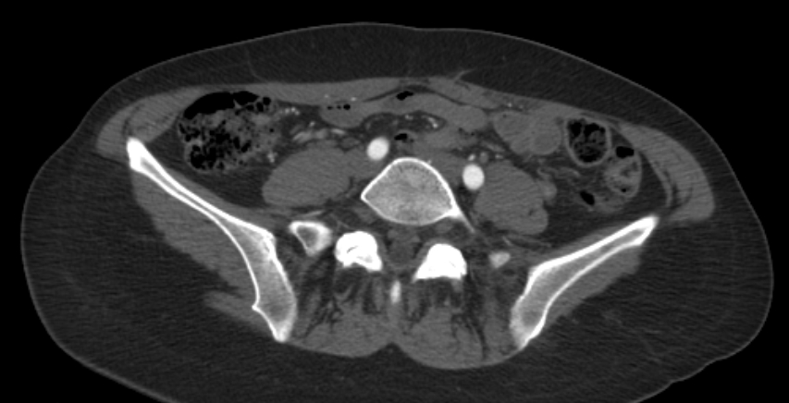
Case 3
X
CT angiogram of case 3. The X shows the dominant perforator on the left side
This was no longer present at surgery due to abdominal GnRH agonist injections

Slide 11
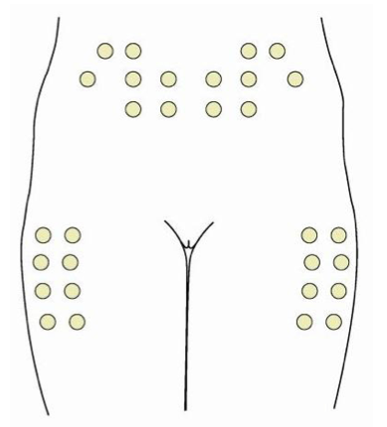
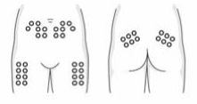
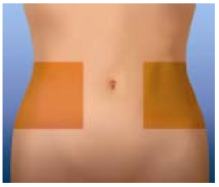
Manufacturers’ Guidance on injection sites
A
B
C
Diagrams taken from product monographs^{1,2,3} highlighting suggested injection sides for Dalteparin (A), Tinzaparin (B) and Enoxaparin (C).
Sites shown in A may affect DIEP and ALT perforators and donor tissue as does B with the addition of SGAP tissue and perforators.
C avoids the main DIEP perforators, but may still affect flap tissue.

Slide 12
Manufacturers’ Guidance on injection sites
Therapeutic Agent | Method of Administration | Licensed Administration Site | Needle Specification
Dalteparin¹ | Subcutaneous | Anterolateral or posterolateral abdominal wall Lateral part of the thigh | 27 gauge x 12.7mm needle
Enoxaparin² | Subcutaneous | Anterolateral & posterolateral abdominal wall | 27 gauge x 12.7mm needle
Tinzaparin³ | Subcutaneous | Anterolateral & posterolateral abdominal wall | 27 gauge x 12.7mm needle
Fondaparinux⁴ | Subcutaneous | Anterolateral or postlateral abdominal wall | 27 gauge x 12.7 mm needle
Goserelin (3.6mg)⁵ | Subcutaneous | Anterior abdominal wall | 16 gauge x 36 +/- 0.5mm siliconized needle
Goserelin (10.8mg)⁵ | Subcutaneous | Anterior abdominal wall | 14 gauge x 36+/- 0.5mm siliconized needle
PDGF | Subcutaneous | Not specified | Not specified

Slide 13
Discussion
Subcutaneous injections are common part of breast cancer treatment. Their use is likely to become more widespread as other agents e.g. subcutaneous trastuzumab (Herceptin®) are introduced
Fat necrosis has been reported with therapeutic injections of Enoxaparin⁶. Dalteparin injection near DIEP perforators has previously been reported⁷
Although the numbers of patients adversely affected seems low, it can have a great impact on their reconstructive options and is easily preventable with no impact on delivery of therapeutic agents

Slide 14
Discussion
Actual numbers of patients affected may be unknown as many may not see a plastic surgeon or be offered microsurgical reconstruction
This may affect other reconstructive patients e.g. ALT or SGAPs as some drug monographs recommend injection into the site of perforators to these flaps
We recommend working to educate nurses, primary care physicians, & the pharmaceutical industry regarding the risks of abdominal injection, the use of alternative sites & modifying the documented guidance

Slide 15
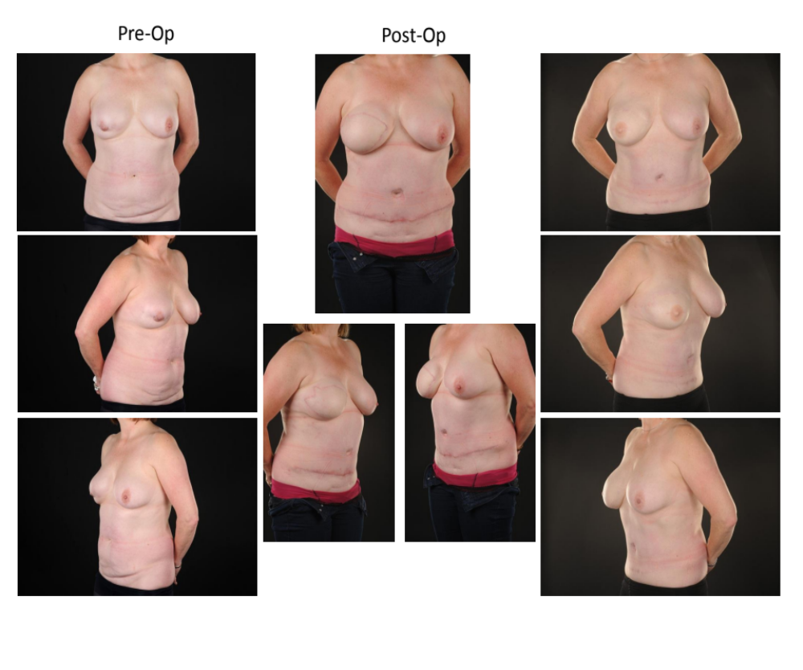
References
Product Monograph Fragmin (Dalteparin Sodium). Available online at http://www.pfizer.ca
Product monograph Lovenox (Enoxaparin Sodium), Available online at http://products.sanofi.ca
Product Monograph Innohep (Tinzaparin SodiumAvailable online at www.leo-pharma.com/canada
Product Monograph Arixtra (Fondaparinux Sodium), Available online at http://www.gsk.ca
Product Monograph Zoladex (Goserelin Acetate), Available online at http://www.astrazeneca.ca
Davies J1, Lagattolla NR, Scholey G. Fat necrosis associated with the subcutaneous injection of enoxaparin. Postgrad Med J. 2001;77:43-4.
Shelley,OP. DIEP flap perforators and prophylaxis . JPRAS. 2006; 59: 891

