Slide 1

Open Reduction of Malar Fractures is Associated with Improved Resource Utilization
David Gerth MD, Jun Tashiro MD MPH, Seth Thaller MD DMD FACS
DeWitt-Daughtry Family Department of Surgery
University of Miami Miller School of Medicine

Slide 2
Disclosures
None of the authors have any financial disclosures to declare

Slide 3
Objectives
Compare open vs closed management of malar and zygoma (“tripod”) fractures
  Cost
  Complications
Notes:
One of the major age-related changes in women is hormone loss. Menopause has several cutaneous effects, including thinning, increase in wrinkles, increase in dryness, and loss of elasticity (Stevenson S Clin Interv Aging 2007)

Slide 4
Materials & Methods
National Inpatient Sample (2006-2011)
Closed reduction of malar & zygomatic fracture (76.71)
Open reduction of malar & zygomatic fracture (76.72)
Notes:
MSCs also play an important role in skin function, especially in wound healing. MSCs contribute to the wound healing cascade at all phases. they regulate inflammation and T-cell activity. Through cytokines they help the wound progress from inflammatory to proliferative phase. Additionally they recruit fibroblasts, keratinocytes, and epidermal stem cells to the wound site. They downregulate Metaloproteinases and assist in progression to remodeling phase.

Slide 5
Materials & Methods
Total Charges (TC)
Length of Stay (LOS)

Slide 6
Materials & Methods
Complications
  Reopening of surgical site
  Hemorrhage
  Hematoma/seroma
  Wound infection
  dehiscence

Slide 7
Results
Mean LOS: 3 days
Mean TC: 44371.40 USD

Slide 8
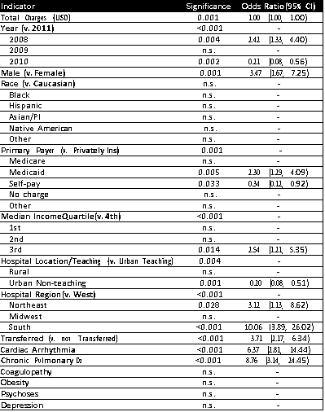
Results
Notes:
We know that the estrogens interact with multiple tissue types, not just with reproductive organs. Through ER, estrogens also acts on MSCs, regulating various functions including differentiation

Slide 9
Results-Multivariate Analysis
No difference in complications with surgical approach

Slide 10
Results-Multivariate Analysis
Increased complications:
  Males (O.R. 3.47)
  Medicaid (2.30)
  3rd quartile income (2.54)
  Transferred
  Northeast and South Region

Slide 11
Results-Multivariate Analysis
Comorbidities that increased complications:
  Chronic pulmonary disease (8.76)
  Cardiac arrhythmia (6.37)

Slide 12
Results- mulitvariate analysis
No change in LOS with surgical approach
TC were less for open approach

Slide 13
Conclusions & Significance
Open approach favorably affected Total Charges
Demographics and comorbidities impacted total charges
Future studies should focus on these factors in relation to resource utilization for malar and zygomatic fractures

