Slide 1


Preoperative pregabalin or gabapentin for acute and chronic pain among patients undergoing breast cancer surgery:
A systematic review and meta-analysis of randomized controlled trials
Ajit Rai BHSc
Wayne State University
Hance Clarke MD PhD, Jasneet Dhaliwal BHSc, Stephen Choi MSc MD, Jason W. Busse DC PhD, PJ Devereaux MD PhD, James Khan BHSc MD

Slide 2
Disclosure
There was no financial support for this study
There were no conflicts of interest

Slide 3
Background
Breast cancer is the most commonly diagnosed cancer worldwide with one of the highest incidence rates
Surgical resection (Mastectomy or BCS) is central to breast cancer management
However, acute pain is an issue after breast cancer surgery and 23-65% develop a chronic pain syndrome known as post-mastectomy pain syndrome

Slide 4
Purpose
Pregabalin and gabapentin have been shown to reduce acute and chronic pain in other surgical contexts
This study systematically reviewed RCTs to assess analgesic effects of preoperative pregabalin or gabapentin for acute and chronic pain in breast cancer surgery

Slide 5
Methods
806 records identified through database searching
19 additional records identified through other sources
Identification
756 records after duplicates removed
Screening
756 records screened
690 records excluded
1 was not an RCT
8 could not retrieved
2 did not assess patients undergoing breast cancer surgery
41 did not administer pregabalin or gabapentin
2 did not assess for pain
Eligibility
66 full-text articles assessed for eligibility
12 studies included in the qualitative and quantitative review
Included
806 records identified through database searching
19 additional records identified through other sources
Identification
806 records identified through database searching
19 additional records identified through other sources
806 records identified through database searching
19 additional records identified through other sources
Identification
756 records after duplicates removed
806 records identified through database searching
19 additional records identified through other sources
Screening
756 records screened
690 records excluded
756 records after duplicates removed
Identification
1 was not an RCT
8 could not retrieved
2 did not assess patients undergoing breast cancer surgery
41 did not administer pregabalin or gabapentin
2 did not assess for pain
Eligibility
66 full-text articles assessed for eligibility
Identification
Screening
12 studies included in the qualitative and quantitative review
Included
756 records screened
690 records excluded
756 records after duplicates removed
756 records after duplicates removed
Eligibility
66 full-text articles assessed for eligibility
1 was not an RCT
8 could not retrieved
2 did not assess patients undergoing breast cancer surgery
41 did not administer pregabalin or gabapentin
2 did not assess for pain
Screening
Screening
12 studies included in the qualitative and quantitative review
Included
756 records screened
690 records excluded
756 records screened
690 records excluded
1 was not an RCT
8 could not retrieved
2 did not assess patients undergoing breast cancer surgery
41 did not administer pregabalin or gabapentin
2 did not assess for pain
Eligibility
66 full-text articles assessed for eligibility
1 was not an RCT
8 could not retrieved
2 did not assess patients undergoing breast cancer surgery
41 did not administer pregabalin or gabapentin
2 did not assess for pain
Eligibility
66 full-text articles assessed for eligibility
12 studies included in the qualitative and quantitative review
12 studies included in the qualitative and quantitative review
Included
Included

Slide 6
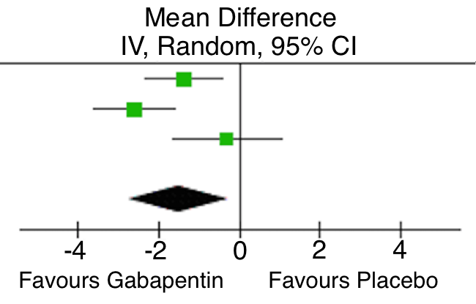
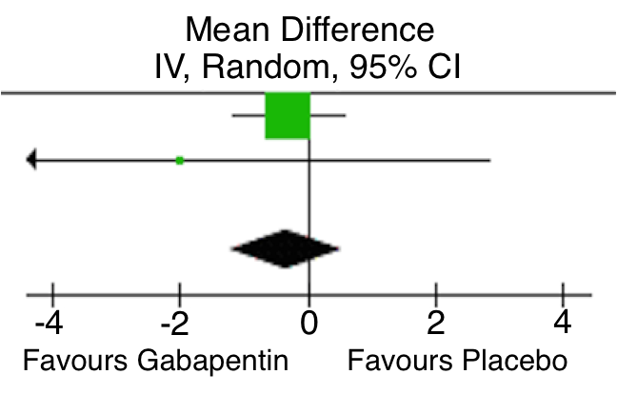
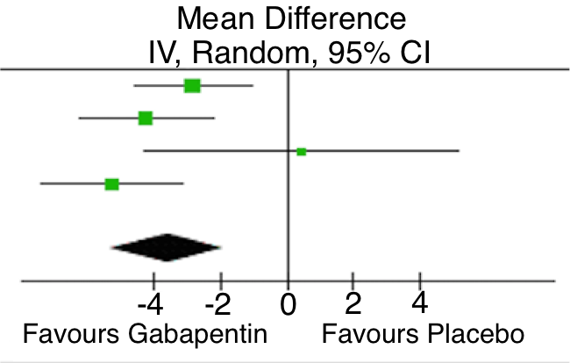
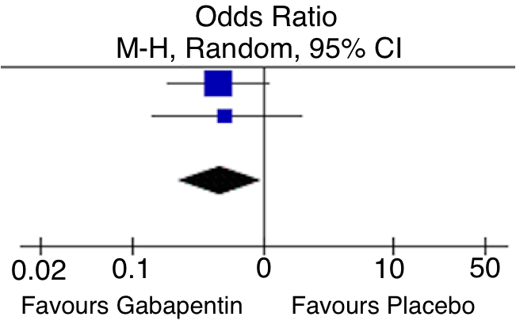
Results: Gabapentin
Pain Score in Recovery Room
24 Hour Pain Scores
24 Hour Opioid Consumption
Vomiting

Slide 7
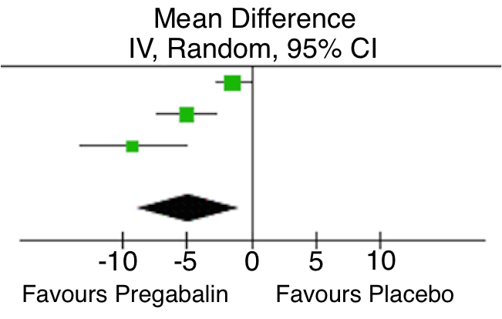
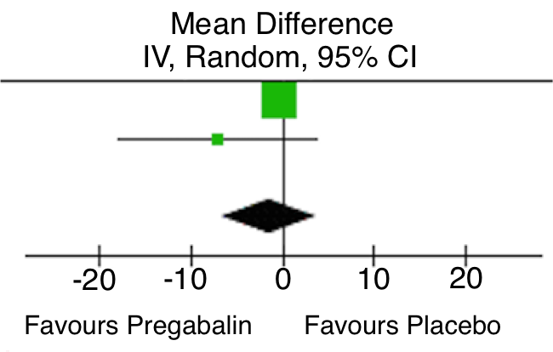
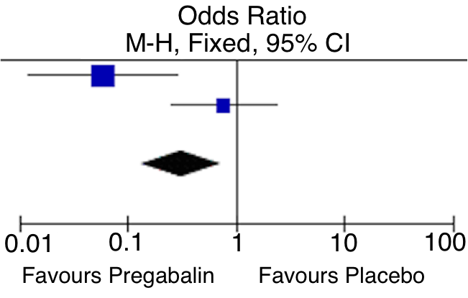
Results: Pregabalin
Opioid Consumption in Recovery
24 Hour Pain Score
Chronic Pain at 3 Months

Slide 8
Limitations
Limited sample size
Heterogeneity of studies

Slide 9
Conclusion
Preoperative administration of Gabapentin or Pregabalin appears to reduce postoperative opioid consumption and acute pain
Pregabalin may reduced chronic post-mastectomy pain
Data limited by a paucity of studies and small sample sizes - larger RCTs are required

