Slide 1

Quantifying the Dynamic Smile: A Novel 3-D Technology for Precise Facial Analysis
Fares Samra, MD; Anthony J. Wilson, MD; Brian L Chang, BS; Ivona Percec, MD PhD; Oksana Jackson, MD
Nothing to Disclose
Notes:
Thank you for the opportunity to present our work

Slide 2

Background-Rationale
Current Analyses
Facial Motion Rating Scales
  House-Brackmann
  Sunnybrook
2D and 3D Photography
  3D Surface Imaging
  Stereophotogrammetry
  Liquid Crystal
Subjective
Not specific
Cannot guide treatment
No consensus
Inconsistently used
Need for reproducible objective tool for dynamic facial assessment
Notes:
Evaluation of facial palsy has long posed a complex challenge. There is a need to provide accurate, detailed and clinically relevant data to both patients and providers. Prior scoring methods, while providing great insight to facial dynamic motion have been limited by their subjective nature. More recently, technology based attempts have never gained traction and there is a lack of consensus regarding their application. Thus, there is a clear need for reproducible, objective and quantitative data to evaluate and guide facial animation.

Slide 3
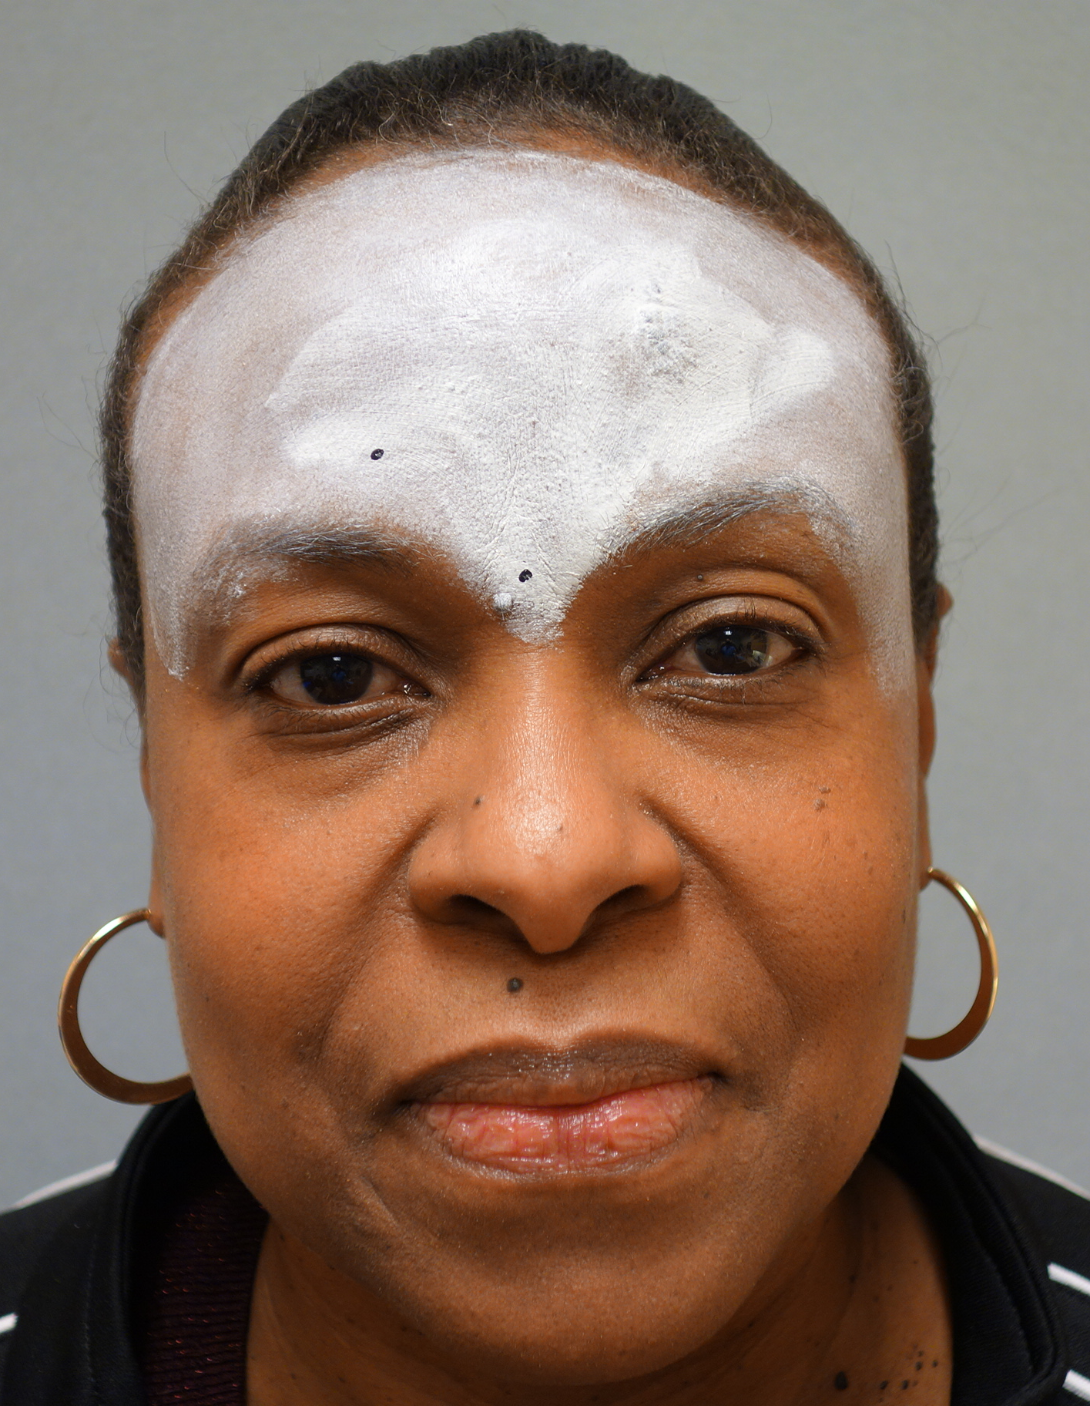
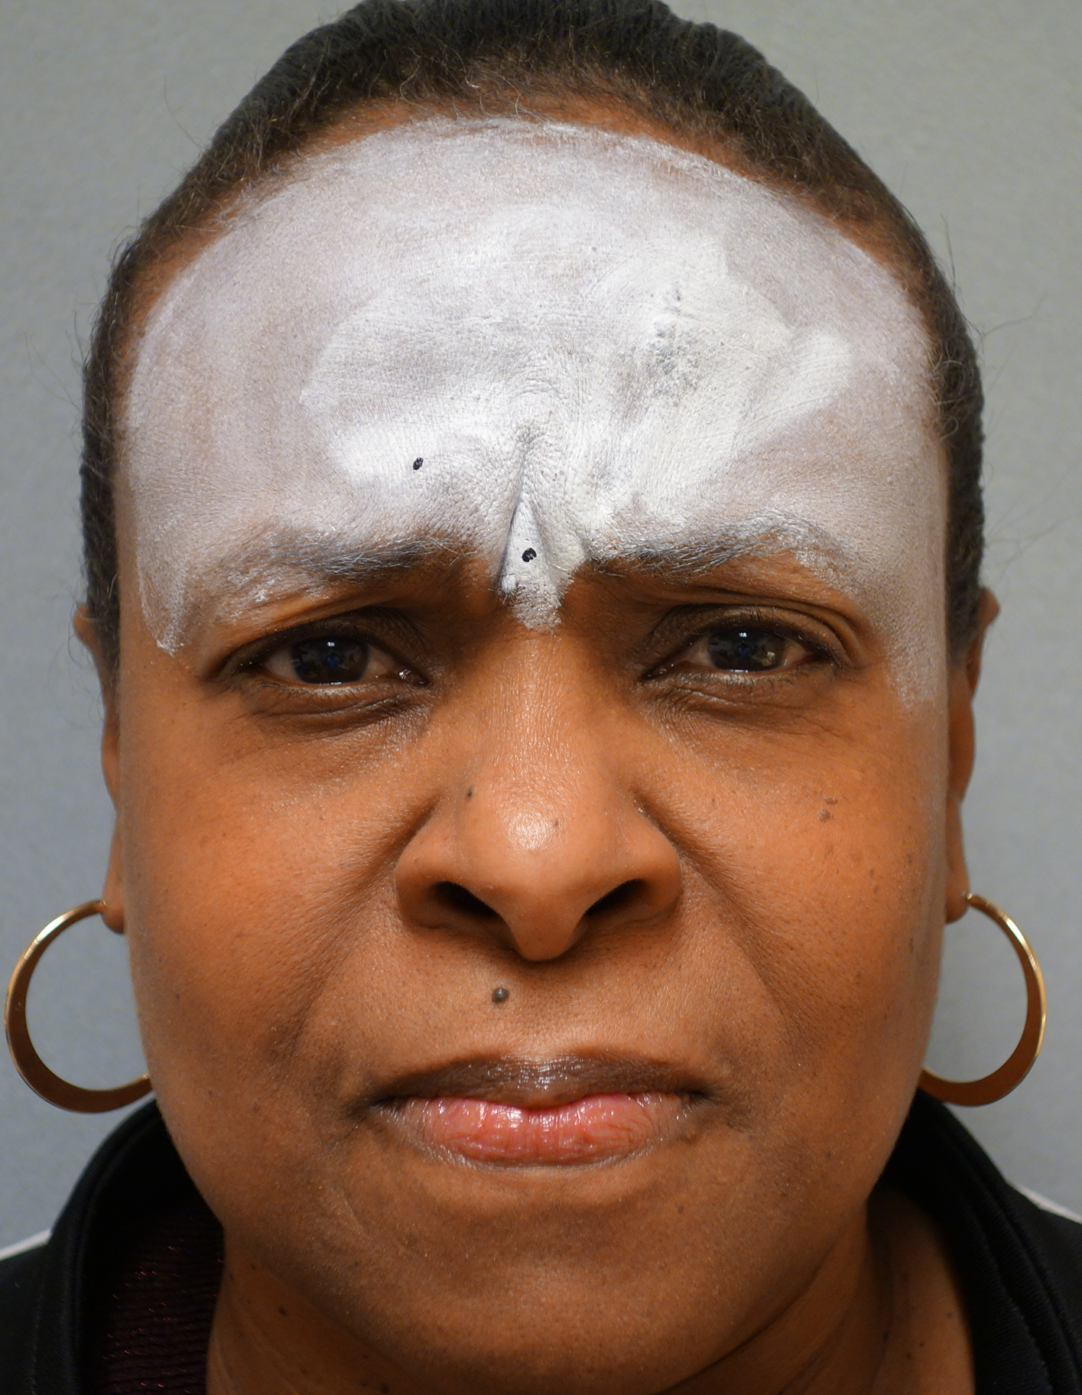
Digital Image Correlation
L(0)
L(t)
L(0) = Length between two points at time 0
L(t) = Length between two points at time t
  Decreased during corrugator contraction
Notes:
Digital image correlation is based on the concept of speckle tracking. Here on your left you see two points placed across the glabella. The distance between these two point changes at time t with corrugator contraction. Strain is measured as the change between the distance of these two points.

Slide 4
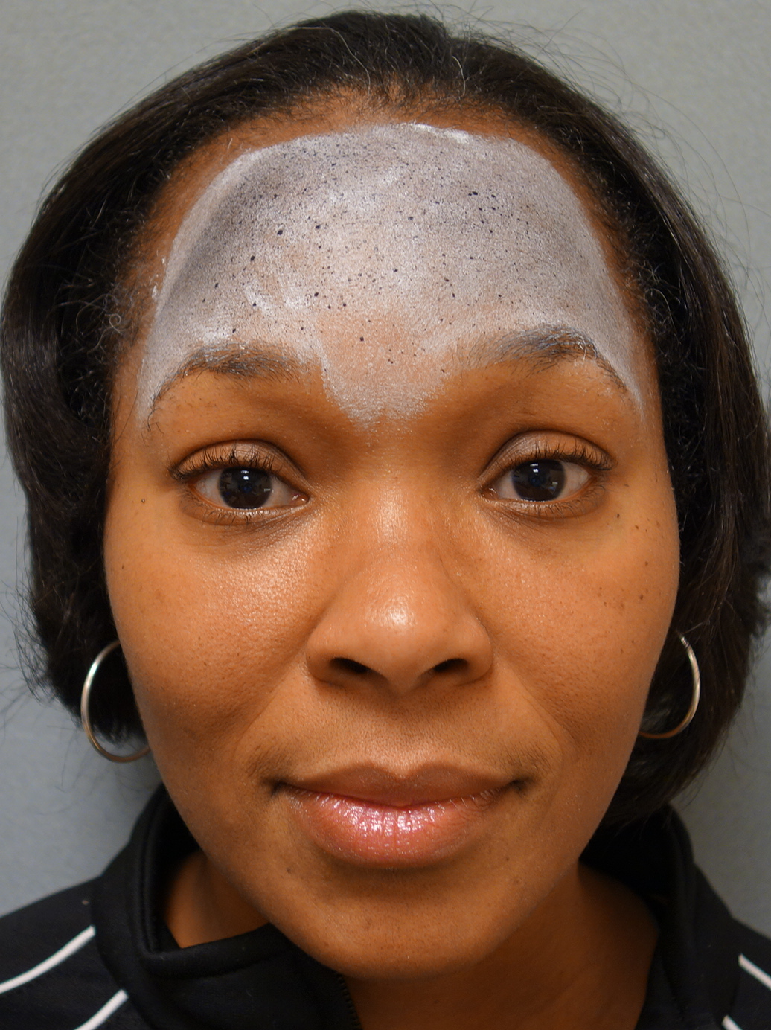
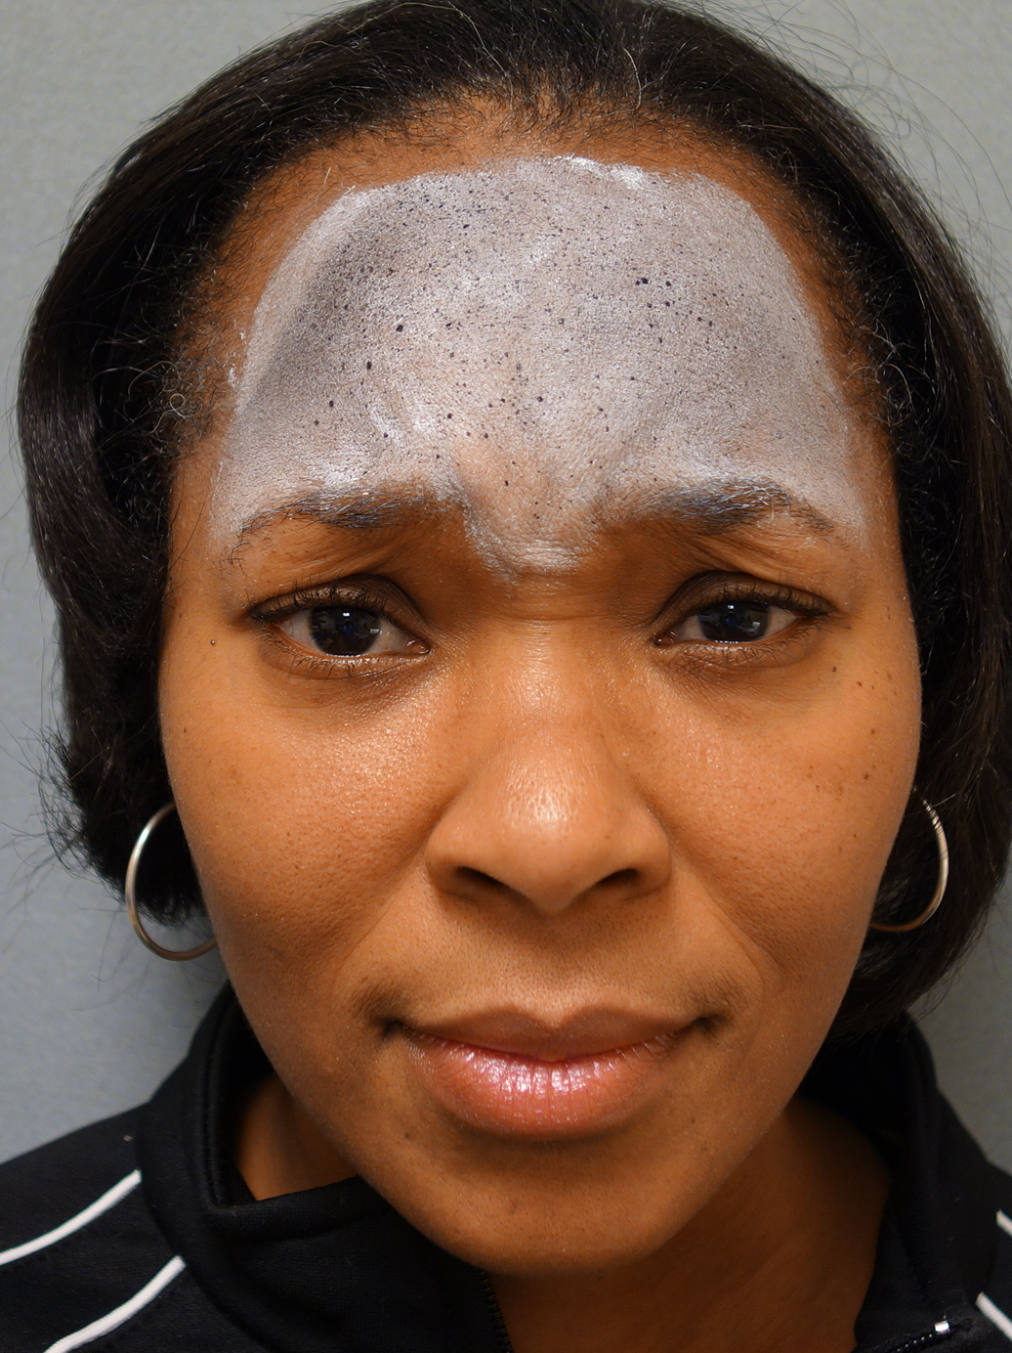
Digital Image Correlation
L(0)
L(t)
.
L(1)
L(2)
L(3)
L(4)
Dynamic Motion
7 frames/second ➔ 35 Frames
Strain_{a} (0)
Strain_{b} (0)
Strain_{c} (0)
Strain_{a} (t)
Strain_{b} (t)
Strain_{c} (t)
Notes:
DIC allows for the measurement of motion between multiple points over several frames. In this study 7 frames are shot per second over 5 seconds for a total of 35 dynamic frames and one baseline frame.

Slide 5
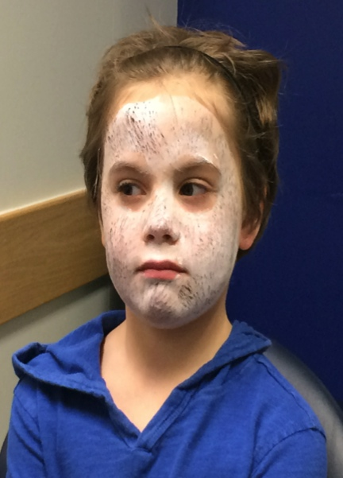
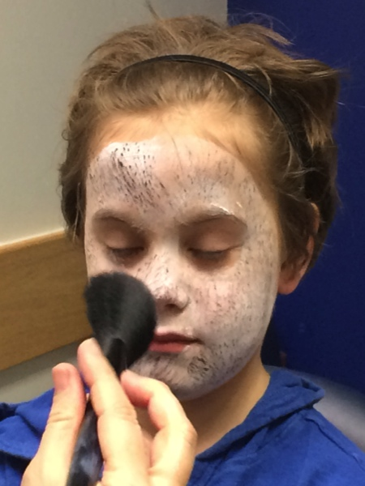
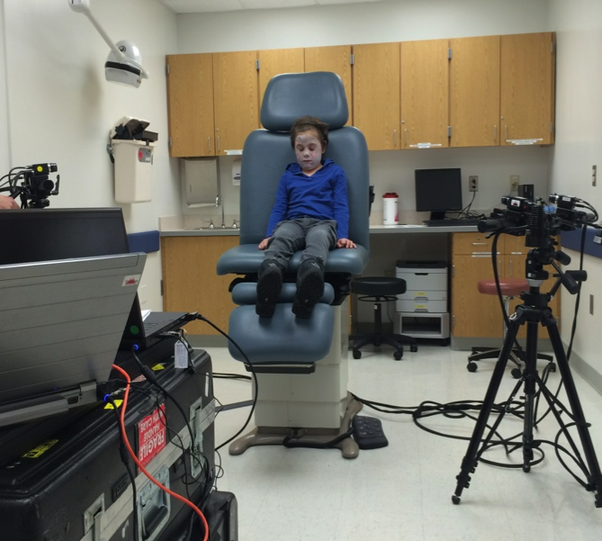
Digital Image Correlation - Setup
Apply white make-up foundation
Apply Speckles with black make-up
Position correctly in front of camera
Notes:
DIC setup requires base foundation of over the counter white make-up and black speckles. Once the patient has been prepared he or she is then placed a set distance between two separate calibrated cameras and asked to make an expression of interest for five seconds.

Slide 6
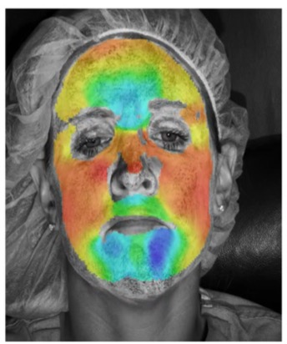
Digital Image Correlation - Video
ARAMIS® software (GOM mbH, Germany)
  calculates strain per algorithm
  produces color coded dynamic map
Notes:
The images are then uploaded to ARAMIS software where strain is calculated. Degrees of strain are depicted in a color coded heat map such as the one seen here.

Slide 7
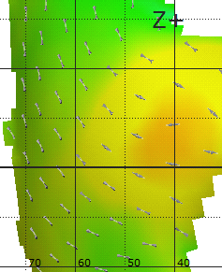
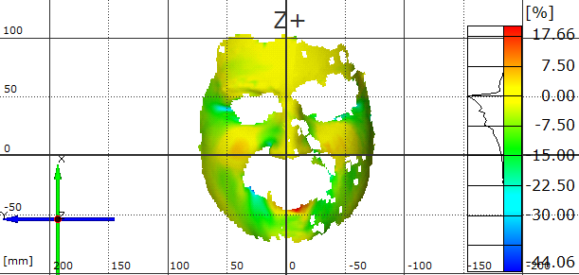
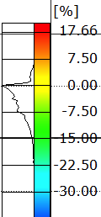
Digital Image Correlation - Direction
Determine Direction of strain
Toggle region of interest
Notes:
Direction (horizontal/vertical) is also illustrated as shown in this close up of the patients right cheek. An investigator can then toggle the region of interest and calculate average, maximum or minimuim strain in that region over all frames.

Slide 8
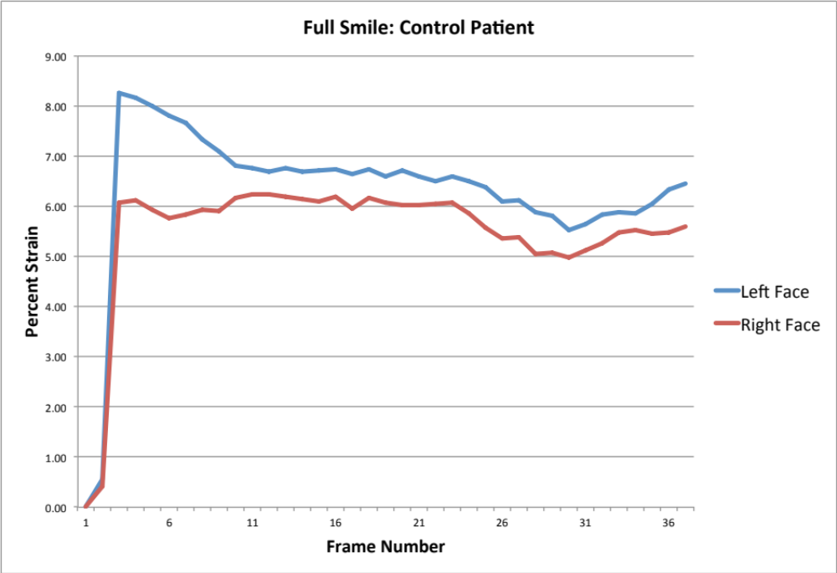
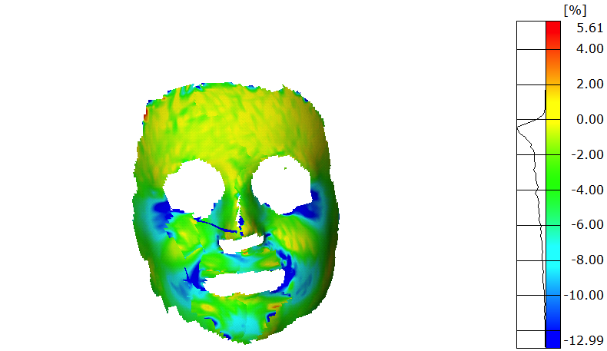
Digital Image Correlation - Video
Notes:
As an example, here you see the per frame plot of average strain in the perioral region when a non affected patient is asked to make smile. You can see that levels of strain very similar between the two sides, although not identical.

Slide 9
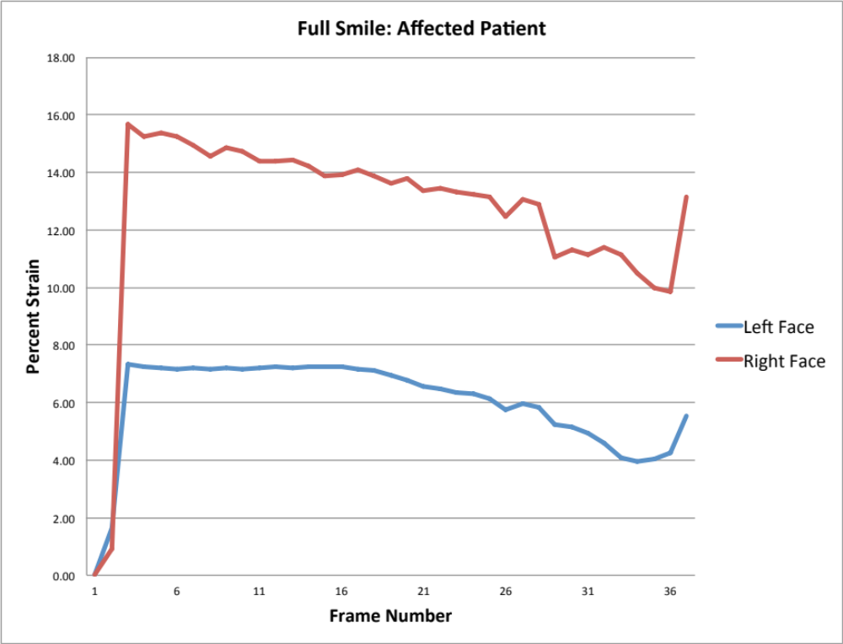
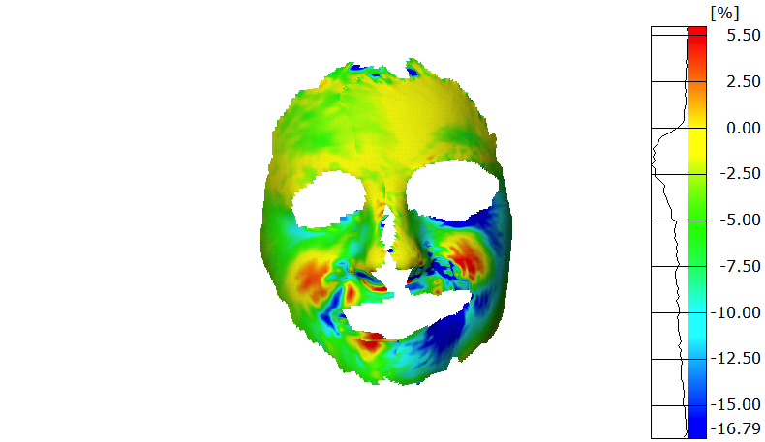
Digital Image Correlation - Video
Notes:
Conversely, here is the frame by frame plot of a patient with facial palsy while making a smile. As you can see the Left face is the affected side. With this data, the amount of assymetry can be calculated mathematically.

Slide 10
Study Design
Prospective Cohort Study (IRB Approved)
22 Patients recruited
  9 patients with unilateral facial palsy (Mean age 13.9; Heterogeneous Etiologies)
  13 control patients (Mean age 11.7)
Assessed
  Open mouth smile
  Closed mouth smile
Single Investigator:
  Selected region around mouth bilaterally
  Selected region around eyes bilaterally
Percentage difference in strain between sides determined (asymmetry coefficient)
ANOVA used to compare soft tissue asymmetry between groups
Notes:
This slide outlines our pilot study protocol. A total of 22 patients were recruited - 9 with unilateral facial palsy of multiple etiologies and 13 control patients. The open mouth smile and closed mouth smile were assessed using DIC. Following imaging sessions, a single trained investigator selected identical regions around the mouth (representative of the nasolabial fold) bilaterally and around the lateral canthi. Difference in average strain between the two sides was calculated. Differences between control and affected groups were compared using ANOVA.

Slide 11
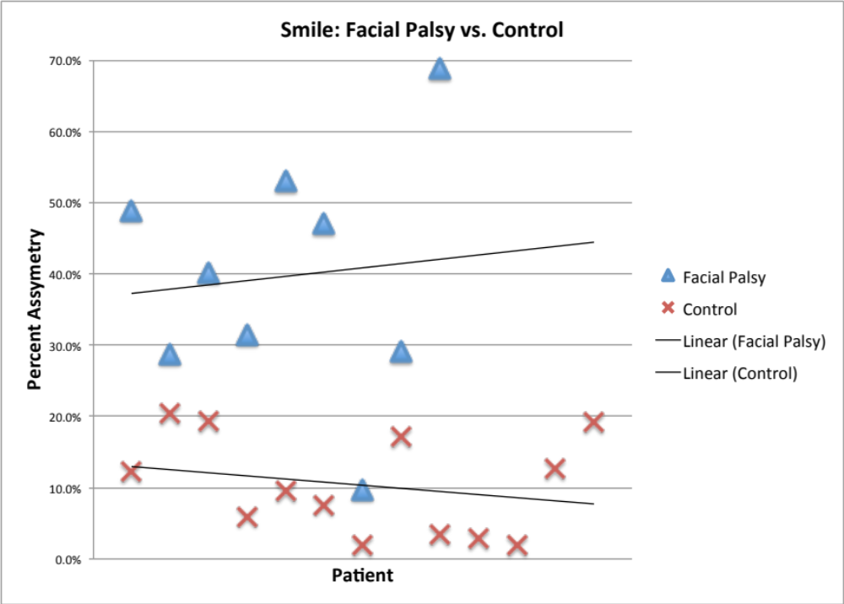
Results – Open Mouth Smile
Notes:
Here is a scatter plot showing the distribution of facial palsy patients and control patients with respect to the percent asymmetry of the lower face in the horizontal vector (i.e. the nasolabial fold). There is a clear difference between the two groups.

Slide 12
Results – Open Mouth Smile
 |  | Lower Face |  | Eyes
 | N | Horizontal Asymmetry | Vertical Asymmetry | Horizontal Asymmetry | Vertical Asymmetry
Facial Palsy Patients | 9 | 39.66% | 38.13% | 31.71% | 29.07%
Control Patients | 13 | 10.34% | 9.98% | 10.84% | 11.20%
P Value |  | < 0.001 | < 0.001 | 0.009 | 0.005
Notes:
Here the precise value of asymmetry is illustrated. During the open mouth smile you can see there is significant difference in the amount of asymmetry at both the eyes and the mouth. With a normal degree of dynamic asymmetry of about 10%.

Slide 13
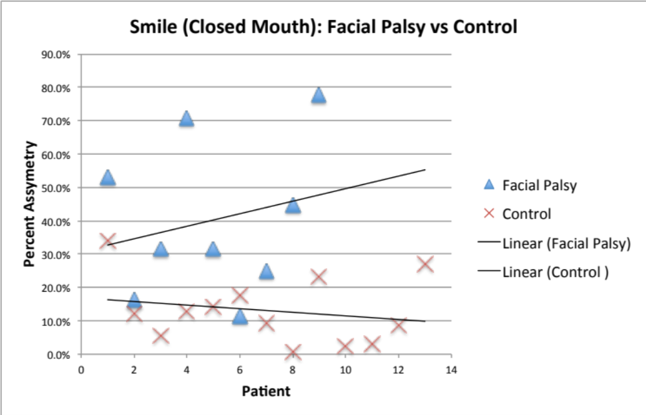
Results – Closed Mouth Smile
Notes:
Here the degree of asymmetry in the lower face with a closed mouth expression is illustrated. Although still significantly different, there is more overlap of the two groups relative to the open mouth smile.

Slide 14
Results – Closed Mouth Smile
 |  | Lower Face |  | Eyes
 | N | Horizontal Asymmetry | Vertical Asymmetry | Horizontal Asymmetry | Vertical Asymmetry
Facial Palsy Patients | 9 | 40.24% | 32.79% | 28.67% | 26.47%
Control Patients | 13 | 13.11% | 10.66% | 15.84% | 18.71%
P Value |  | 0.001 | 0.001 | 0.074 | 0.288
Notes:
When we look at the data of the closed mouth smile more closely, we see there is significant difference in the amount of asymmetry at the mouth, similar to the open mouth smile. However there is a greater amount of asymmetry at the eyes in control patients with the closed mouth smile, with no significance reached between our two cohorts.

Slide 15
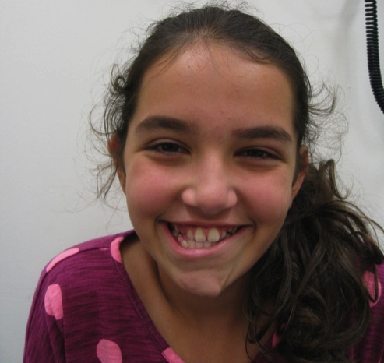
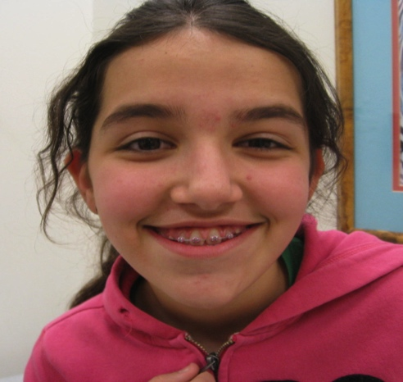
Conclusions
DIC is a precise, quantitative technology to measure facial dynamic motion
Future DIC studies:
  Quantifying/Correlating Sunnybrook Scale
  Define degrees of “normal” asymmetry
  Guide future directions of treatment for more natural appearance.
Limitations:
  Cost – 60K U$S
  Training
  Fine areas (Mouth, Eyelids) – spot density
Notes:
In conclusion, DIC is a precise, quantitative tool for measuring facial dynamic motion. Future efforts of DIC in our group will focus on providing a quantitative equivalent for the sunnybrook assessment as well as defining true, normal asymmetry. We also believe that using DIC as a metric for facial symmetry can help us to evaluate and improve our surgical planning as well as outcomes.
Clear limitations to this pilot study include the sample size, the cost of the equipment, the need for training and the need to vary painting style when focusing on more discrete areas.

