Slide 1
Result of the Management of Velopharyngeal Insufficiency with Double Opposing Z-plasty. An 11-year experience of a Single Surgeon
Cheng Chun Wu M.D., Chien Chung Chen M.D., Ching Hsiang Yang M.D., Faye Huang M.D., Yi Lin Tsai, Jui Pin Lai M.D.
Craniofacial Center, Division of Plastic and Reconstructive Surgery, Department of Surgery, Kaohsiung Chang Gung Memorial Hospital Chang Gung University College of Medicine, Taiwan

Slide 2
Background
Incidiency of velopharyngeal insufficiency( VPI ) in cleft patients after primary palatoplasty
varied from 5 to 36 % , reported in different centers
-Bardach, J, and Morris
multidisciplinary management of cleft lip and palate.Philadelphia :saunders, 1990, p303-365

Slide 3
Background
Furlow, 1987
cleft palate repair by double opposing Z-plasty
-Plast. Reconstu.surg.78:724 1987
Philip Kuo-Ting Chen-1994
correction of secondary velopharyngeal insufficiency in cleft palate pateints with Furlow palatoplasty
-Plast. Reconstu.surg.94:9931994
1999-Kirschne
2004-LaRossa D Children's Hospital of Philadelphia
2005-Jonathan A.
2008-Khosla RK University of Washington,

Slide 4
Furlow palatoplasty
Lengthening the soft palate by opposing Z-plasty on both the oral and nasal side
Realignment of he levator veli palatini muscle
Creating a strong muscle sling by overlapping the levator muscle

Slide 5
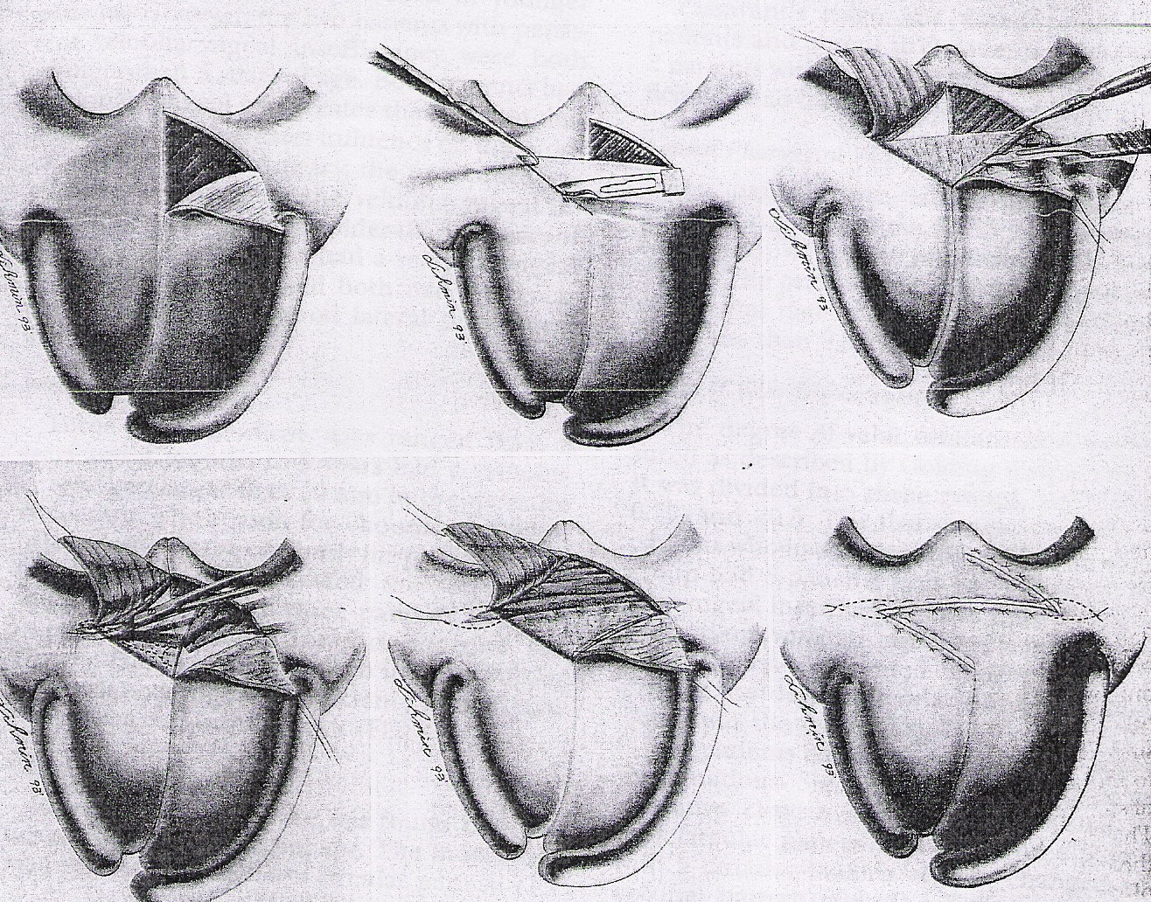
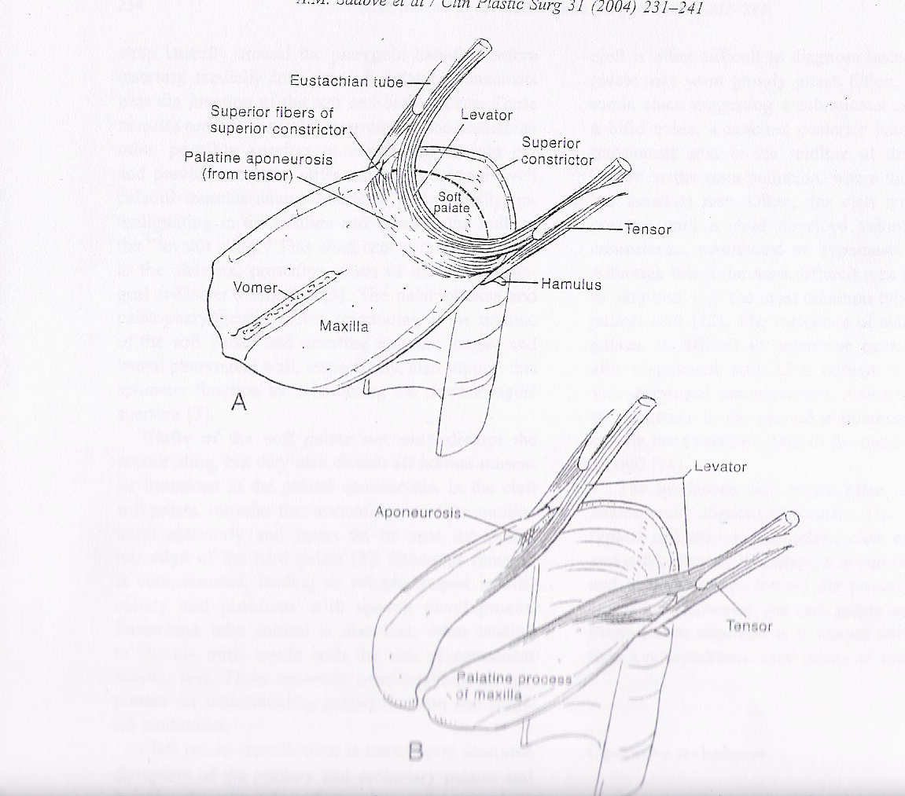
Overlapping the levator veli palatini muscle
Not physiological repair
Inversion of the myomucosal flap as overlapping
- Plast. Reconstu.surg. 94:933,1994
Clin Plastic Surg 31(2004) p233

Slide 6
Purpose
End to end levator veli palatini muscle reposition
Realignment
Physiological repair

Slide 7
Patient and methods
Retrospectively reviewing of secondary VPI, treated by Furlow palatoplasty at our center from 2004 to 2014
Exclude : post orthoganthic surgery VPI. Syndromic , inadequate follow up, multiple anomaly. Old age
Follow up – as least one year after surgery
E group: End to End muscle repair
O group: Overlap muscle repair
.

Slide 9
Patients and methods
Preoperative speech evaluation
Preoperative nasopharyngoscopy (NPS) study : moderate to mild (closure ratio > 0.7)
speech follow up since postoperative 3m, then at 6-month interval

Slide 10
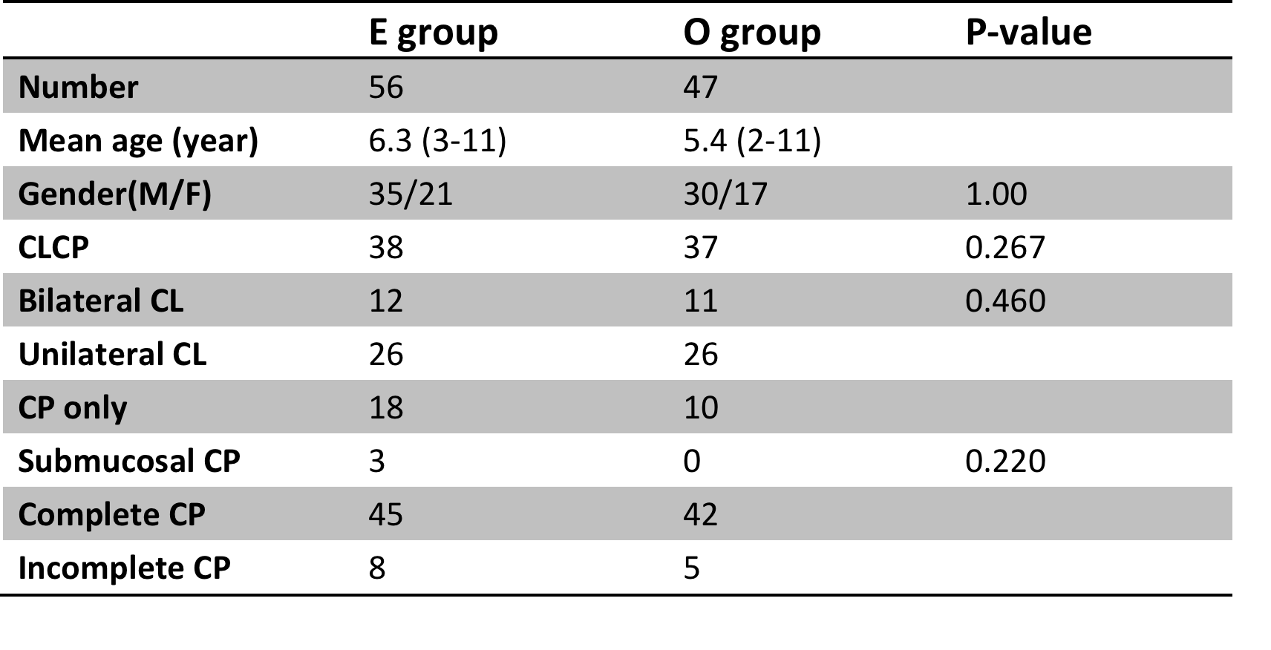
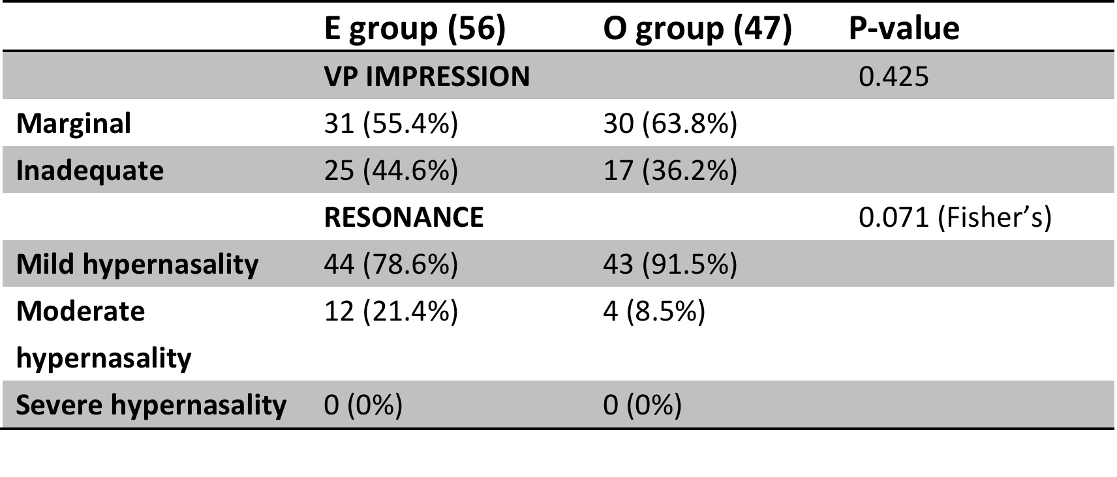
Result
Patient data
Preop VP impression

Slide 11
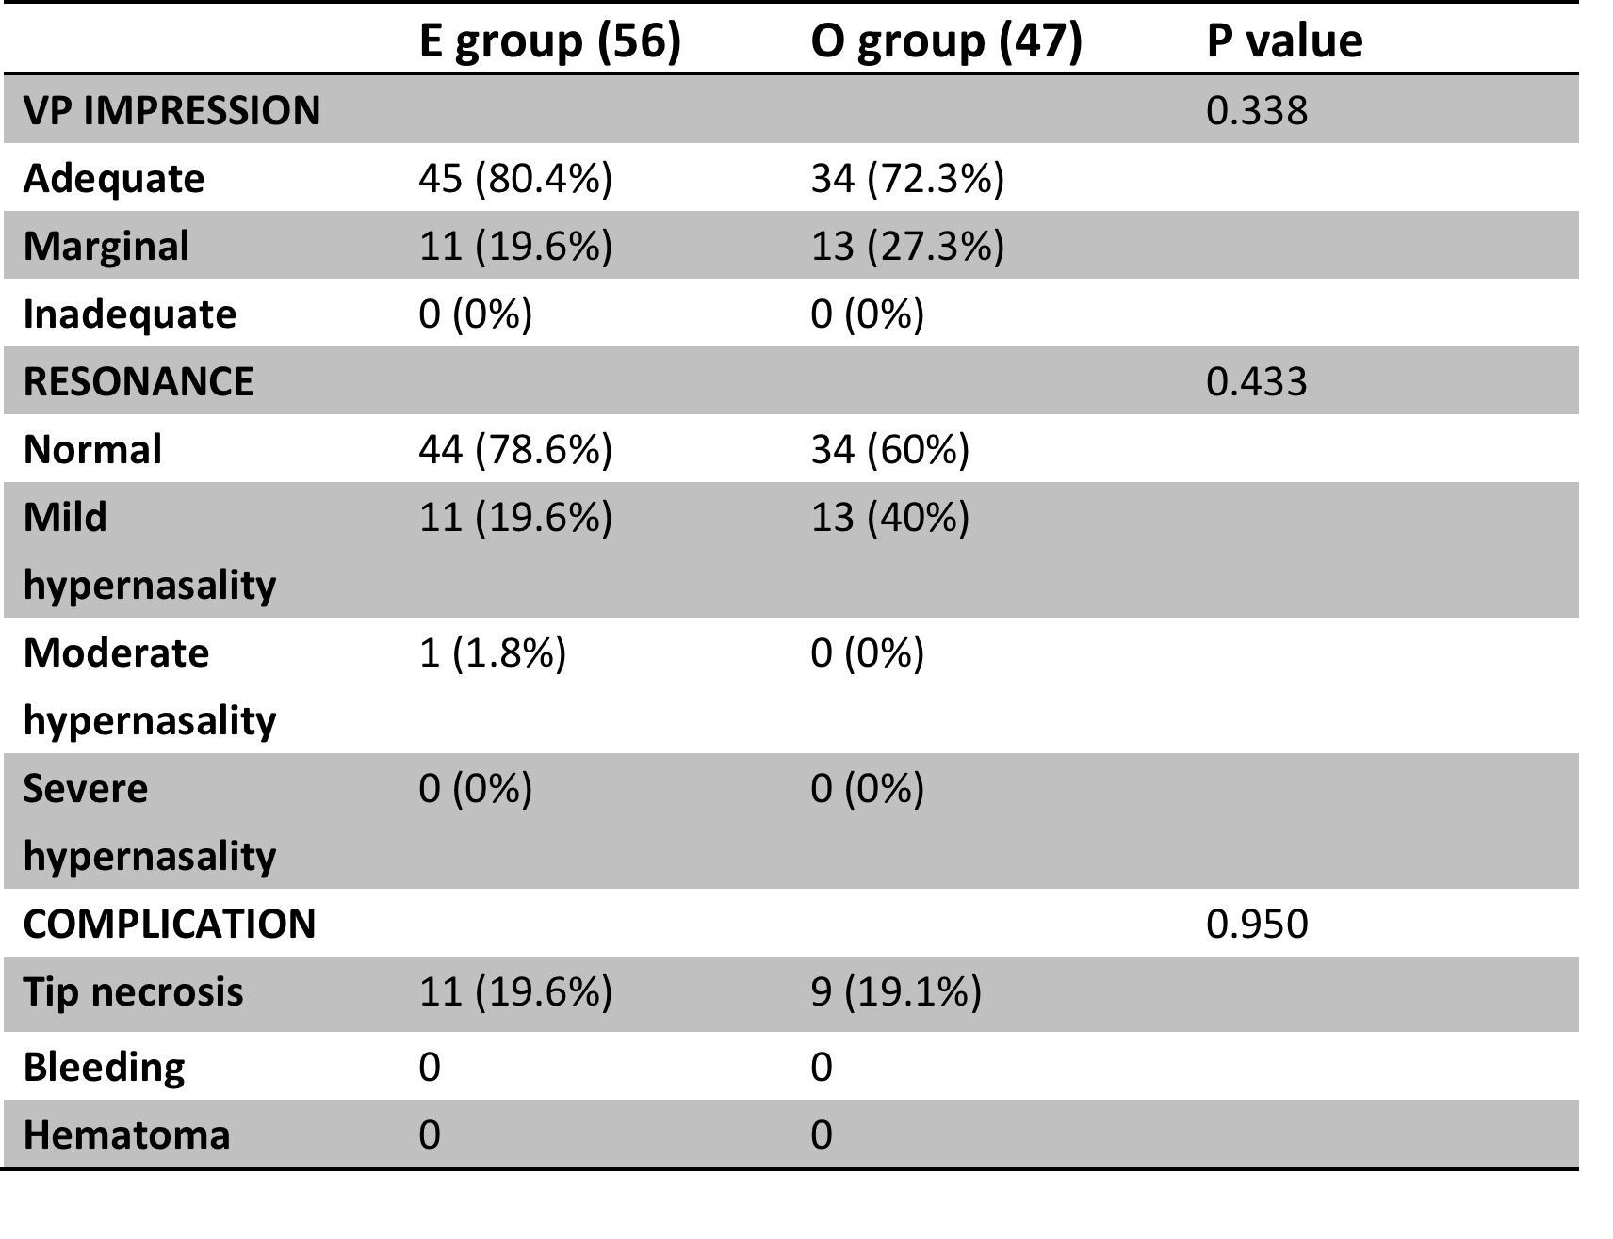
Result
Postop VP impression

Slide 12
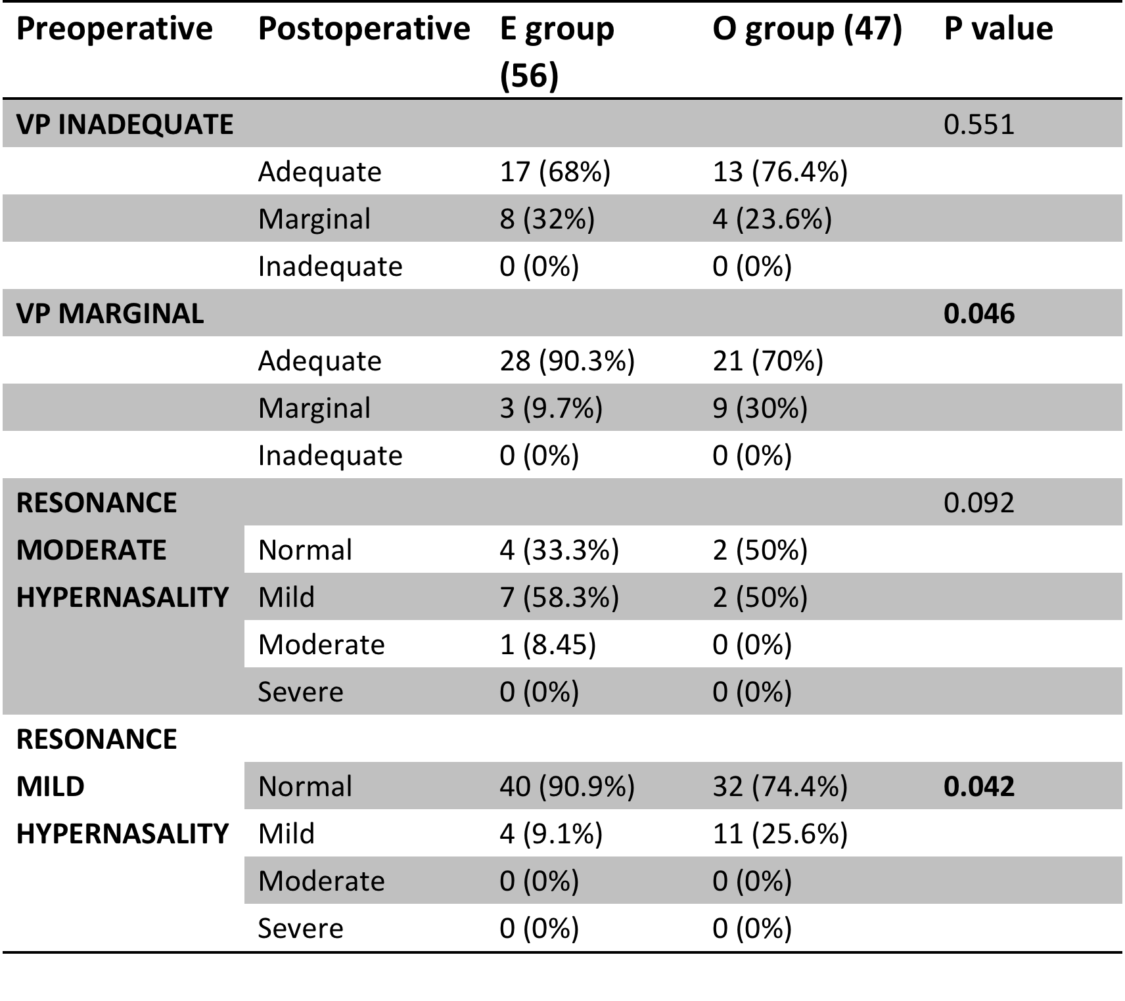
Result
Improvement of VP

Slide 13
Soft palatal length
Some previous studies have shown that palatal elongation is a factor that could achieve velopharyngeal competence (VPC), postoperatively
High VPC in E group but the elongation of soft palate similar in both group
Palatal elongation might be limited in improving VPI and that it is, but may not be, the key factor associated with VPC

Slide 14
Soft palatal thickness
D’Antonio: greater velar length and thickness both were associated with complete velopharyngeal closure
Higher rate of VPC in the end-to-end group was noted. Soft palate thickness might not have the key role in velopharyngeal function
End-to-end repair: three layer repair, physiological repair, combine other procedure

Slide 15
Conclusion
Double opposing Z-plasty has utility in the treatment of velopharyngeal insufficiency
Although traditional overlap levator veli palatine muscle repair may provide greater thickness, the end-to-end method represents an alternate method of levator veli palatine muscle repair which provides three layers, potentially greater physiological repair, and demonstrates comparable outcomes to those of overlap repair.

