Slide 1
The experience of intraoperative Spy System use for microvascular evaluation
Shang-his Lin, MD, Yu-Hsien Lin, MD, Cha-Chun Chen, MD, Chu-Hsu Jeng, MD
Division of Plastic Surgery, Department of Surgery,
Shin Kong Wu Ho-Su Memorial Hospital, Taipei, Taiwan
“Nothing to disclose.”

Slide 2

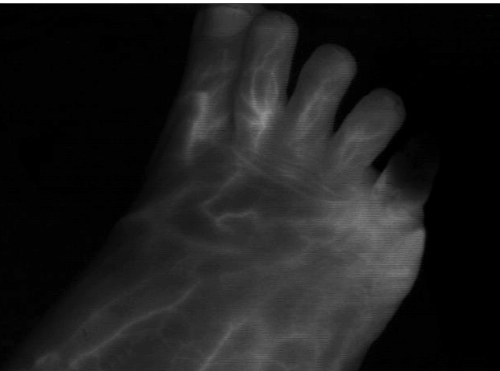
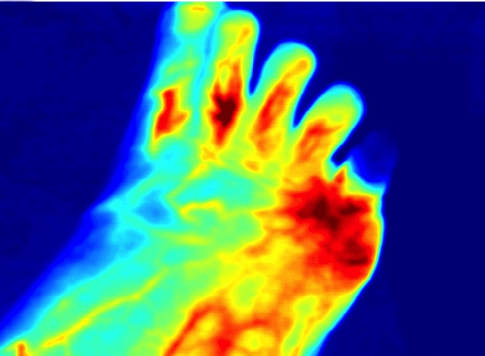
Real-time Fluorescence Imaging
SPY® Fluorescence
core technology
drives NOVADAQ®’s suite of imaging products
More than 85 peer-reviewed journal articles demonstrate
use of SPY Fluorescence positively impacts outcomes and reduces healthcare costs
Notes:
SPY Fluorescence is the core technology that drives NOVADAQ’s suite of imaging products. In PINPOINT, SPY Fluorescence combines solid state illumination, high-definition real-time sophisticated imaging technology, and a fluorescing imaging agent with a strong safety record.
SPY Fluorescence enables a precise visual assessment of blood flow in vessels as well as the quality of tissue perfusion. SPY Fluorescence also allows surgeons to observe the state of certain anatomical structures such as hepato-biliary ducts and anastomotic patency in real-time, which may assist in reducing instances of costly and, most importantly, life-threatening complications.
More than 85 peer-reviewed journal articles demonstrate that the use of SPY Fluorescence positively impacts outcomes and reduces healthcare costs

Slide 3
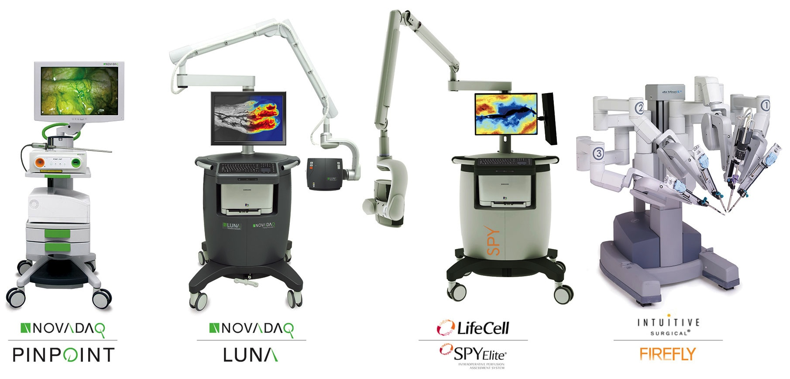
The Leader in Fluorescence Imaging
Minimally Invasive Surgery
Diagnostic Imaging, Wound Care
Open Surgery
Robotic Surgery
Notes:
NOVADAQ is the global leader in fluorescence imaging.
We develop solutions for a wide variety of procedure types within MIS, Diagnostic Imaging, Open Surgery and MIS Robotic Surgery

Slide 4
PURPOSE
Compared with Doppler ultrasound, SPY® Fluorescence can provide more precise data before and after we do microvascular anastomosis, as well as more accurate data about the vascular system of a patient with peripheral arterial occlusive diseases.
We share our experience in the use of SPY® fluorescence.

Slide 5
MATERIAL AND METHODS
From 1st Nov., 2014 to 31st Dec., 2014, SPY® fluorescence has been applied on 12 patients, 9 males and 3 females.
  head and neck reconstruction: 8
  peripheral arterial occlusive disease: 2

Slide 6
MATERIAL AND METHODS
  reconstruction for necrotizing fasciitis: 1
  complication after tibial fracture with internal fixation: 1
Intravenous Indocyanine Green(ICG) injection intraoperatively
  then low-level light source excites ICG

Slide 7
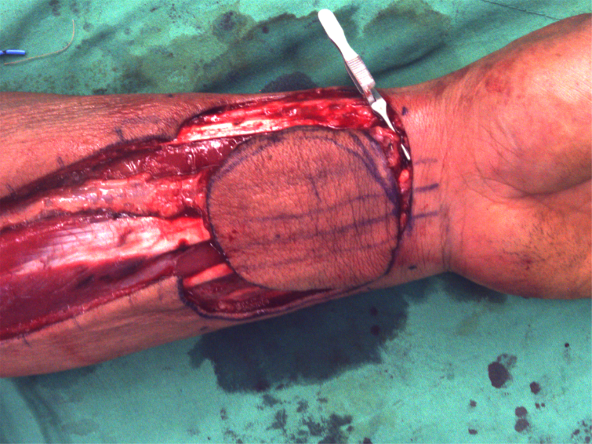
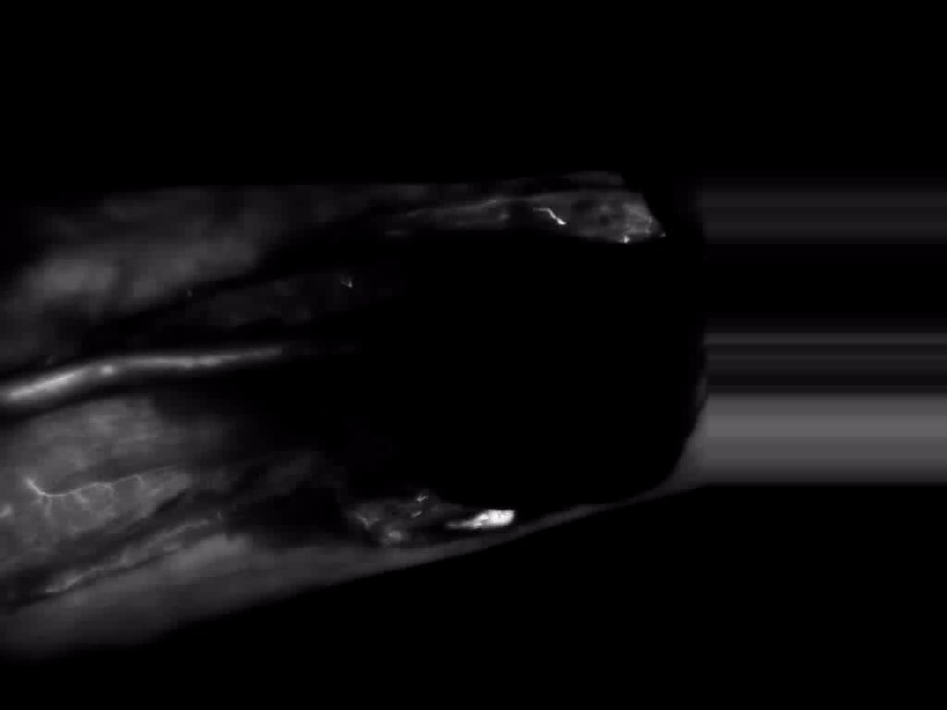
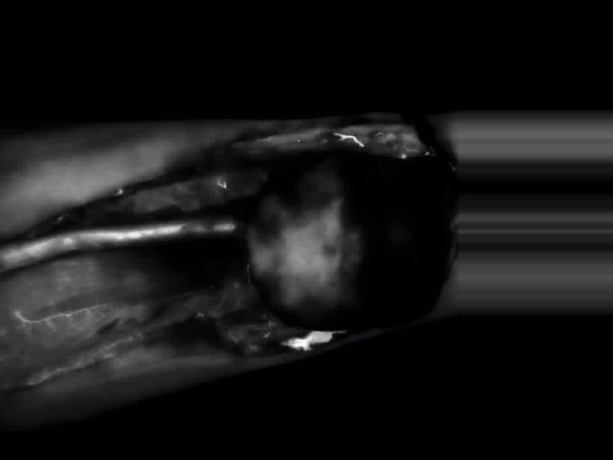
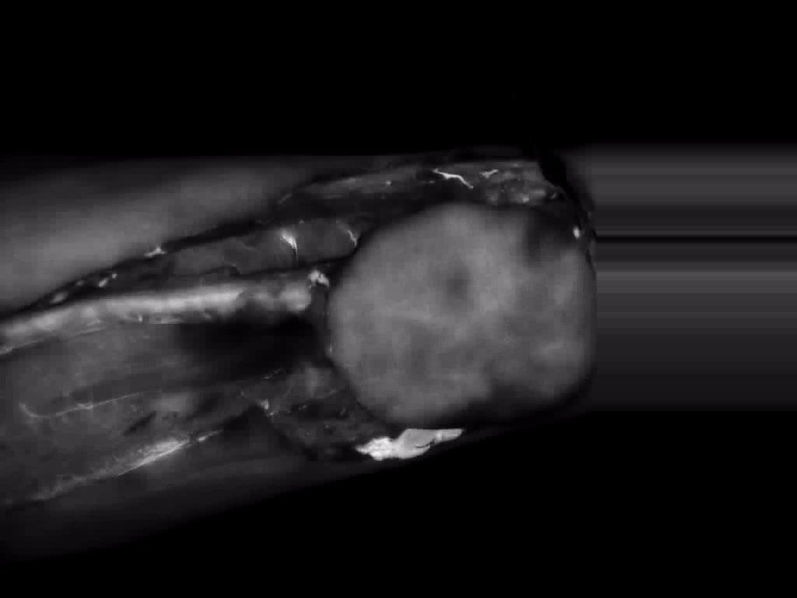
Case presentation- buccal Ca
Radial forearm flap
ICG view-1
ICG view-2
ICG view-3

Slide 8
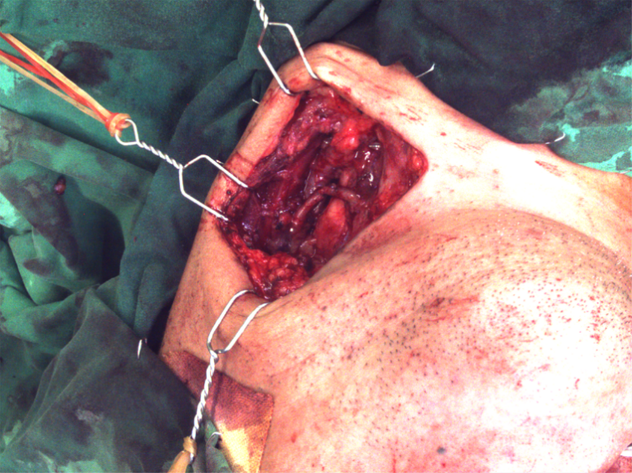
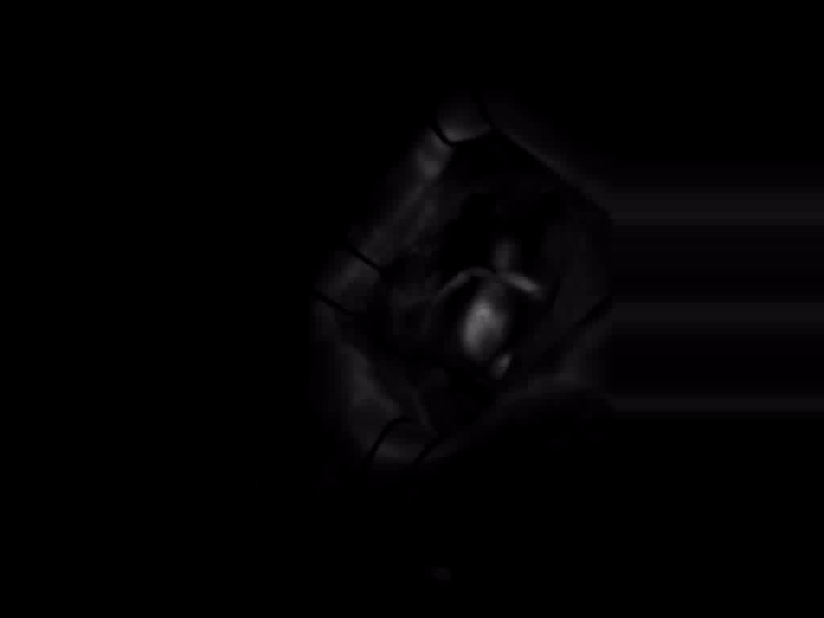
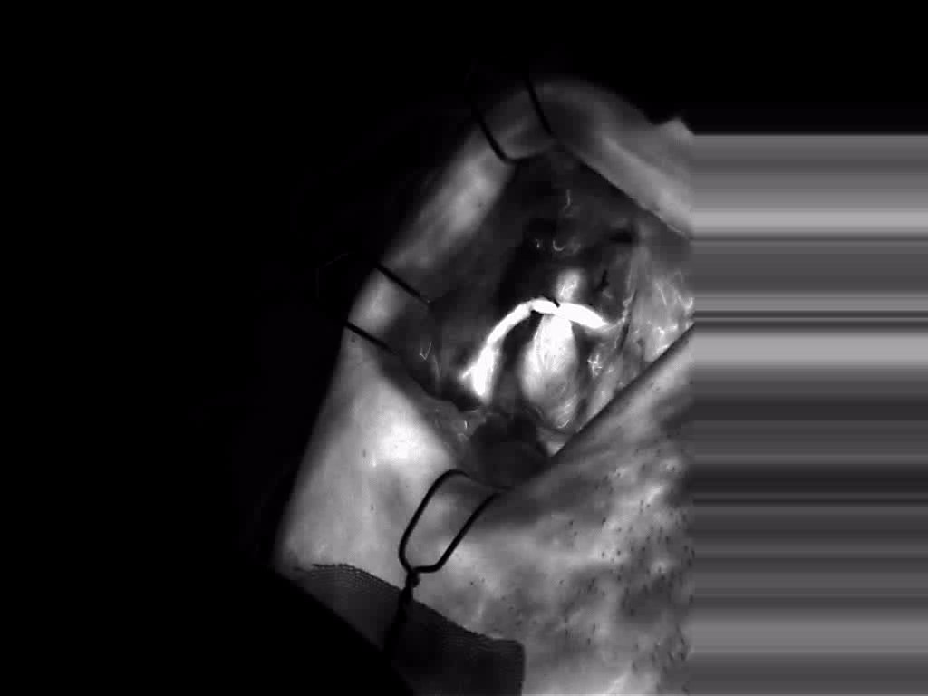
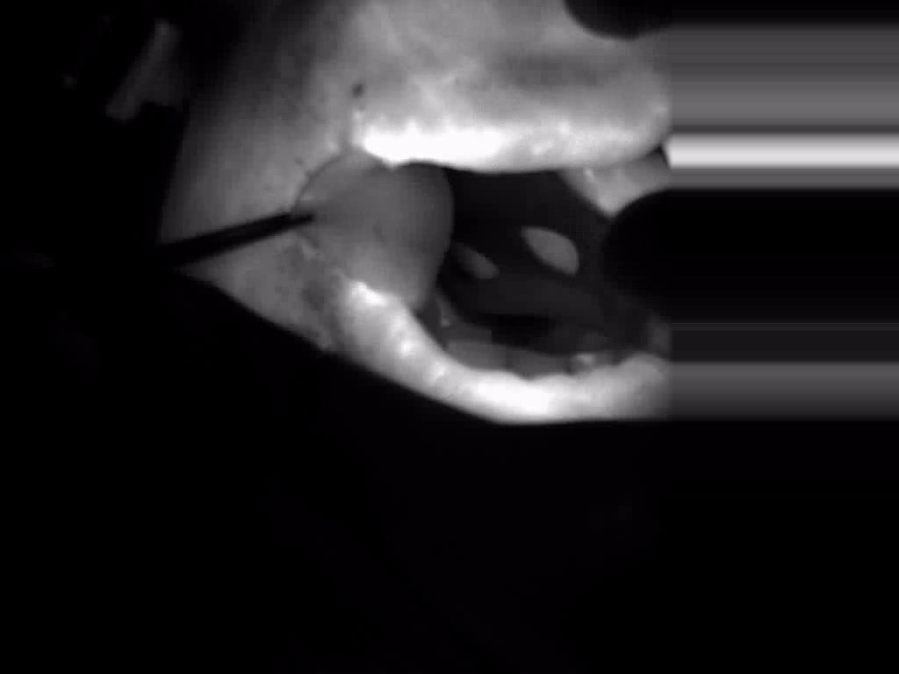
Case presentation- buccal Ca
After vessels anastomosis
ICG view-1
ICG view-2
ICG view-3

Slide 9
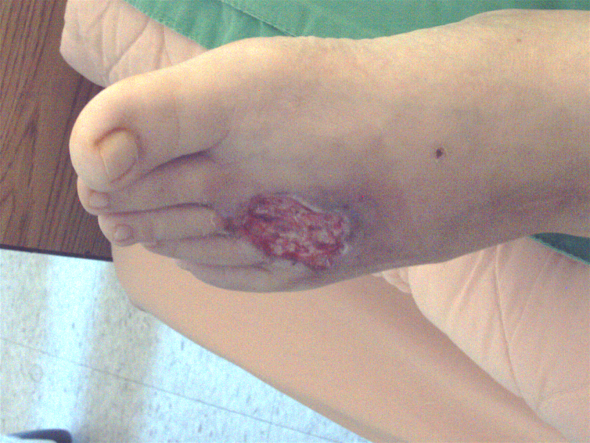
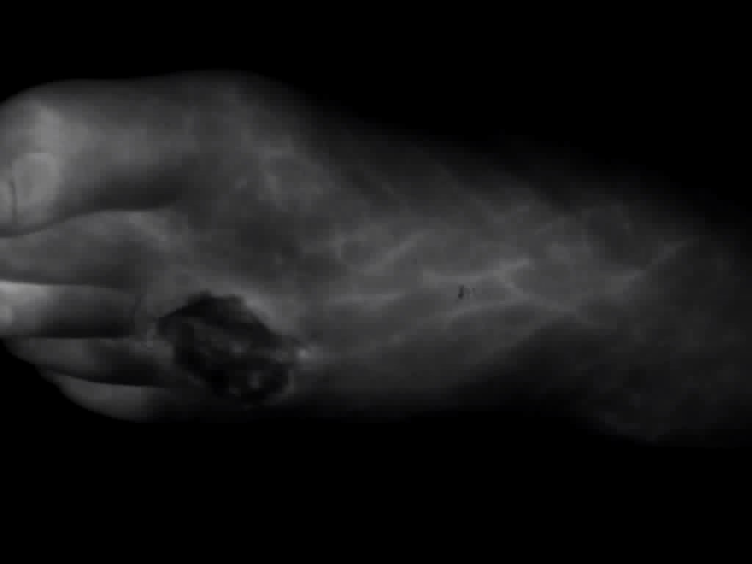
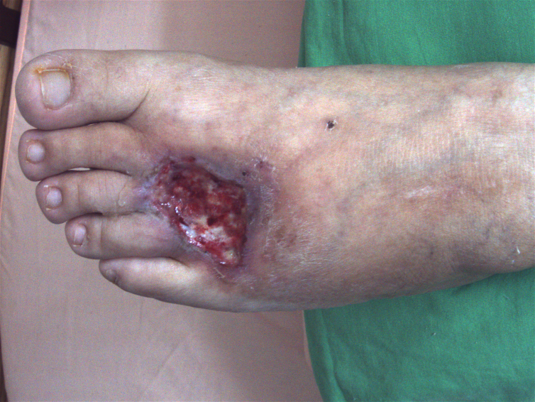
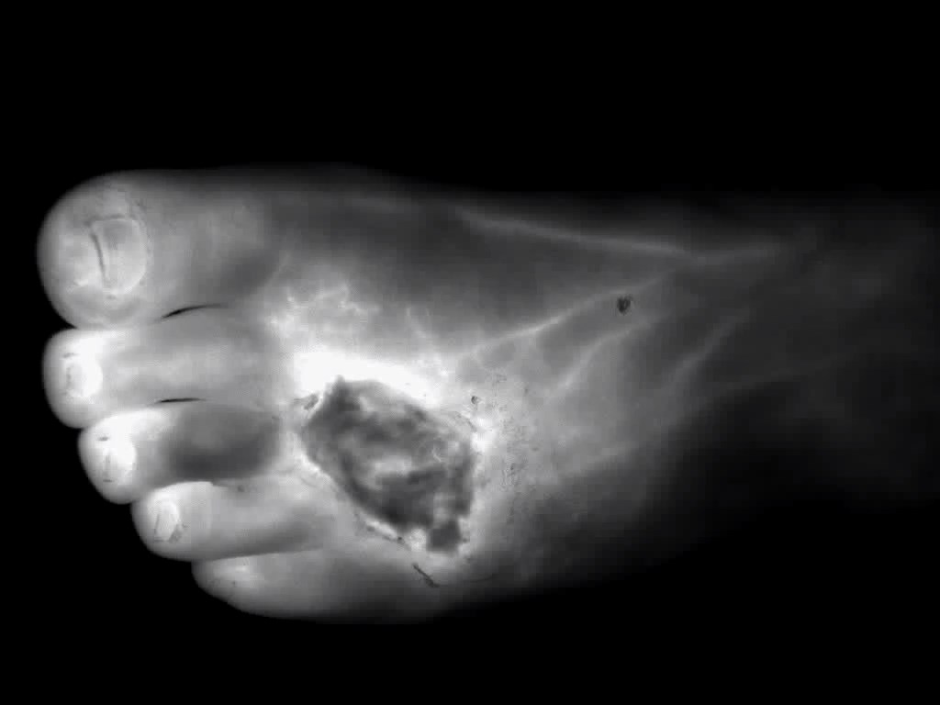
Case presentation- PAOD
Pre-PTA
Pre-PTA, ICG view
Post-PTA
Post-PAT, ICG view

Slide 10
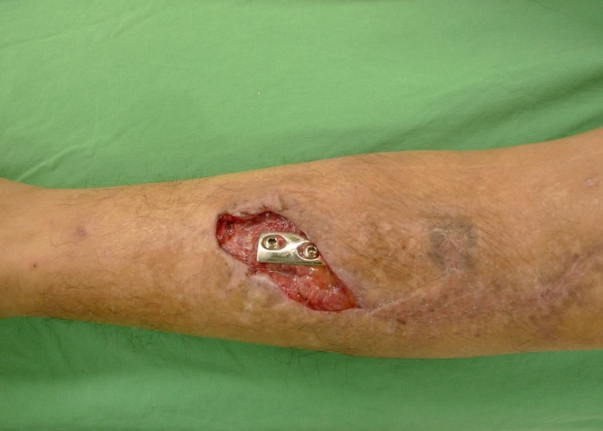
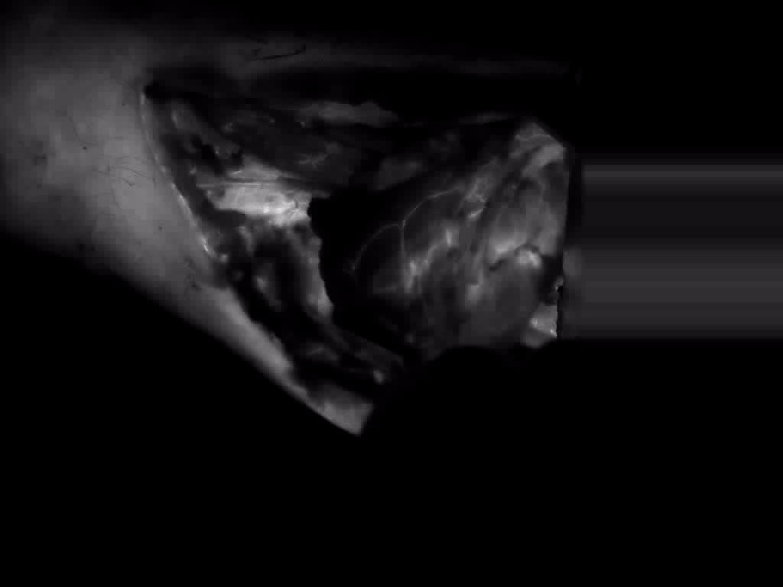
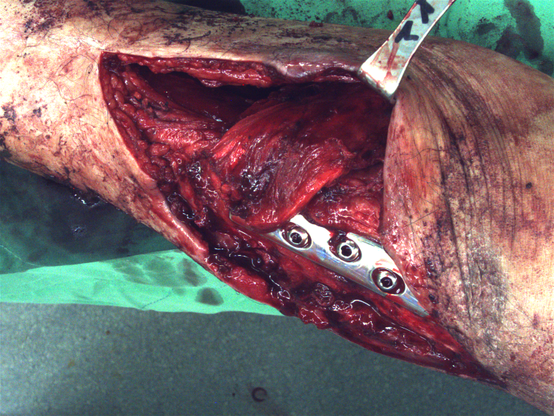
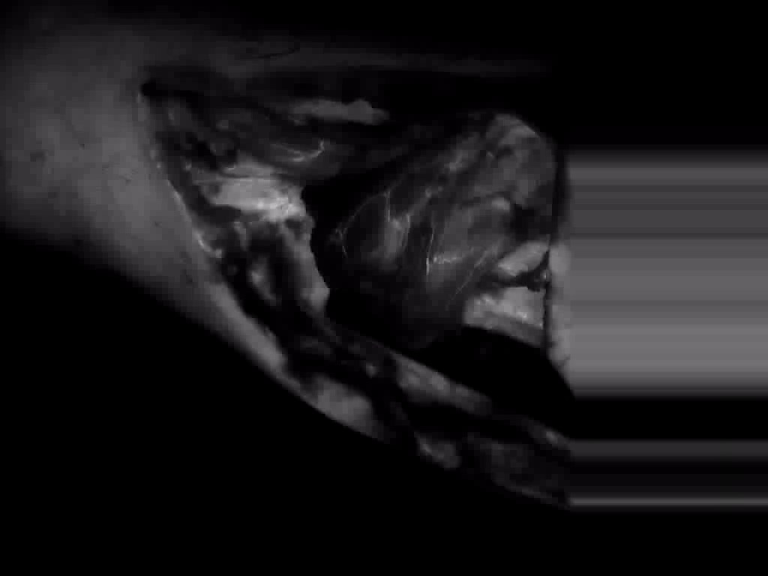
Case presentation- complication after tibial fracture with internal fixation
Pre-OP, exposure
Muscle flap ICG view
Gastrocnemius m. flap
ICG view-2

Slide 11
Introduction
Early complications following reconstructive procedures
  inadequate tissue perfusion
Clinical judgment
  not always reliable
Multiple methodologies
  Doppler devices, tissue oximetry, fluorescein, CTA, ICG angiography

Slide 12
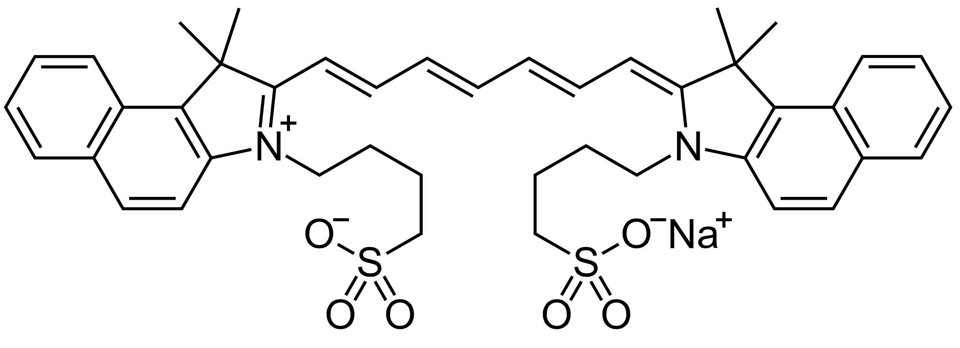
Indocyanine Green
Developed by Kodak in the 1950’s
Widely used in medical applications since the 1970’s:
  Retinal angiography
  Liver function and cardiac output tests
Strong record of safe clinical use
Excreted hepatically – not contraindicated in patients with compromised renal function
3-5 minute half-life
Only contraindication – should be used with caution in patients that have a history of sensitivity to iodides
Notes:
ICG has a 40+ year history of use in medical diagnostics. It has a very strong safety record, with an average of one mild adverse event per 40,000 uses.
It is rapidly bound to plasma proteins, and as a result stays intra-vascular. This contributes to making it the ideal compound for imaging perfusion.

Slide 13
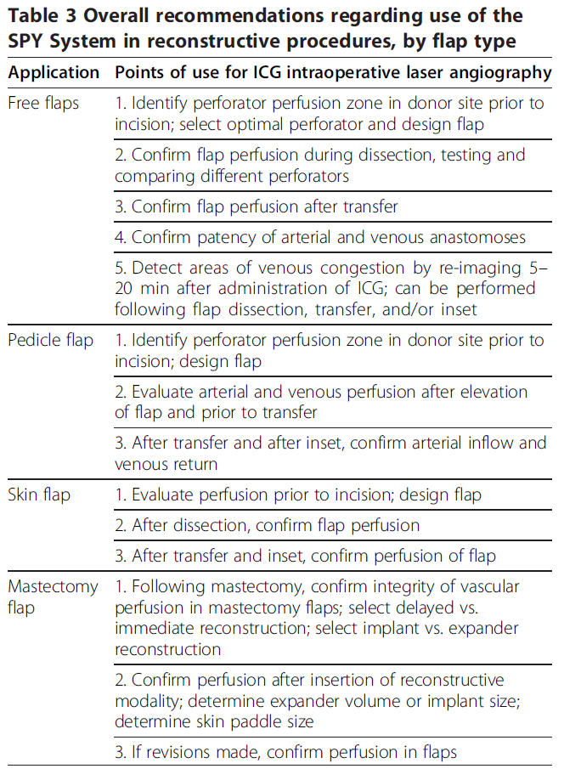
Advantages

Slide 14
Result
We can accurately find the vascular system before and after microvascular anastomosis for those cases with free flap reconstruction in the 8 case with head and neck reconstruction.
About 2 cases with peripheral arterial occlusive disease, during debridement procedure and PTA surgery by CVS doctor, we can have a clear idea about the effect.
However, the disadvantage of the system is its high price. That’s why the value of this machine is still under observation in Taiwan.

Slide 15
CONCLUSION
Compared with popular Doppler method and invasive angiography, SPY® fluorescence system can provide valuable and quantifiable data on a patient’s local microvascular conditions.
We offer our experience in a single center, and we think, clinically, it’ s a great tool, with less invasion and visible results, but because of its high price, its clinical popularity in Taiwan will be still a question.

Slide 17

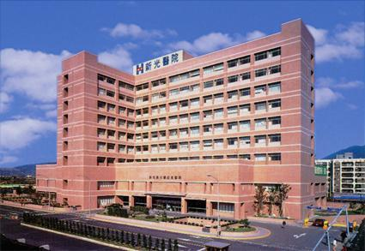
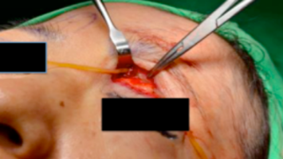
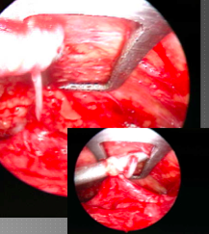
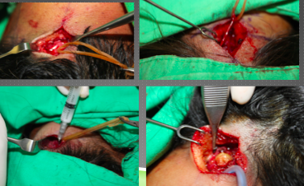

The Potential of Migraine Surgery in Taiwan: personal experience in two medical centers
Purpose
Migraine affects more than 1,500,000 people in Taiwan per year, and among them, there exists unknown percentage with refractory headache. Dr. Bahman Guyuron(B.G.) has developed effective surgeries for refractory migraine since 1999. However, some conflicts appeared from neurologists due to “no accurate data” intraoperatively. Even though, true effect and benefits have been published from those patients after operation. We applied Dr. B.G.’s methods¹ in Taiwan for those cases with medical treatment failure. Here we share our experience.
Material and Method
From 1st Sep, 2012 to 31st Jan, 2014, total of 109 patients visited Shin Kong Wu Ho-Su Memorial hospital and Landseed hospital. From the popular media, people in Taiwan had a basic idea about this operation. We evaluated all patients’ trigger points according to Dr. B.G.’s method by either questionnaires or BOTOX® . About medication evaluation, severe adverse effects and refractory to medication IMIGRANE® and CAFEGROT® are our additional indications. All operative fees are not included in the PUBLIC HEALTH INSURRANCE system.
Result
109 cases visited for consultation of migraine surgery, 82 females and 27 males (the ratio was 1:3). There were 29 patients whom accepted operations with either deactivation of frontal (Fig. 1), zygomaticotemporal (Fig 2) and occipital triggers(Fig 3). 8 patients received BOTOX®, and 1 patients received triamcinolone injection due to scar-related neck muscle spasm. Wth additional indications, about 35% of patients was suitable and “desire” to receive either operation or BOTOX® treatment. Among those with operations, onlay 2 cases received pre-operative BOTOX® test and 16 cases ever experienced BOTOX® treatment by neurologists but not very effective results had been described,
We did not have the exact results of operation because the duration of follow-up was not up to 6 months.
Conclusion
Here we share the potential of migraine surgery for refractory migraine in Taiwan in a single center and its cooperating hospital. Even with the specific public health insurance system in Taiwan, there still exist some patients with refractory migraine who seek for the “relatively life-long” solution. We believe that migraine surgery has great potential in Taiwan. With more accurate and precise indications, doctors in this field can help more patients with this diseases and may show more effective response.
References
1. Guyuron B, Tucker T, Davis J. Surgical treatment of migraine headaches. Plast Reconstr Surg. 2002;109: 2183-2189.
2. Guyuron B, Kriegler JS, Davis J, et al. Comprehensive surgical treatment of migraine headaches. Plast Reconstr Surg. 2005;115:1-9.
Wei-nung Jim Chen¹, Cha Chun Chen¹, Hwang-Chi Lin¹, Chu-Hsu Jeng¹, Cheng-Han Hsieh¹, Yu-Hsien Lin, Hang-Lung Chang²
¹Plastic Surgery, Shin Kong Wu Ho-Su Memorial Hospital, Taipei City, Taiwan
²General Surgery, Landseed Hospital, Taoyuan City, Taiwan
Fig.1:
Yellow rubber shows supratrochlear nerve passing through the glabellar muscles before deactivation of frontal trigger was performed
Fig 1
Fig 2:
Endoscopic view of zygomaticotemporal branch of the trigeminal nerve and avulsion procedure to deactvate it.
Fig 2
Fig 3:
Neurolysis of greater occipital nerve, along with local steroid injection and subcutaneous flaps were used to treat this trigger points.
Fig 3

