Slide 1
Right thigh angiosarcoma - radical resection and functional muscle transfer: A case report
Jih-Sen Wong¹,Jiunn Tat Lee¹,Meng-Si Wu²,Chien-Hsing Wang²,Li-Fu Cheng²,Chao-Chih Yang²,Hon-Da Hsu²
Division of Plastic Surgery, Department of Surgery, Buddhist Tzu Chi General Hospital, Hualien, Taiwan

Slide 2
Patient profile
Age: 28
Gender: male
Past history:
  Scald burn s/p(face, chest wall, four limbs, 2nd degree, 35%) debridement + STSG 16 years ago
Chief complaint
  Right thigh tumor for 4 years

Slide 3
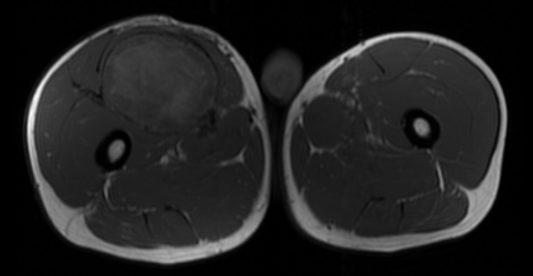
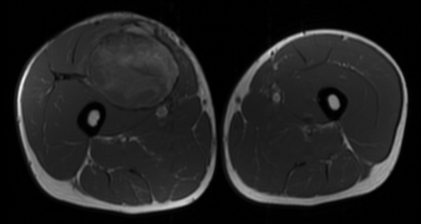
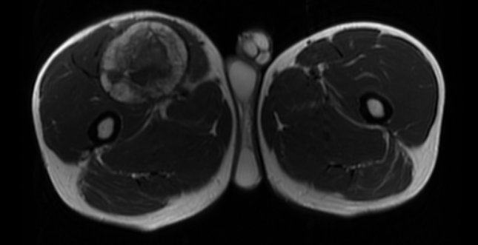
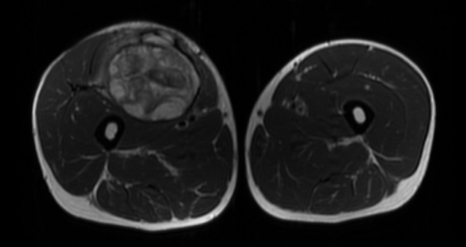
Femur MRI
T1 FSE
T2W
Hypervascular nature and heterogenous enhanced pattern

Slide 4
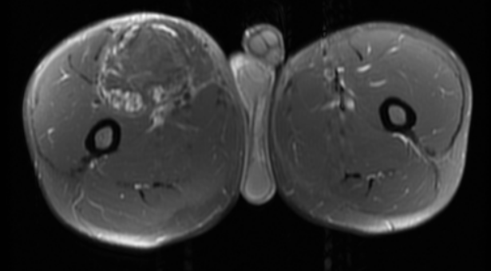
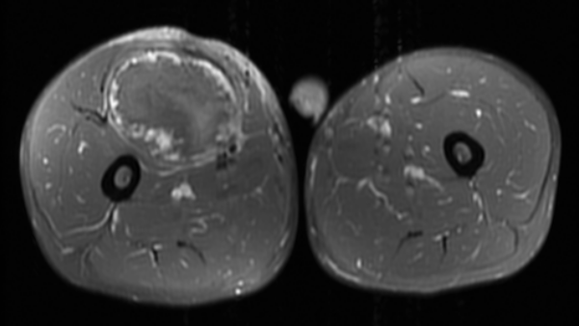

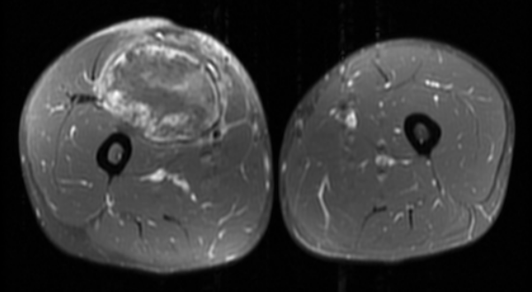
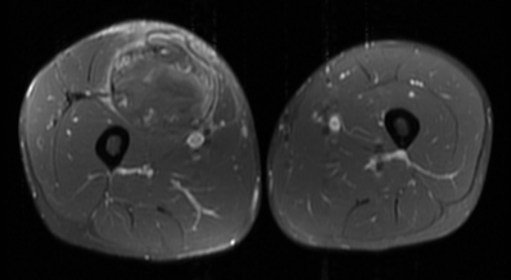
T1 FSE+C

Slide 5
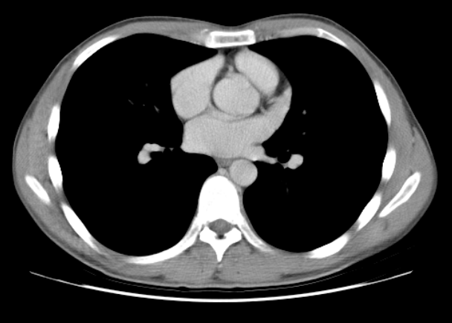
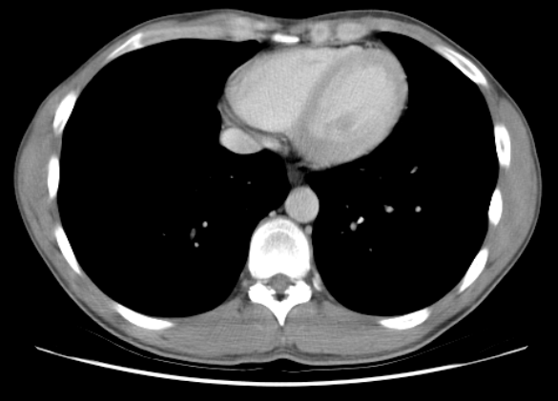
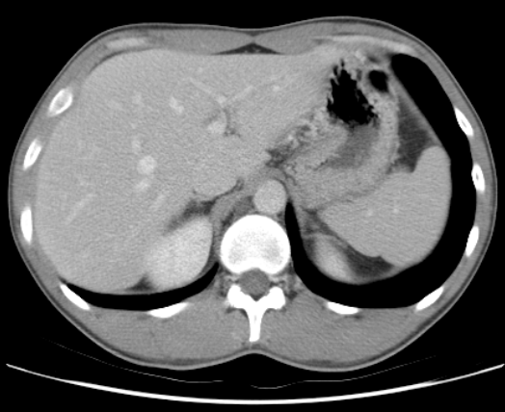
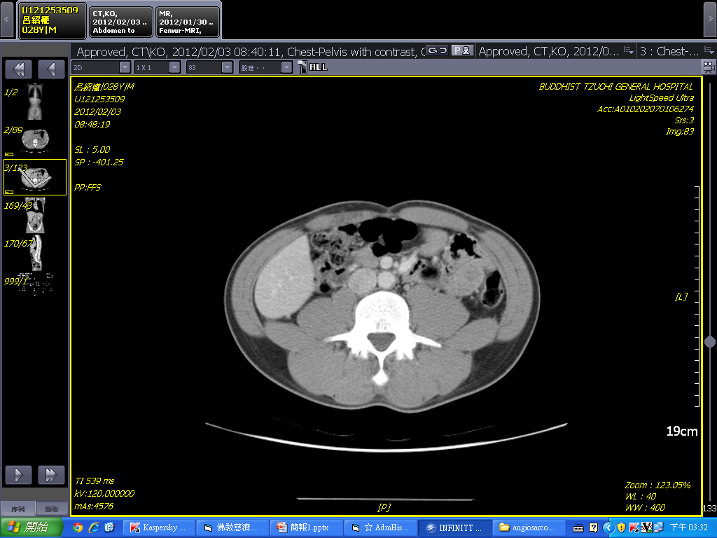
Chest to pelvis CT
Notes:
No metastasis

Slide 6
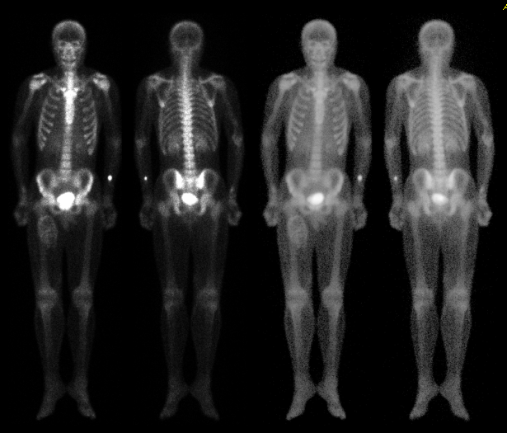
Whole body bone scan
Notes:
No definite evidence of malignant bone metastasis

Slide 7
Incisional biopsy
Well-differentiated angiosarcoma
  Irregular anastomosing vascular channels dissecting through the collagen
  Pleomorphic, hyperchromatic, and multilayering endothelial cells
  Immunohistochemical stain
    S-100 (-)
    CD31 (+)
    CD34 (-)

Slide 8
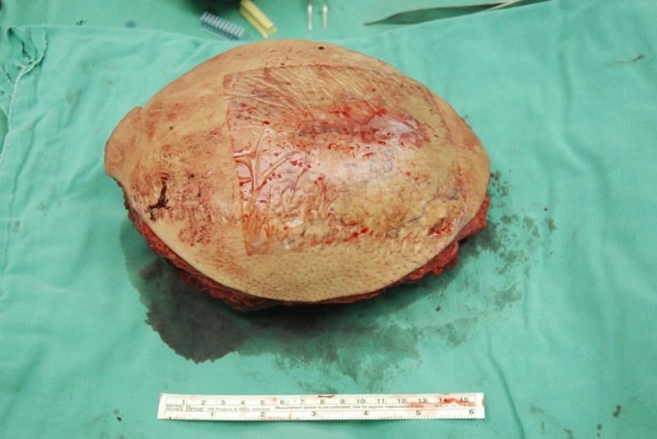
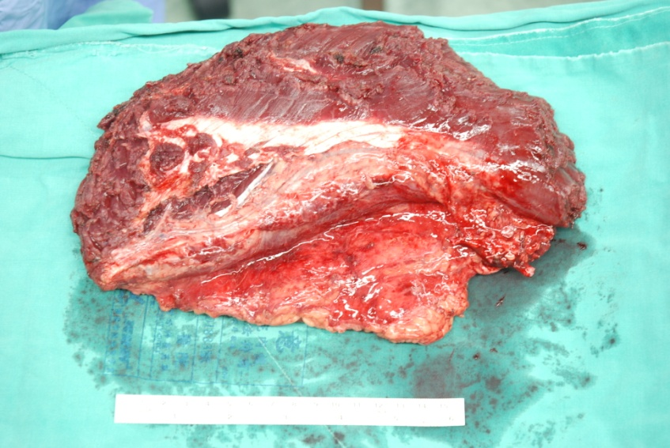
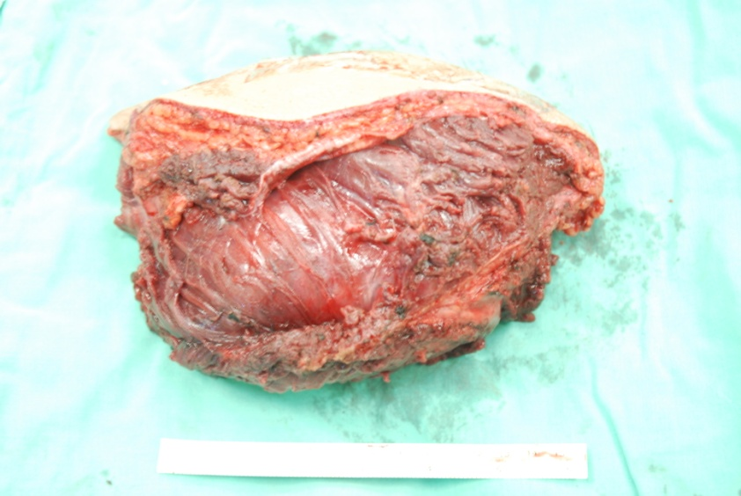
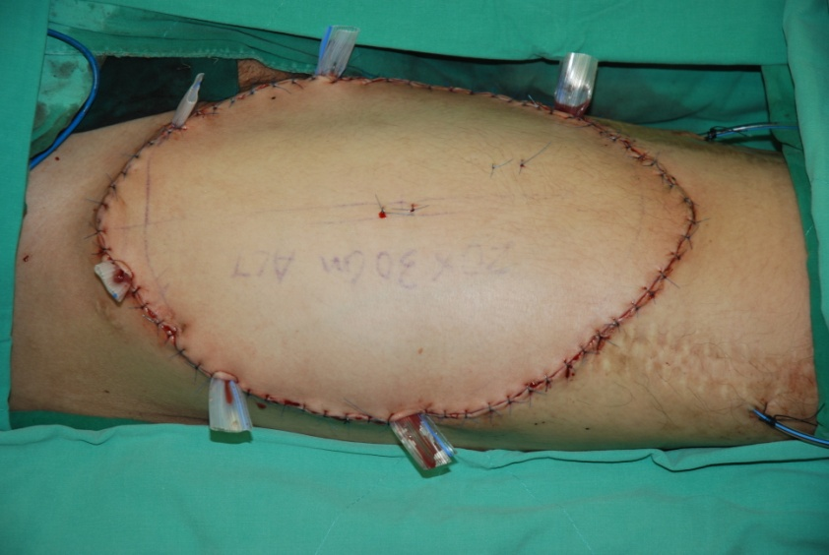
Wide excision and free ALT myocutaneous flap reconstrction

Slide 9
Pathology
Angiosarcoma, well-differentiated
Size of Tumor: 3.2x2.0x1.0cm & 2.5x2.5 x1.5 cm
Histologic Grade: I
Primary Tumor: pT2b
Regional Lymph Nodes: pN0
Immunohistochemical stain: CD31 (+) and CD68 (+)

Slide 10
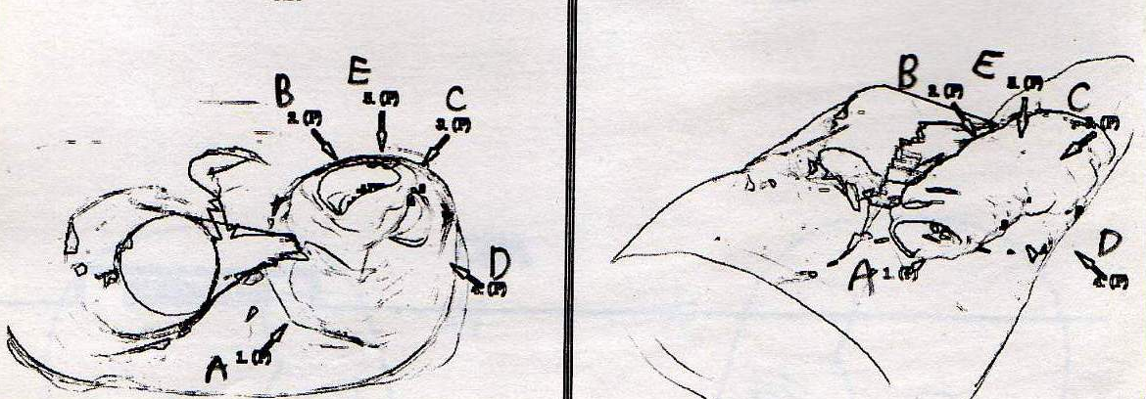
Post-operative radiotherapy
5940cGy in 33 fractions

Slide 11
Post-operative follow up
No radiological sign of local recurrence or distant metastasis for 3 years
Functional outcome also improved that he can jog for 200 meters

Slide 12
Thank you

