Slide 1
3D-Assissted Quantitative Determination of Zygomatic Complex Using an Open-Source Software
¹Victor Bong-Hang Shyu, M.D., ¹Chih-hao Chen, M.D.

Slide 2
Affiliations
¹Craniofacial Research Center, Department of Plastic and Reconstructive Surgery, Chang Gung Memorial Hospital at Linkou, Chang Gung University, College of Medicine, Taoyuan, Taiwan
²Department of Medicine, College of Medicine, Chang Gung University, Taoyuan, Taiwan
³Department of Plastic and Reconstructive Surgery, Chang Gung Memorial Hospital, at Keelung
Nothing to disclose

Slide 3
Objective
Zygomatic complex: unique tetrapod-structure which defines the malar prominence, the orbital shape as well as the orbital volume
Aesthetic and functional deficits can be the result of simple zygomatic complex fractures
Post-operation malar asymmetries in zygomatic fractures have a reported incidence of 10%

Slide 4
Purpose
We present an ideal modality that is both objective and reliable, using anthropometric data from 3D CT images processed by OsiriX® software, to precisely measure the skeleton and soft tissue aspects of the zygomatic complex in the normal zygoma

Slide 5
Materials and Methods
patients who visited our institute with facial trauma from Aug 2009 to May 2013
Patients with negative zygomatic injuries included
All of the 3D scan data were reconstructed and analyzed using a standardized protocol with OsiriX® software
N=28

Slide 6
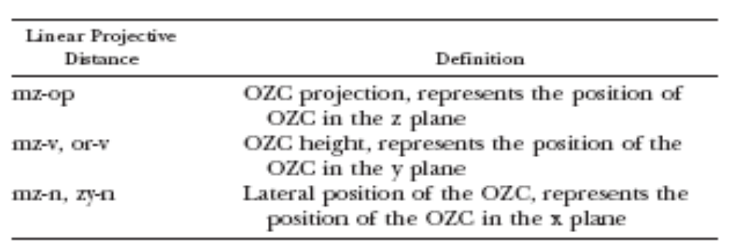
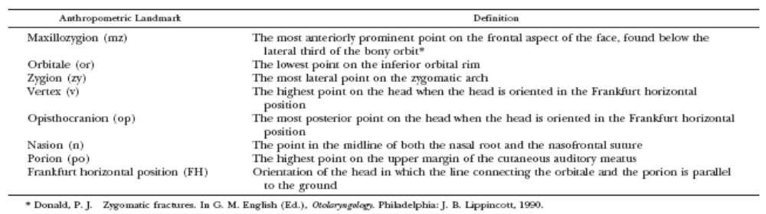
Materials and Methods
Reference points as described by Donald and Czerwinski et al.
Image source: Donald PJ et al. Otolaryngology. 1990

Slide 7
Materials and Methods
Three measurements were conducted on the same patient to determine the reliability of repetitive analysis (intra-subject).
The same measurement obtained from each side of the same patient was then compared to determine the symmetry of the face (inter-subject).

Slide 8
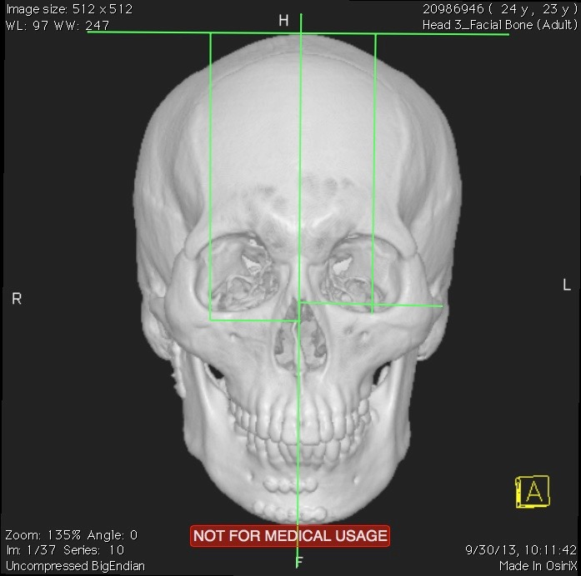
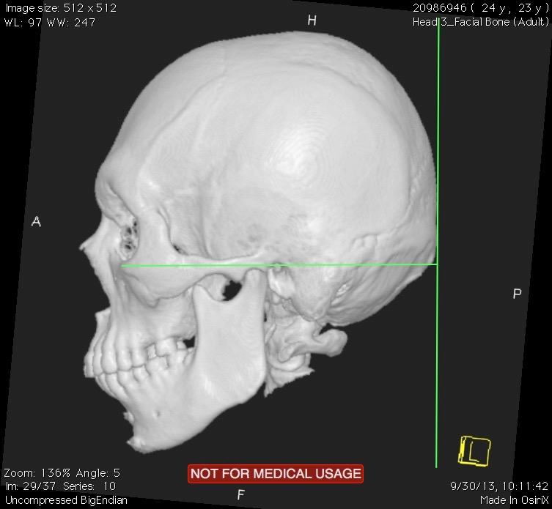
Materials and Methods
Figure 1. Measurement of linear projection distances in three planes of facial bone

Slide 9
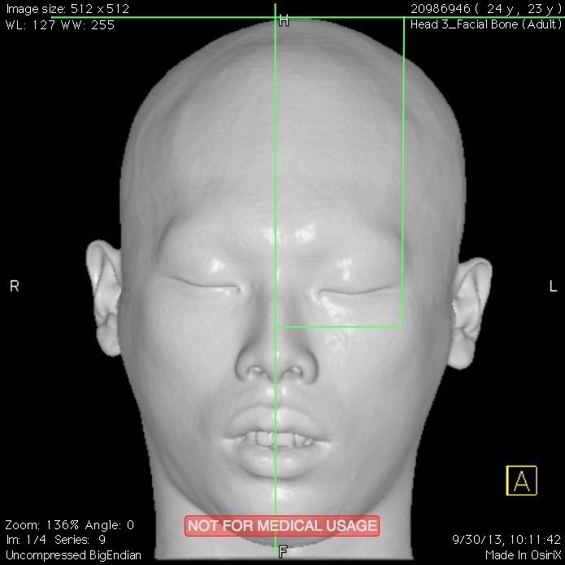
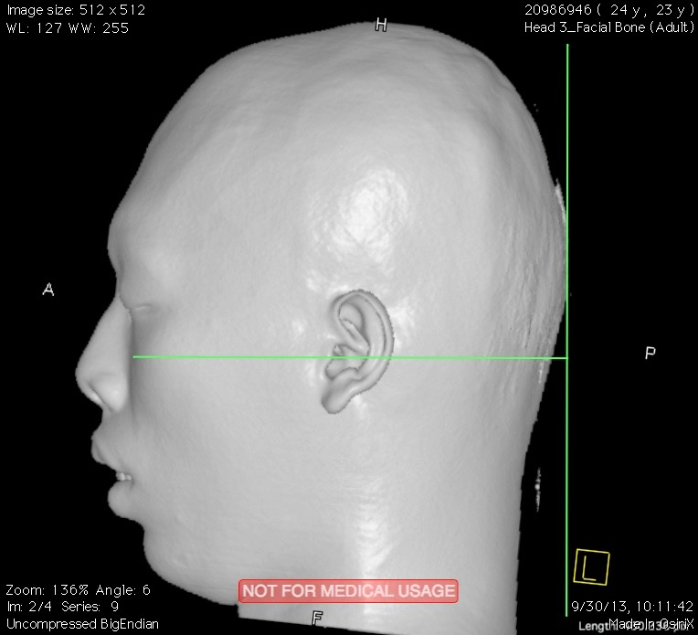
Materials and Methods
Figure 2. Measurement of linear projection distances in three planes of face

Slide 10
Results: Bony component
Zygomatic complex showed no significant differences in all aspects, which include its lateral position, height and projection as well as between both sides of the face intra-subject.
Except for the anterior projection of the zygomatic complex in the z plane, most of the values show no significant difference between each measurement (<1mm, p<0.05)

Slide 11
Results: Soft tissue
In intra-subject measurements, all of the value differences were within 1mm and no statistical differences were found.
When comparing between each side of the face in the same patient, the distance between the maxillozygion (mz) and the nasion (n) (x plane) and the distance between the maxillozygion (mz) to the vertex (v) (y plane) showed significant differences. These difference, however, were within 1 mm.

Slide 12
Conclusion
Clinical symmetry was noted for measurements on bony landmarks between sides.
Soft tissue measurements revealed higher variability, possibly due to the fact that soft tissues may conceal landmarks.

Slide 13
Conclusion
The zygomatic complex can be easily assessed in 3D image using our anthropometric technique and open-source OsiriX software.
It provides an objective, precise, and consistent measurement in any patient whose CT image is available

Slide 14
Significance
Free, open-source OsiriX imaging software can be used for zygoma evaluation and CT evaluation
Bony symmetry in Chinese Taiwanese patients between sides was found for the Zygoma and can be used for surgical outcome evaluation

