Slide 1
Maxillofacial fractures with associated laryngeal injuries; red flag signs and symptoms that should not be overlooked
John Chung-Han Wu, M.D., Hsin-Yu Chen, M.D., Chien-Hung Liao, M.D., Shang-Yu Wang, M.D., Chien-Tzung Chen, PhD Chih-Hao Chen, M.D.

Slide 2

Affiliations and Disclosures
Department of Plastic and Reconstructive Surgery, Department of Trauma and General Surgery, Chang Gung Memorial Hospital, Linkou, Taiwan
Nothing to disclose

Slide 3
Introduction
Maxillofacial fractures with concomitant laryngeal injuries are relatively uncommon, but put both the quality and maintenance of life in jeopardy.
Early diagnosis and proper initial management is often difficult or delayed due to its hidden nature and ranging presentations.

Slide 4
Study Objectives
We tried to identify possible risk factors, which can be used as diagnostic hints and predictors for future clinical practice.
Outcome analysis between patients with and without concomitant laryngeal injuries was also conducted.

Slide 5
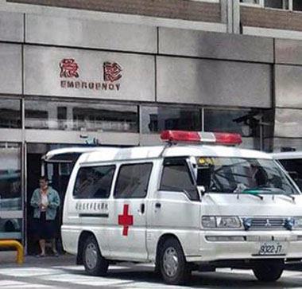
Materials and Methods
A retrospective review of medical records from 2008/8 to 2013/8 was conducted at a level I trauma center.
Propensity score matching (PSM) was applied for further statistical analysis.

Slide 6
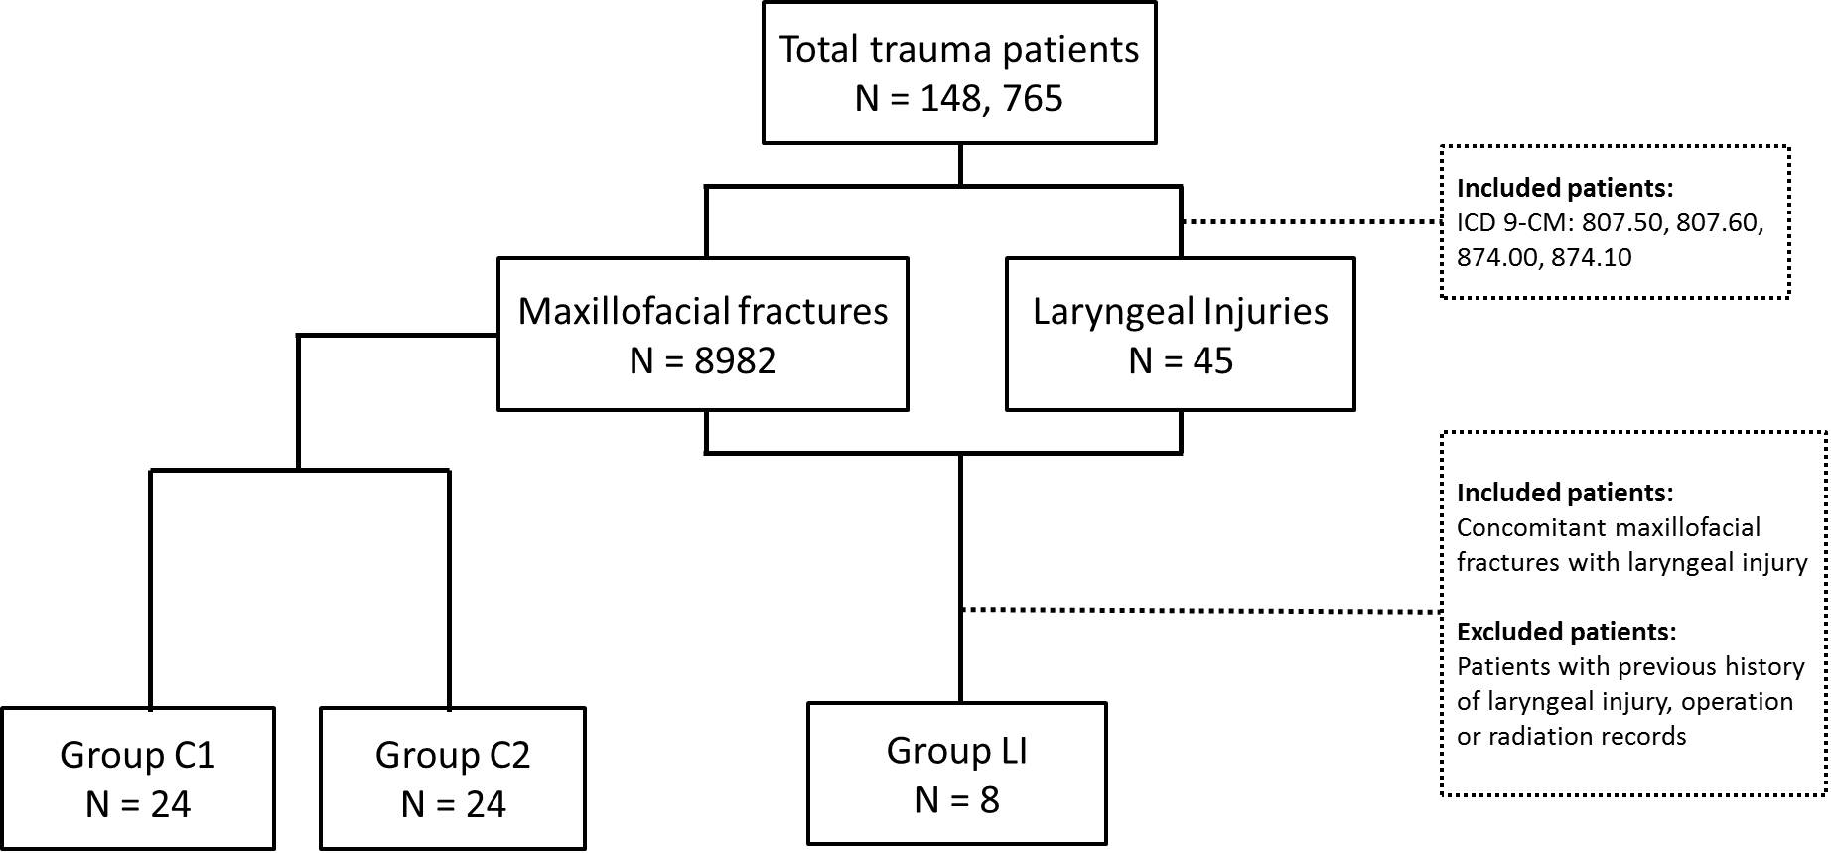
Process of Patient and Control Group Selection
Propensity Score Matching
Age-adjusted
Severity-adjusted

Slide 7
Process of Patient and Control Group Selection
Group LI: focus patient group with maxillofacial fractures and concomitant laryngeal injuries
Group C1: control group one after age-adjusted PSM, no laryngeal injuries
Group C2: control group two after severity-adjusted PSM, no laryngeal injuries

Slide 8
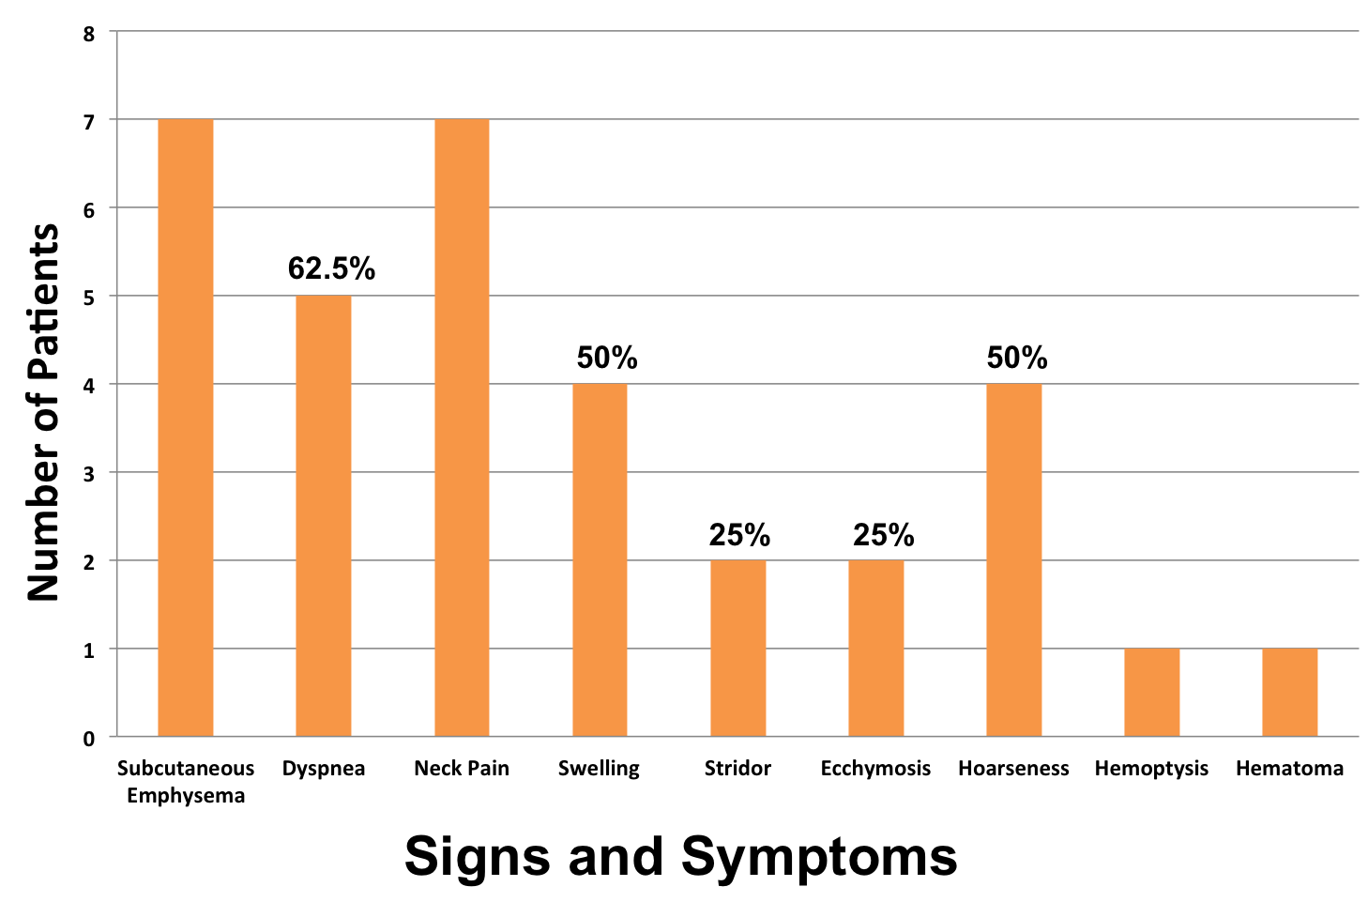
Clinical Presentations of Group LI (n=8)
87.5%
87.5%
12.5%
12.5%

Slide 9
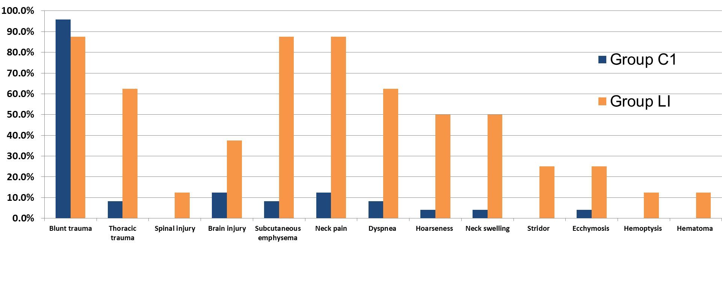
Group LI was compared to Group C1 to identify risk factors of laryngeal injuries
Percentage of Patients
p<0.001
p<0.001
p=0.005
p=0.005
p=0.009
p=0.009
Signs and Symptoms

Slide 10
Significance of Data
Thoracic trauma, Subcutaneous emphysema, Neck pain, Dyspnea, Hoarseness, Neck Swelling were all significantly greater in group LI.
The above mentioned symptoms suggest possible laryngeal injury and further diagnostic action is needed.

Slide 11
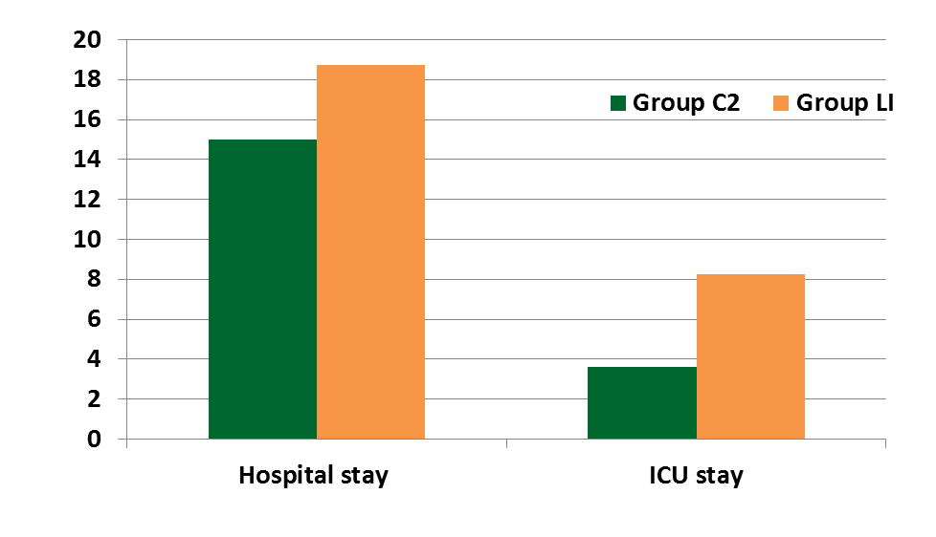
Group LI and Group C2 was compared for outcome analysis
p = 0.029
Days
p = 0.012

Slide 12
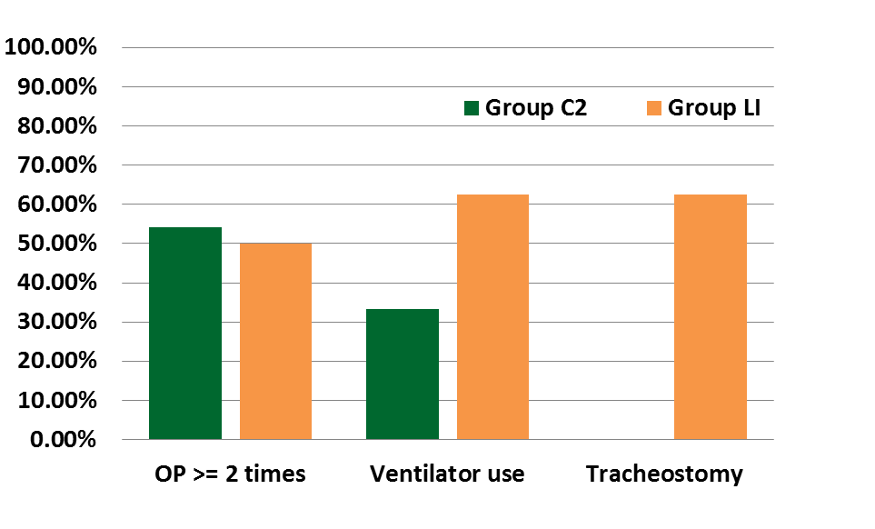
Group LI and Group C2 was compared for outcome analysis
Percentage of Patients
p < 0.001

Slide 13
Significance of Data
Hospital stay, ICU stay and the use of tracheostomies were all significantly greater in group LI.
The number of operations and use of ventilators were not more significant in patients with laryngeal injuries.

Slide 14
Significance of Study
Symptoms and signs that can be used as diagnostic clues of laryngeal injures for future clinical practice were identified.
Early diagnosis and proper immediate treatment reduces medical costs and resources.

Slide 15
Conclusion
Prompt diagnostic actions include palpation of the cervical region, neck CT and a bronchoscope
Early treatment helps restore a patent airway and lead to improved long-term outcomes
Never Assume That a Facial Fracture is Just a “Simple” Facial Fracture

