Slide 1

Salvage Nipple-Sparing Mastectomy and Immediate Breast Reconstruction after Previous Breast Conservation Therapy: Same Safety, Better Cosmesis
Che-Hsiung Lee, Jung-Ju Hung, Chih-Wie Wu, Ming-Huei Cheng
Department of Plastic and Reconstructive Surgery, Chang Gung Memorial Hospital
Chang Gung University College of Medicine, Taoyuan, Taiwan

Slide 2

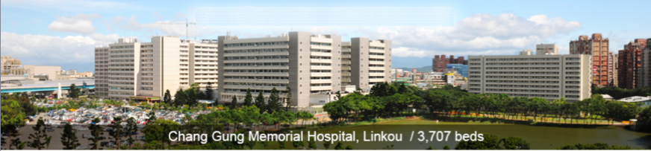
Purpose
Breast conservation therapy (BCT)
  Including
    Partial mastectomy
    Irradiation
  Widely accepted for breast cancer treatment
  Survival is considered compatible to mastectomy in highly selected patients
  Nevertheless, there remains a 10 % risk of developing local recurrence in 10 years

Slide 3
Purpose
Nipple-sparing mastectomy
  Newly developed technique, popular procedure
  Preserve the nipple-areolar complex with better aesthetic results
  20 – 30 % of risk of nipple areolar complications in terms of poor perfusion after surgery
About prior radiation
  Compromise the wound healing and nipple-areolar perfusion after surgery in patients who received BCT and developed local recurrence
Purpose of this study
  Evaluate the oncological safety and results of nipple-sparing mastectomy after breast conservation therapy

Slide 4
Methods
Between November 2009 and January 2015
  Total of eighteen female patient received nipple-sparing mastectomy and immediate breast reconstruction for local recurrence after breast conservation therapy
  Chang Gung Memorial Hospital, Linkou, Taiwan
  Their average age was 44.1±9

Slide 5
Methods
Collected data
  Demographic data
  Use and dosage of intraoperative radiotherapy on nipple-areolar complex
  Perioperative complications
    Medical and surgical-related complication
    Aesthetic outcome
    Local recurrence rate
Control group
  Another 91 patients with nipple-sparing mastectomy and immediate breast reconstruction for primary breast cancer treatment
  Reconstruction method

Slide 6
Results
The reconstruction methods included
  Free DIEP flaps (n=6)
  Implants (n=11)
  Tissue expander (n=1)
Complications
  Three patients (16.7%) developed partial breast pocket necrosis
  Two patients (11.1%) lost their nipple-areolar complex totally due to postoperative necrosis
  Eight patients in the control group developed partial nipple-areolar complex necrosis without total loss of their nipple areolar complex

Slide 7
Results
  With a mean follow up time of 21.7 ± 20.6 months,
    None of the patients developed local recurrence or tumor distant metastasis
    The over all local recurrence/distant metastasis were without significant difference comparing to the control group

Slide 8
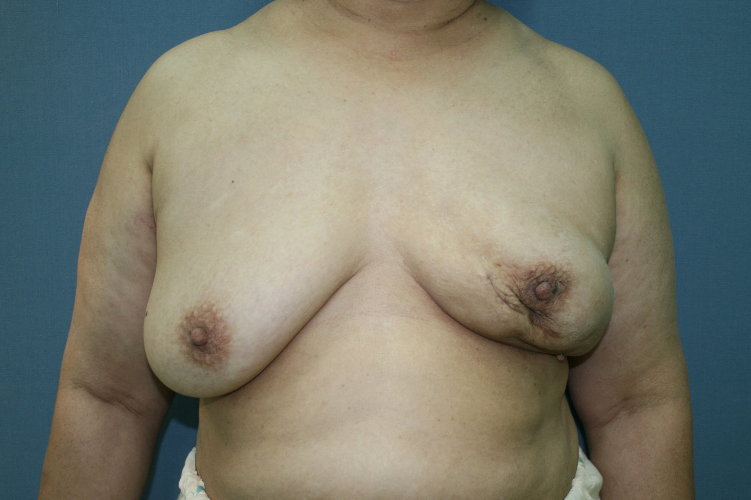
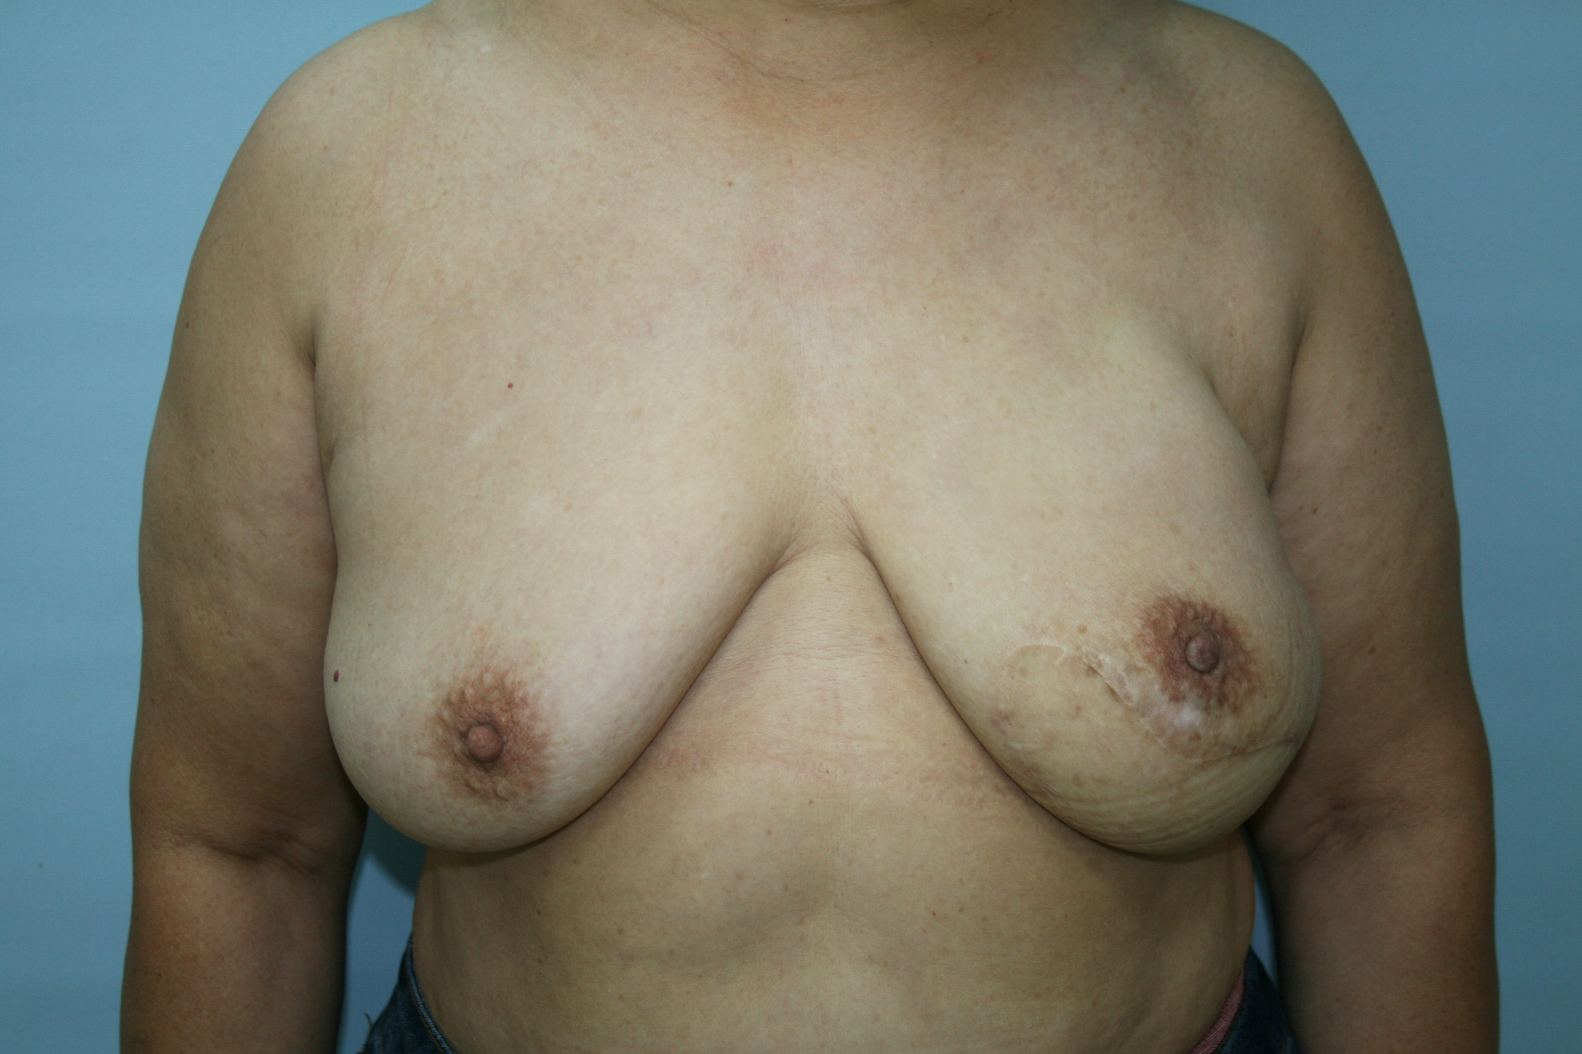
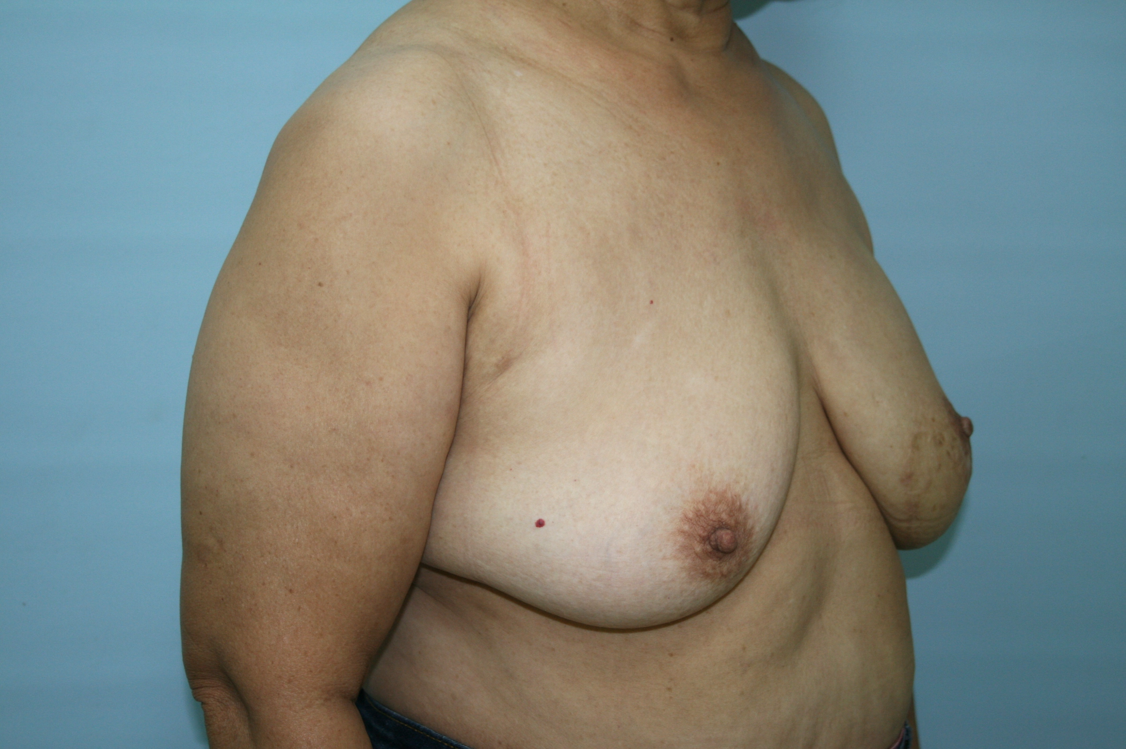
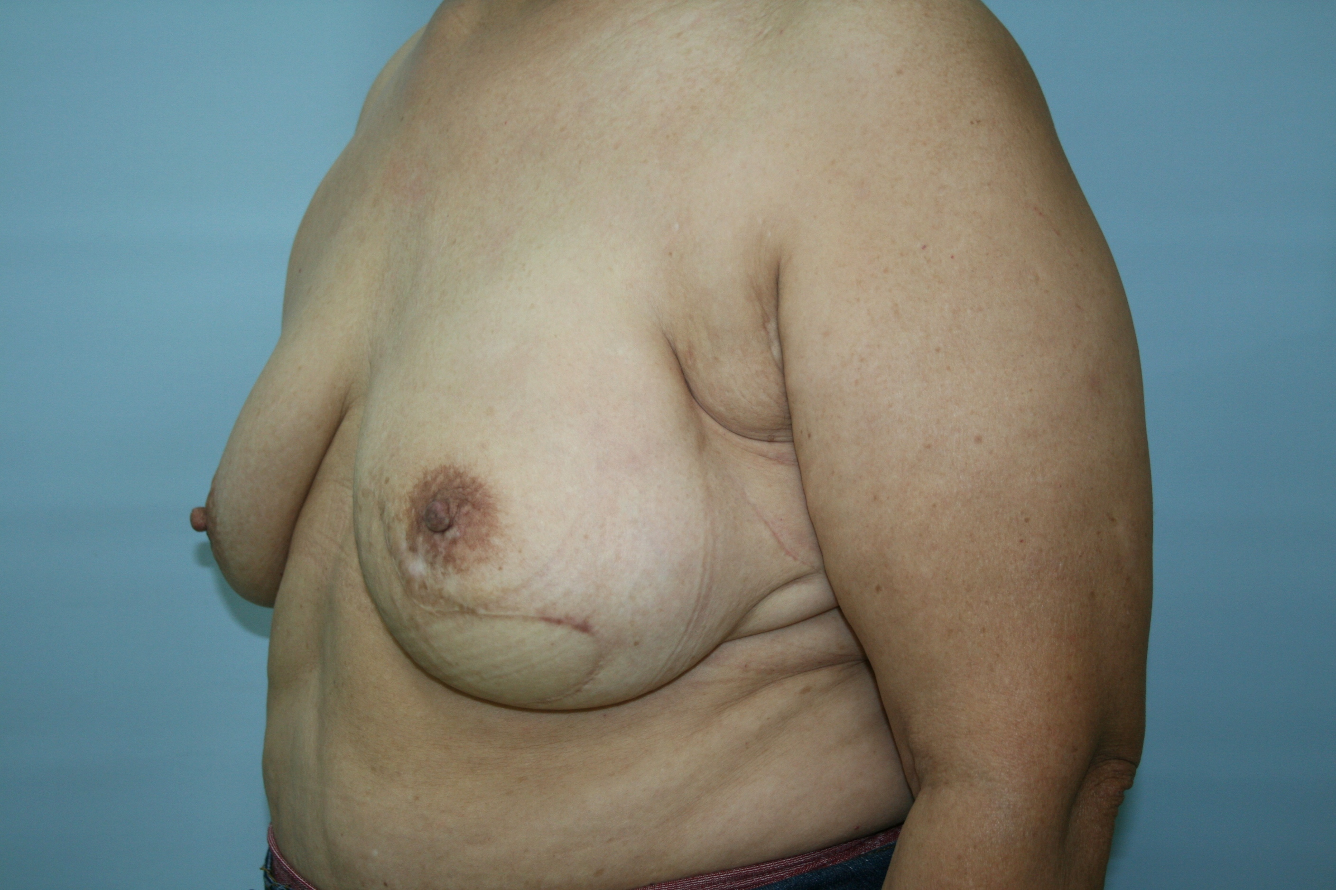
Case PRESENTATION DIEP
A
A 64 years old female with history of left breast intraductal papilloma, status post partial mastectomy in 2010. Fig.A shows local recurrence of left breast intraductal papillary carcinoma. The other photos show Nipple-sparing mastectomy with DIEP reconstruction tend to be good cosmesis

Slide 9
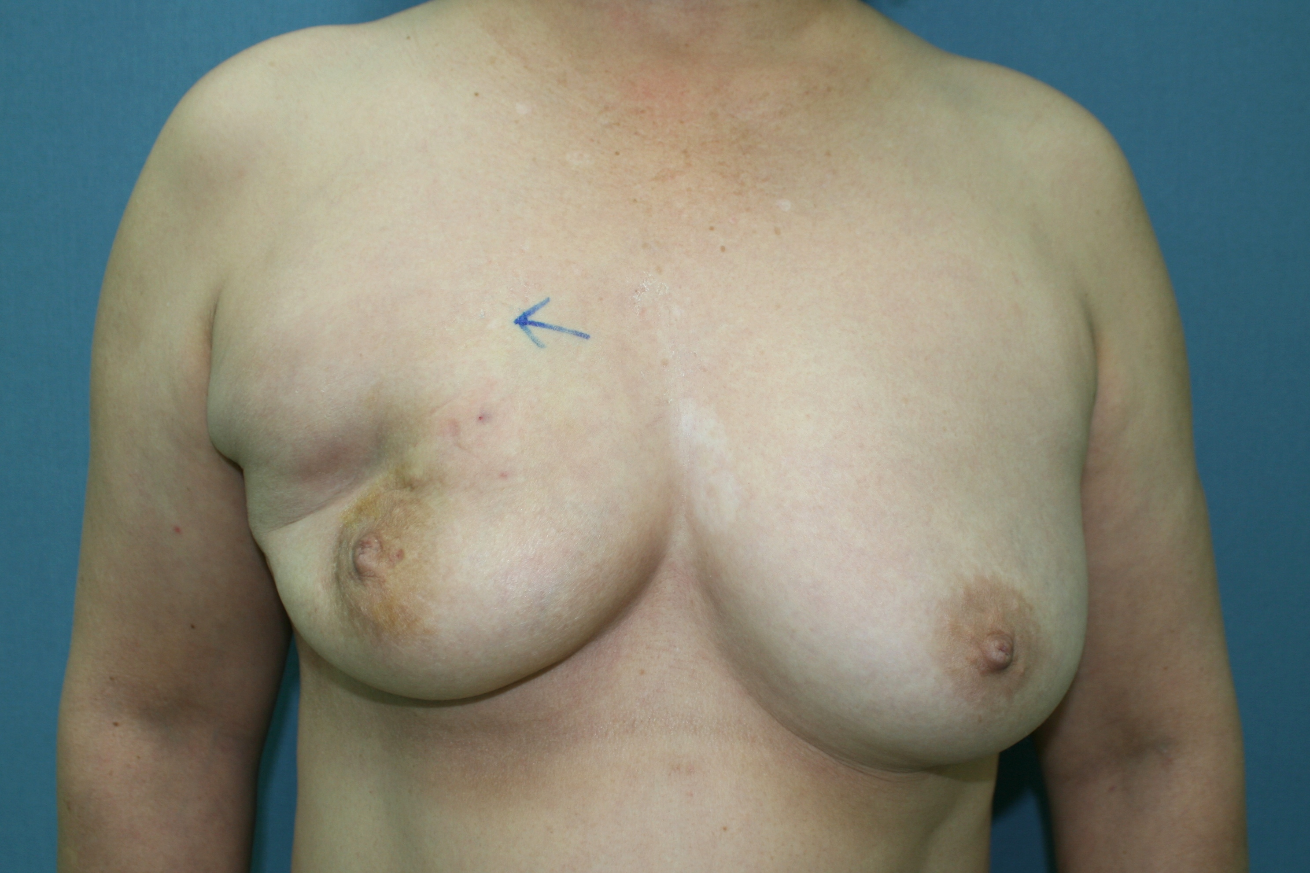
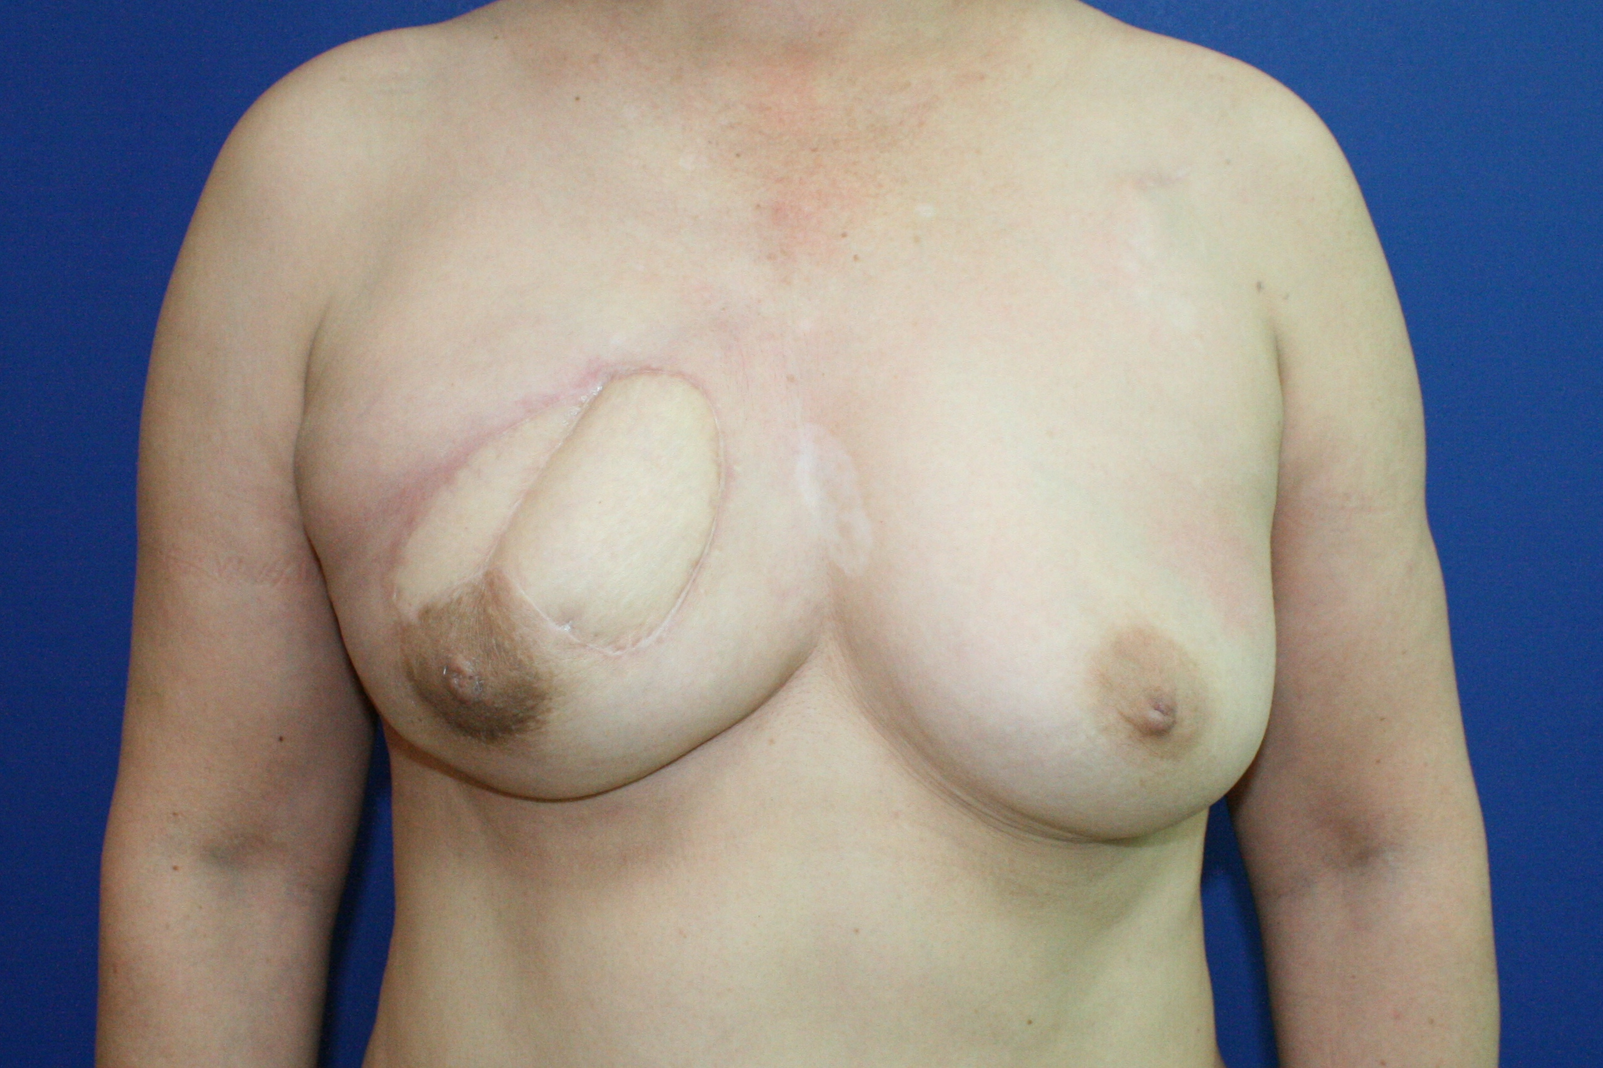
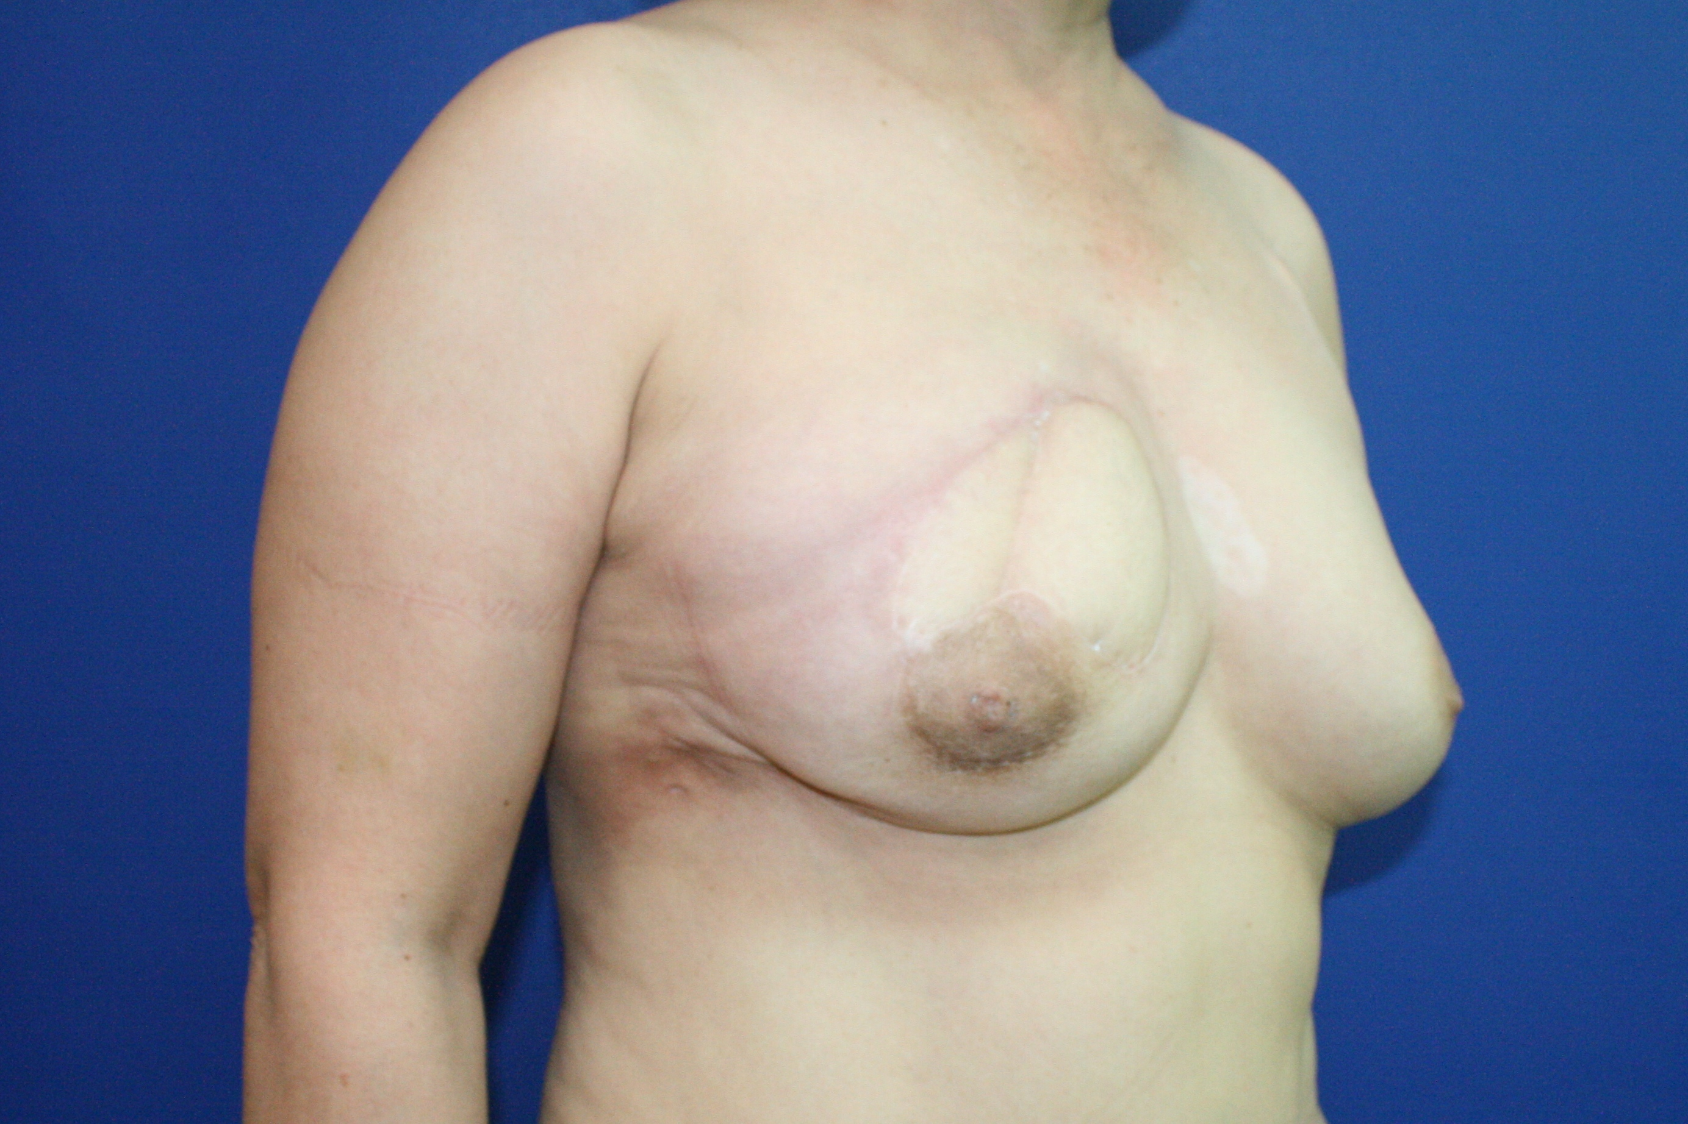
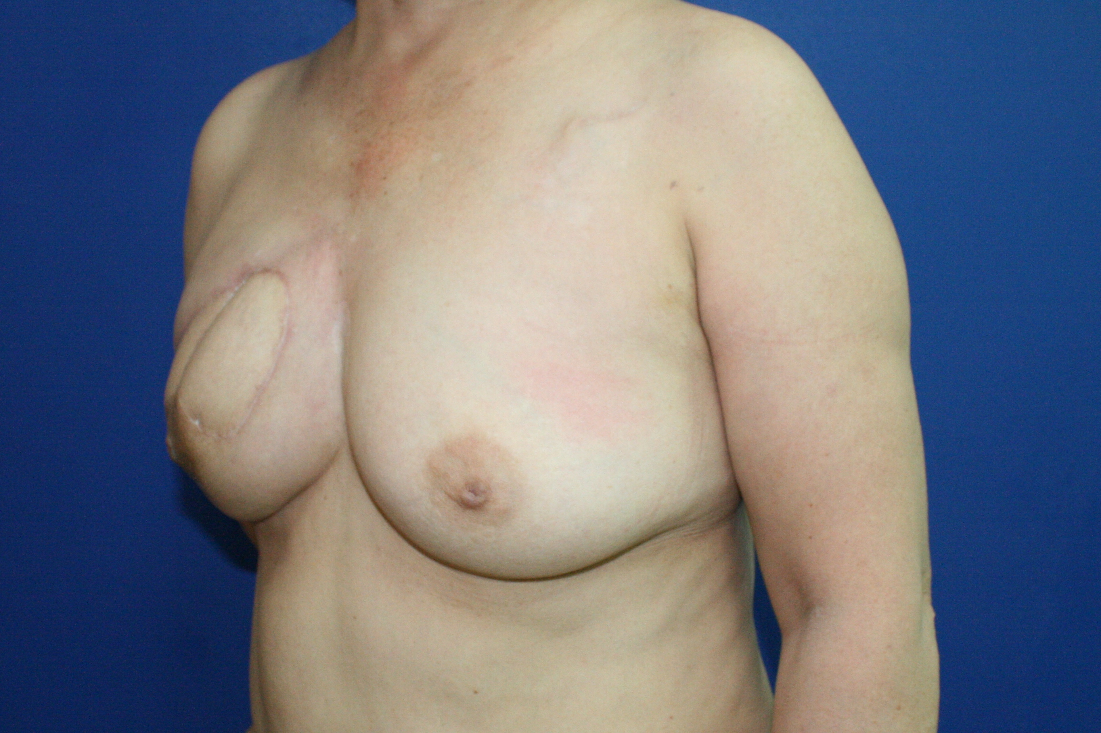
Case PRESENTATION DIEP
B
A 53 years old female with history of right breast DCIS, T2N0M0, status post partial mastectomy and radiotherapy on Sep, 2011. Fig.B shows local recurrence of right breast DCIS. The others show Nipple-sparing mastectomy with DIEP reconstruction can still have good cosmesis

Slide 10
Conclusion
According to our study, prior BCT did not contribute to higher surgical complications to patients who received nipple-sparing mastectomy and immediate reconstruction as salvage procedure after tumor local recurrence
Nipple-sparing mastectomy can be performed in highly selected patients after cancer recurrence
  Compatible surgical safety
  Oncological safety and
  Cosmesis

