Slide 1
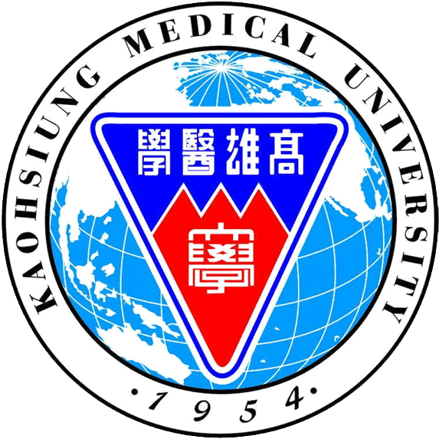
Autologous adipose-derived stem cells attenuates muscular atrophy and protects the spinal cord ventral horn motor neuron in an animal model of burn injury
Shu-Hung Huang; sheng-Hua wu
Sin-Daw Lin; Chung-Sheng Lai
Kaohsiung Medical University Hospital
Kaohsiung Medical University
TAIWAN

Slide 2
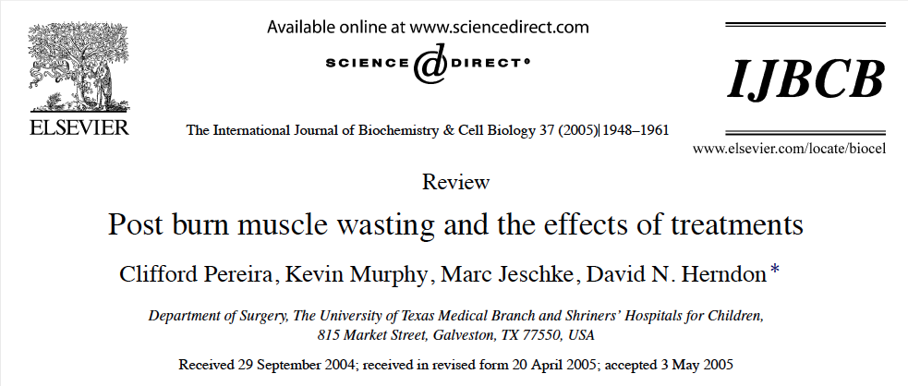
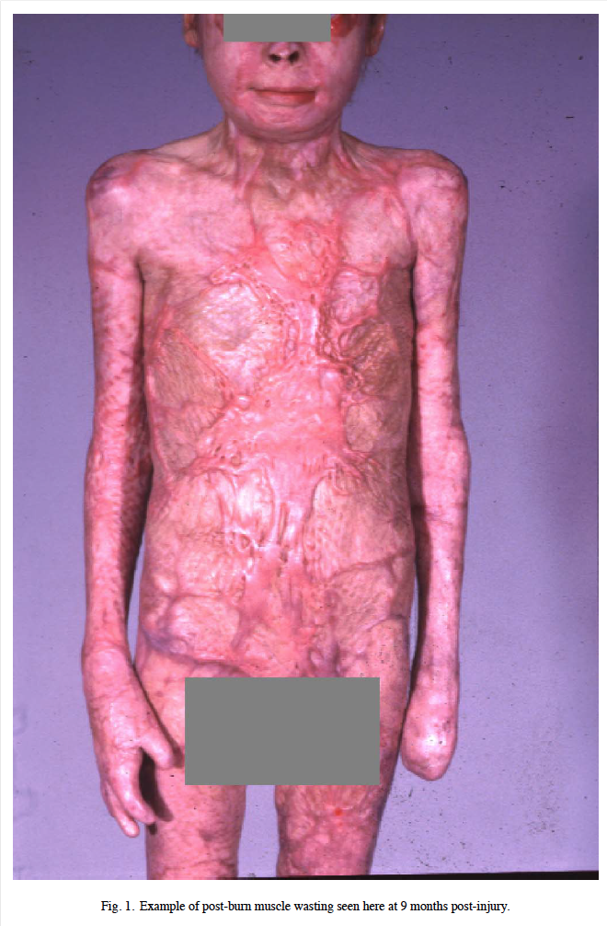
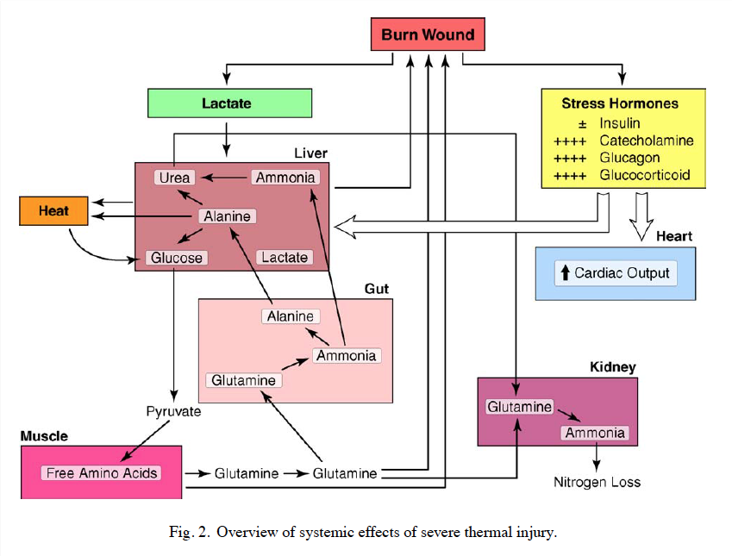

Slide 3
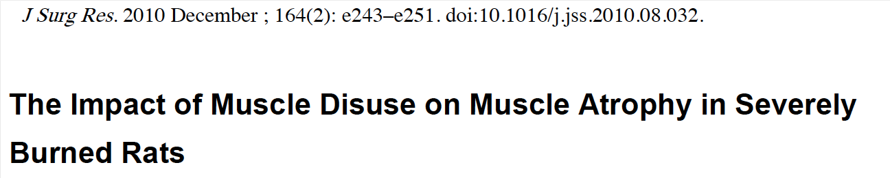
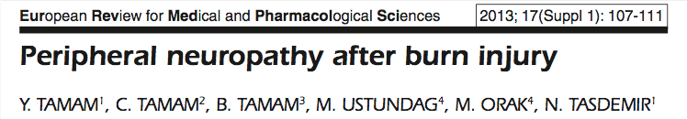
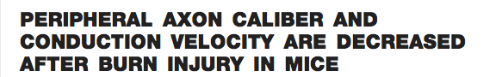

Slide 4
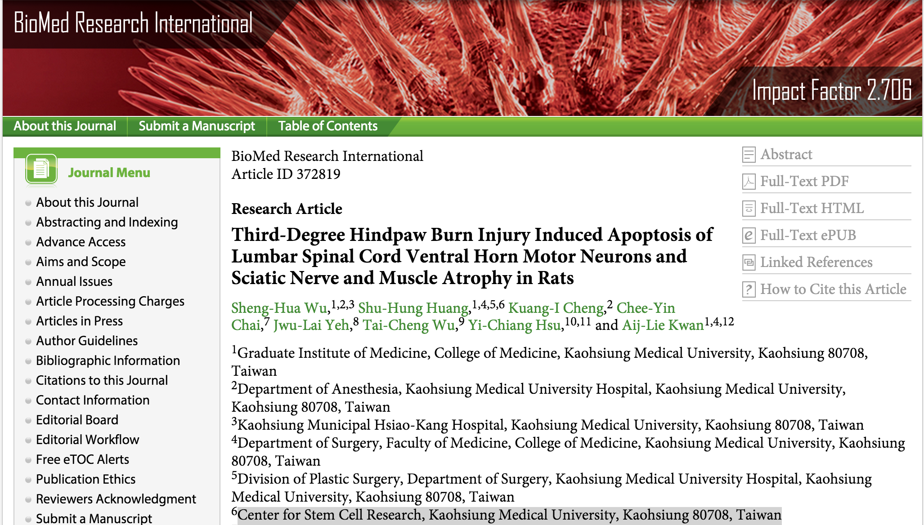

Slide 5
Effective of Autologous adipose-derived stem cells (ASCs)
great potential as therapeutic agents in stroke, autoimmune diseases and motor dysfunction. Mol Neurobiol 2014
produce neurotrophic factors, such as nerve growth factor, brain-derived neurotrophic factor and hepatocyte growth factor
Neuropathology 2002
Also responsible for nerve plasticity after nerve injury and for functional recovery through neuroprotection, cell fusion and neural differentiation Acta Neuro- biol Exp (Wars) 2013

Slide 6
Aim of this study
3rd degree burn injury induced spinal cord ventral horn motor neuron apoptosis cause muscle atrophy → Autologous adipose-derived stem cells can treat this?

Slide 7
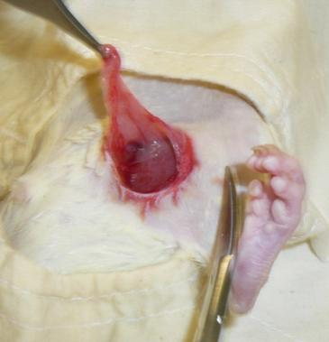
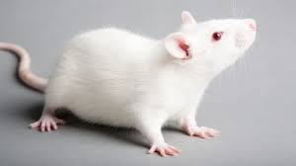


Slide 8
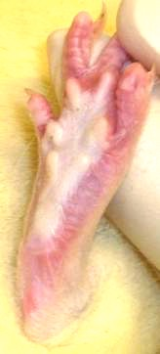
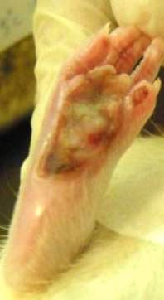
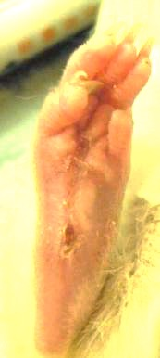
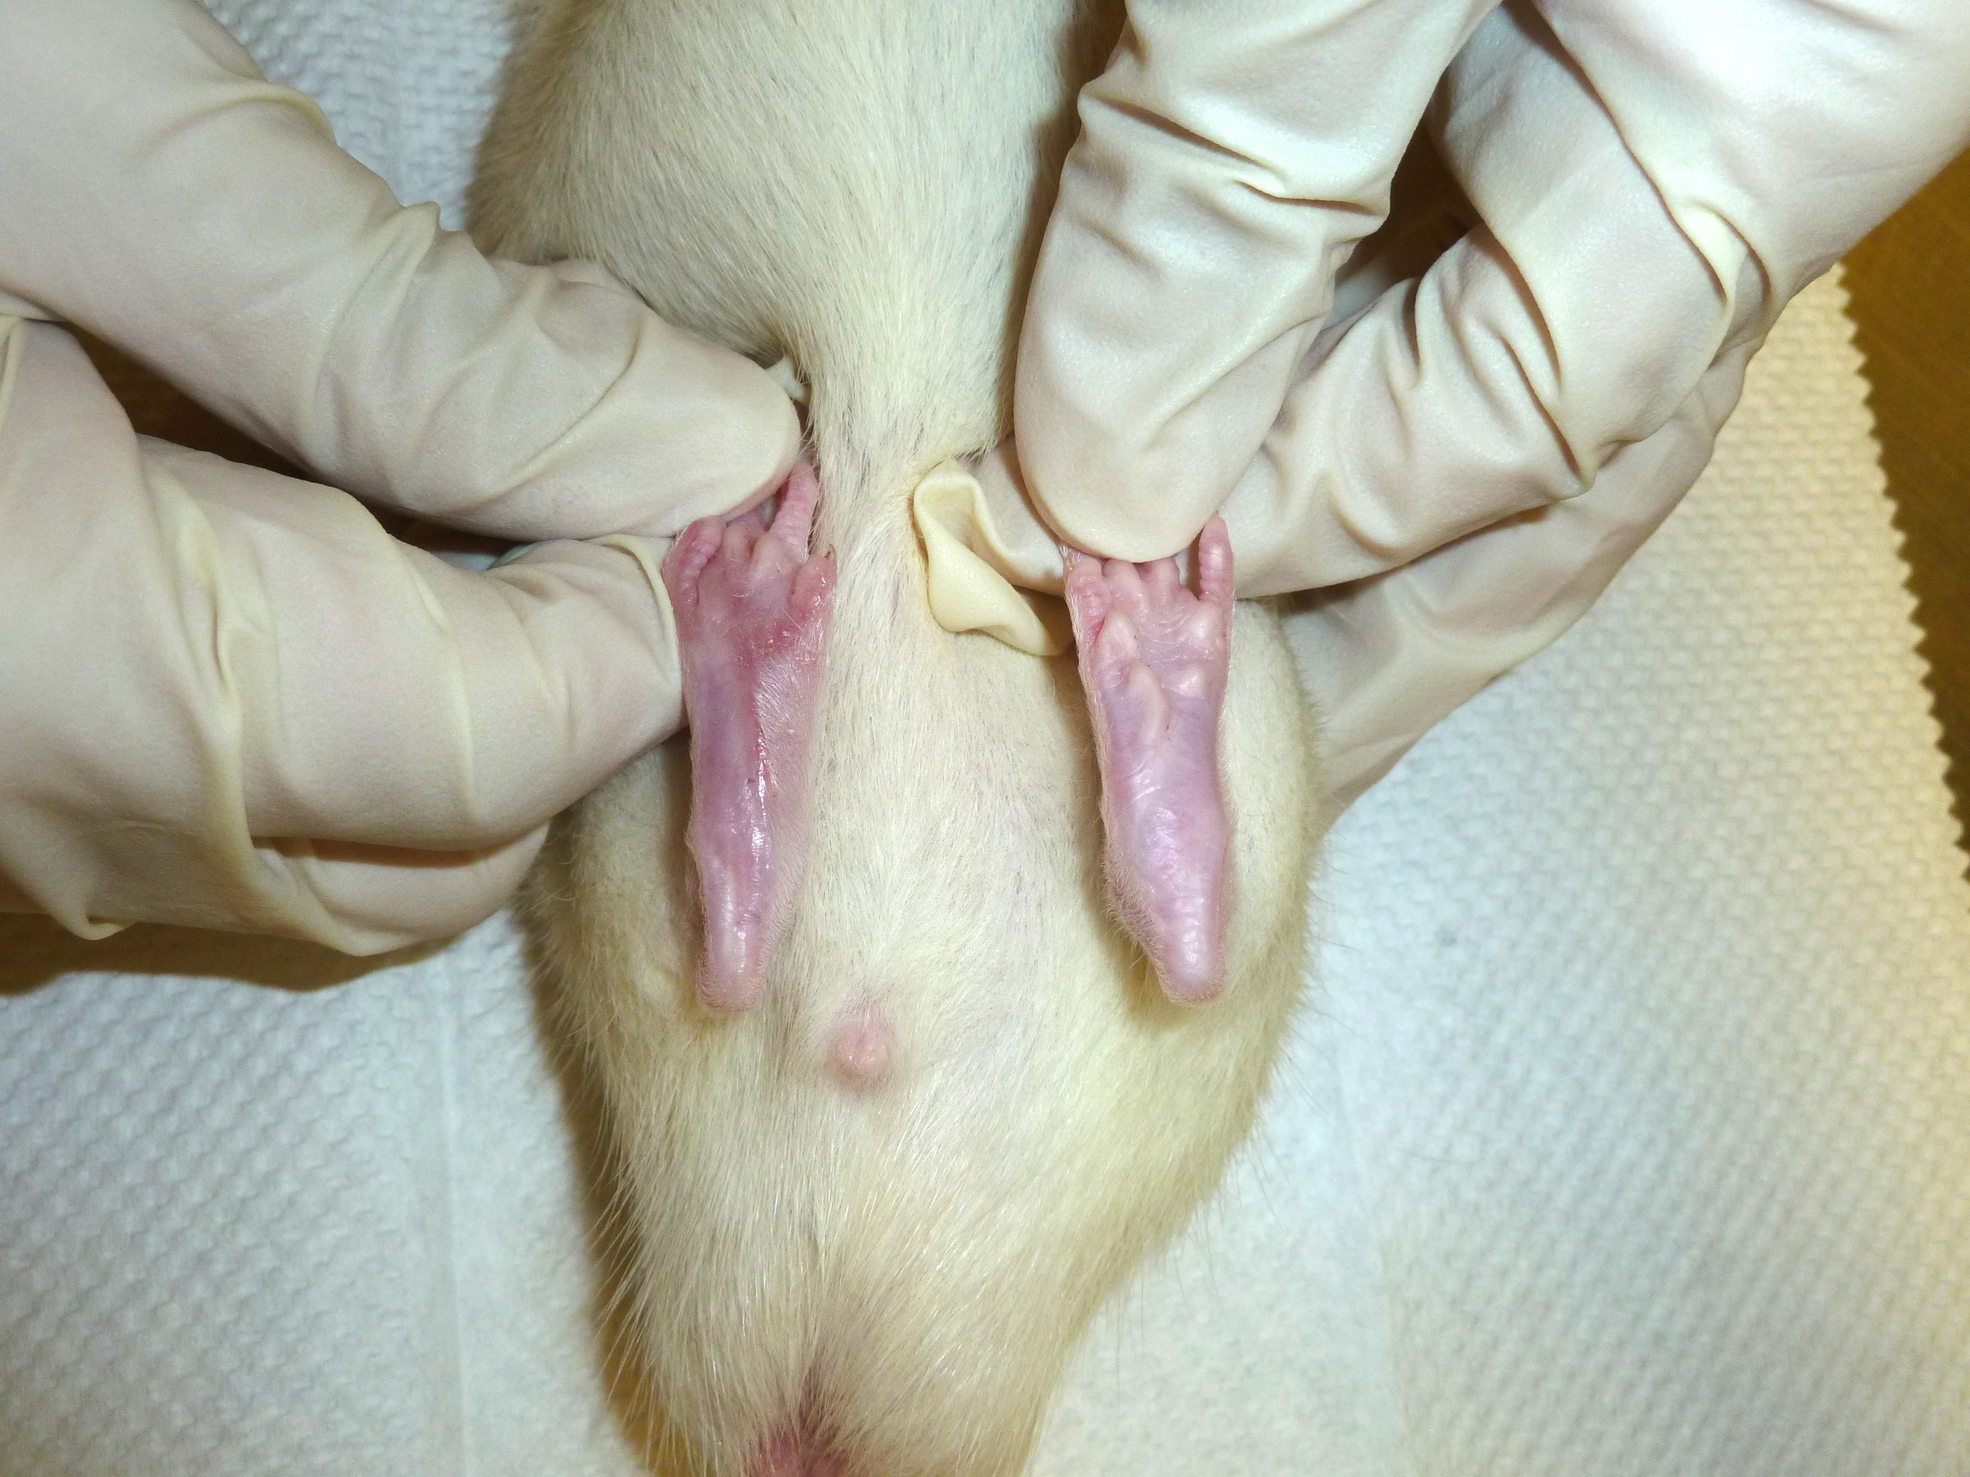
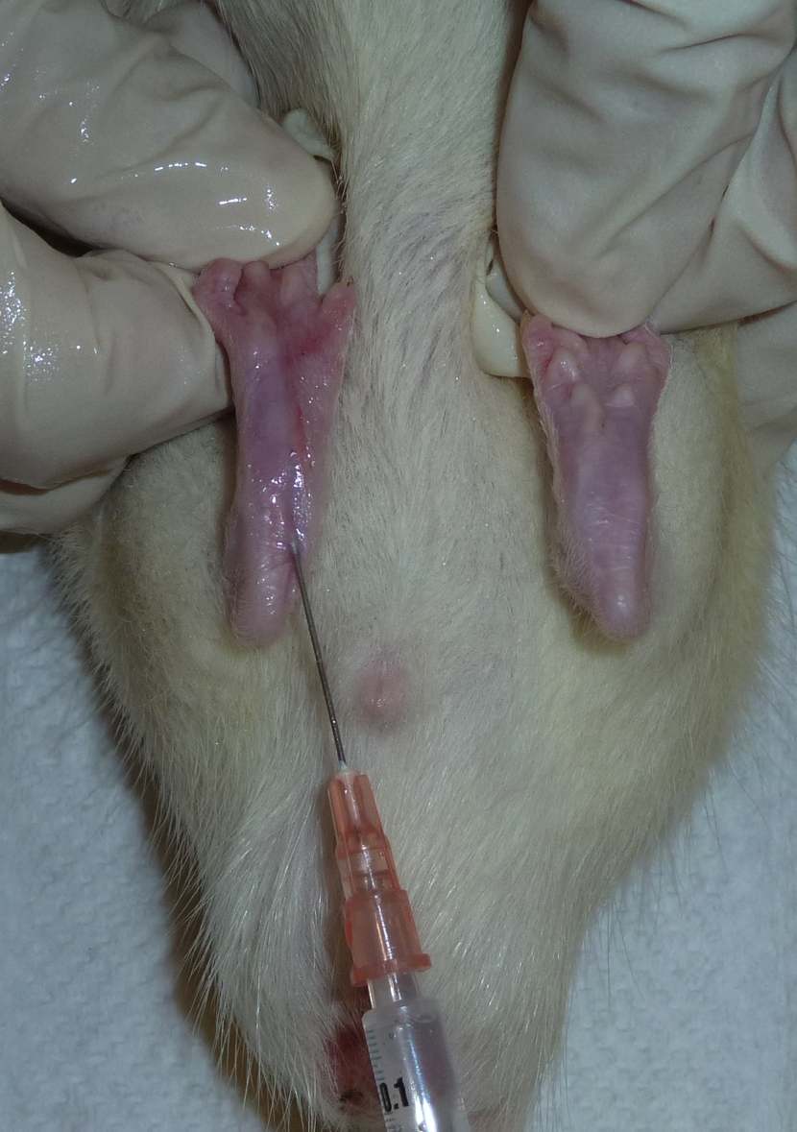
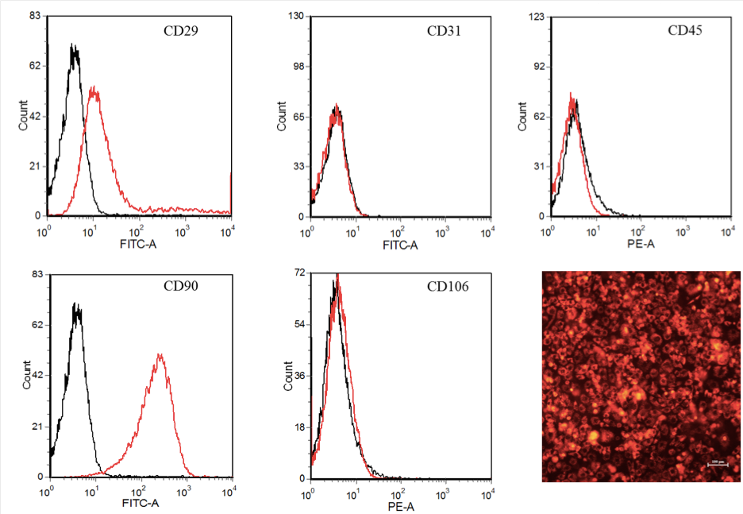
Day 0
Day 7
Day 14
Day 28

Slide 9
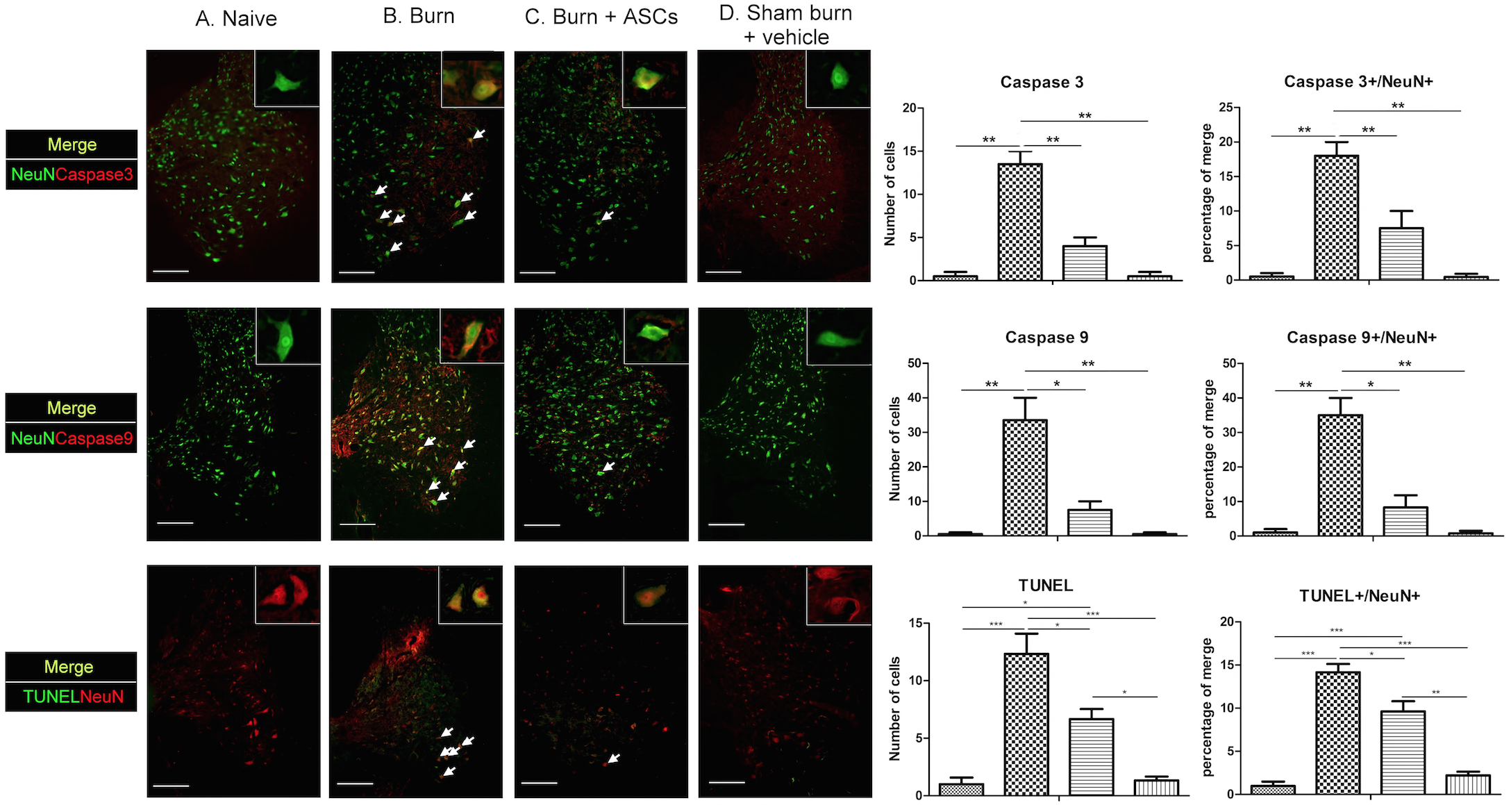
Burn injury induced apoptosis of spinal cord VHMNs
and local injection of ASCs ameliorated VHMNs apoptosis

Slide 10
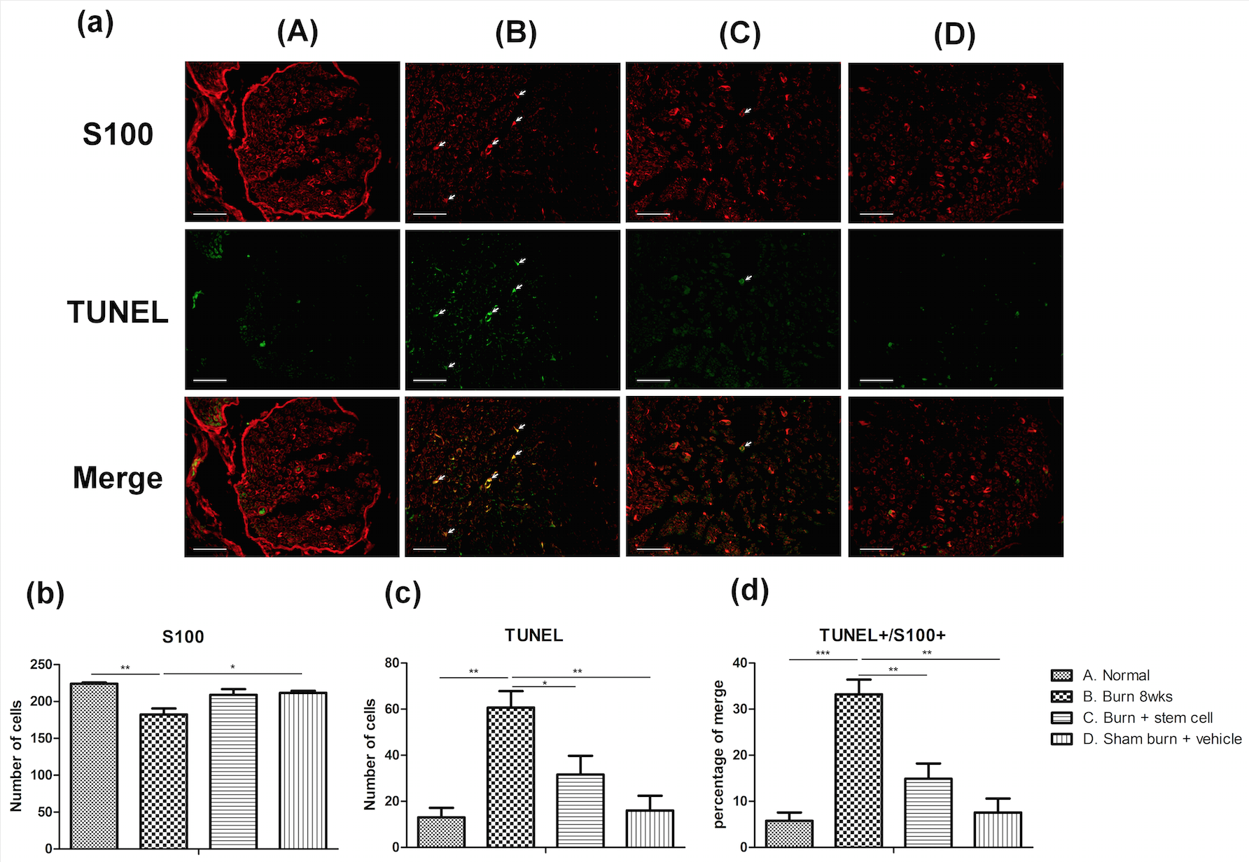
Burn injuries decreased the number of Schwann cells and induced apoptosis in the sciatic nerve and ASCs local injection ameliorated muscle fiber atrophy

Slide 11
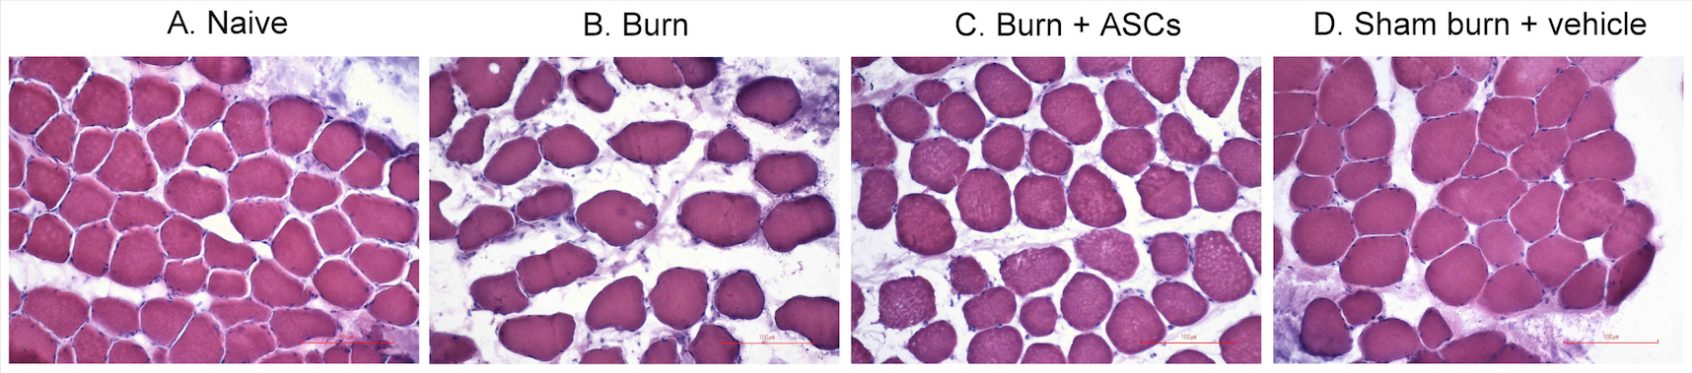
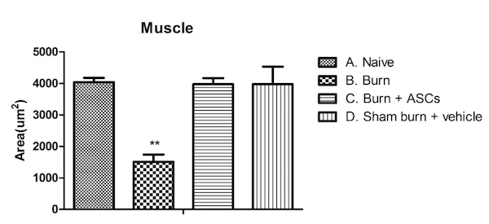
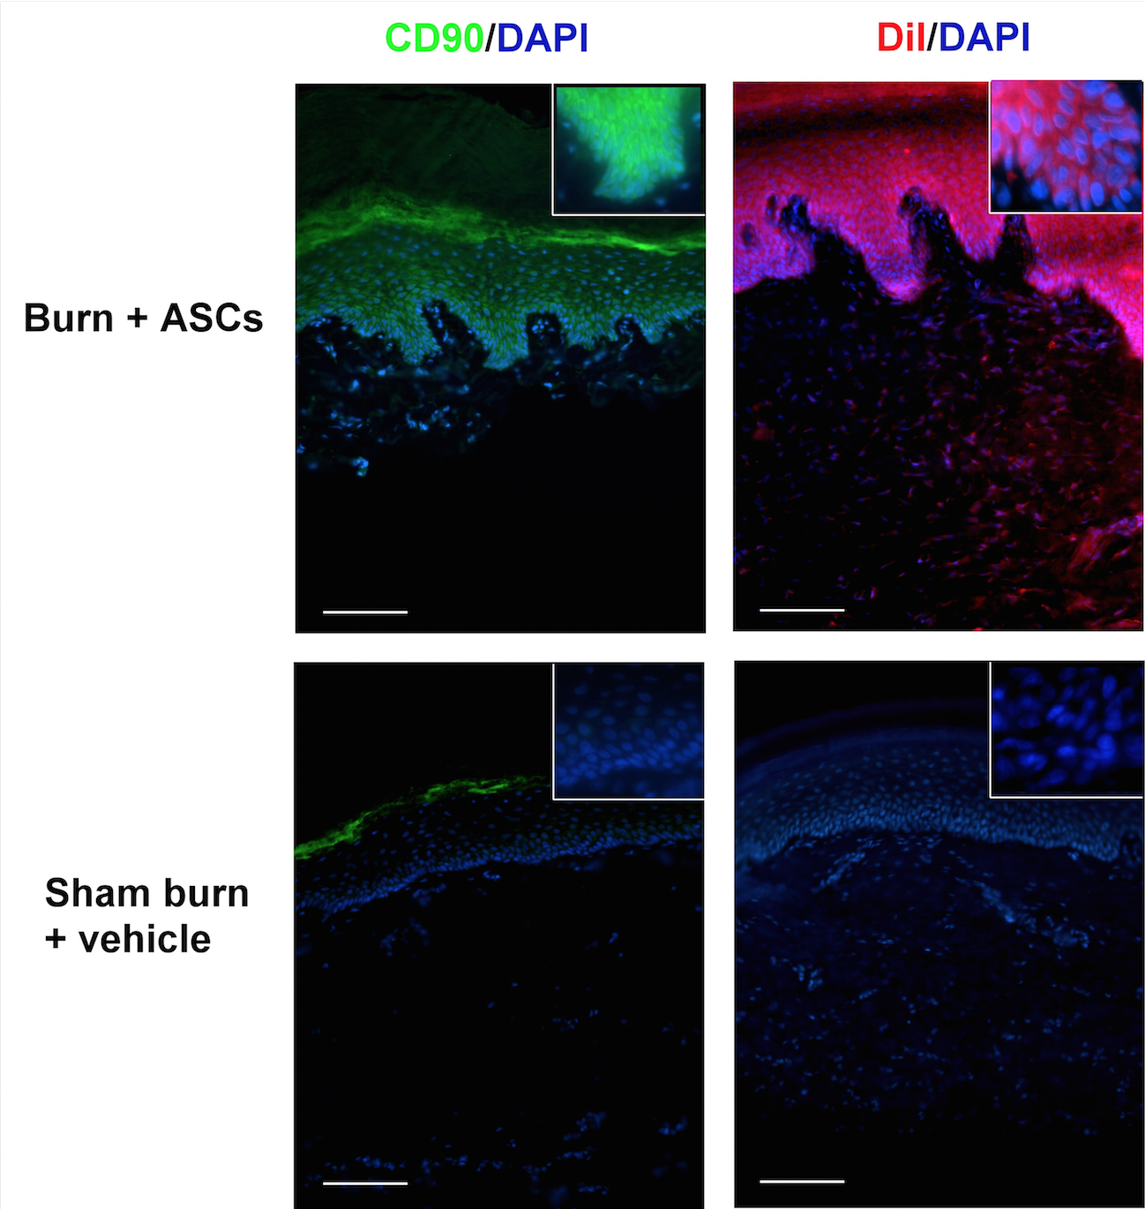
Burn injuries induced denervation atrophy of the gastrocnemius muscle fibers and ASCs local injection ameliorated muscle fiber atrophy
^{ASCs homing to hind-paw skin}

Slide 12
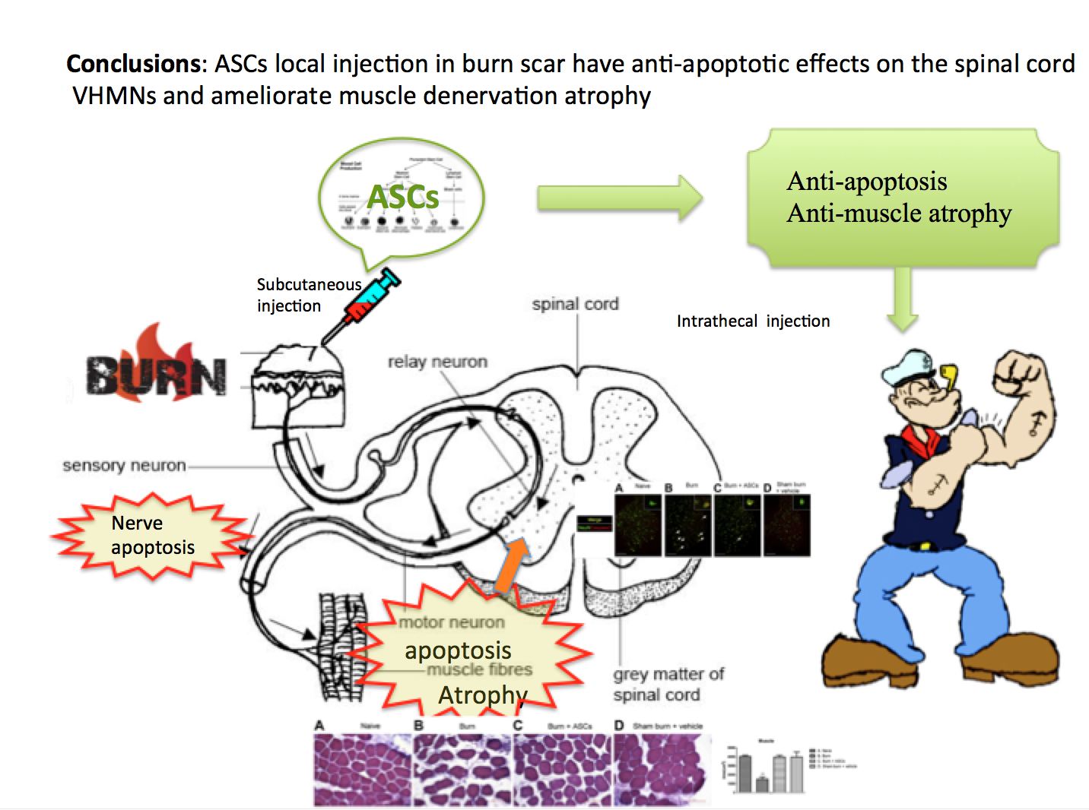

Slide 13
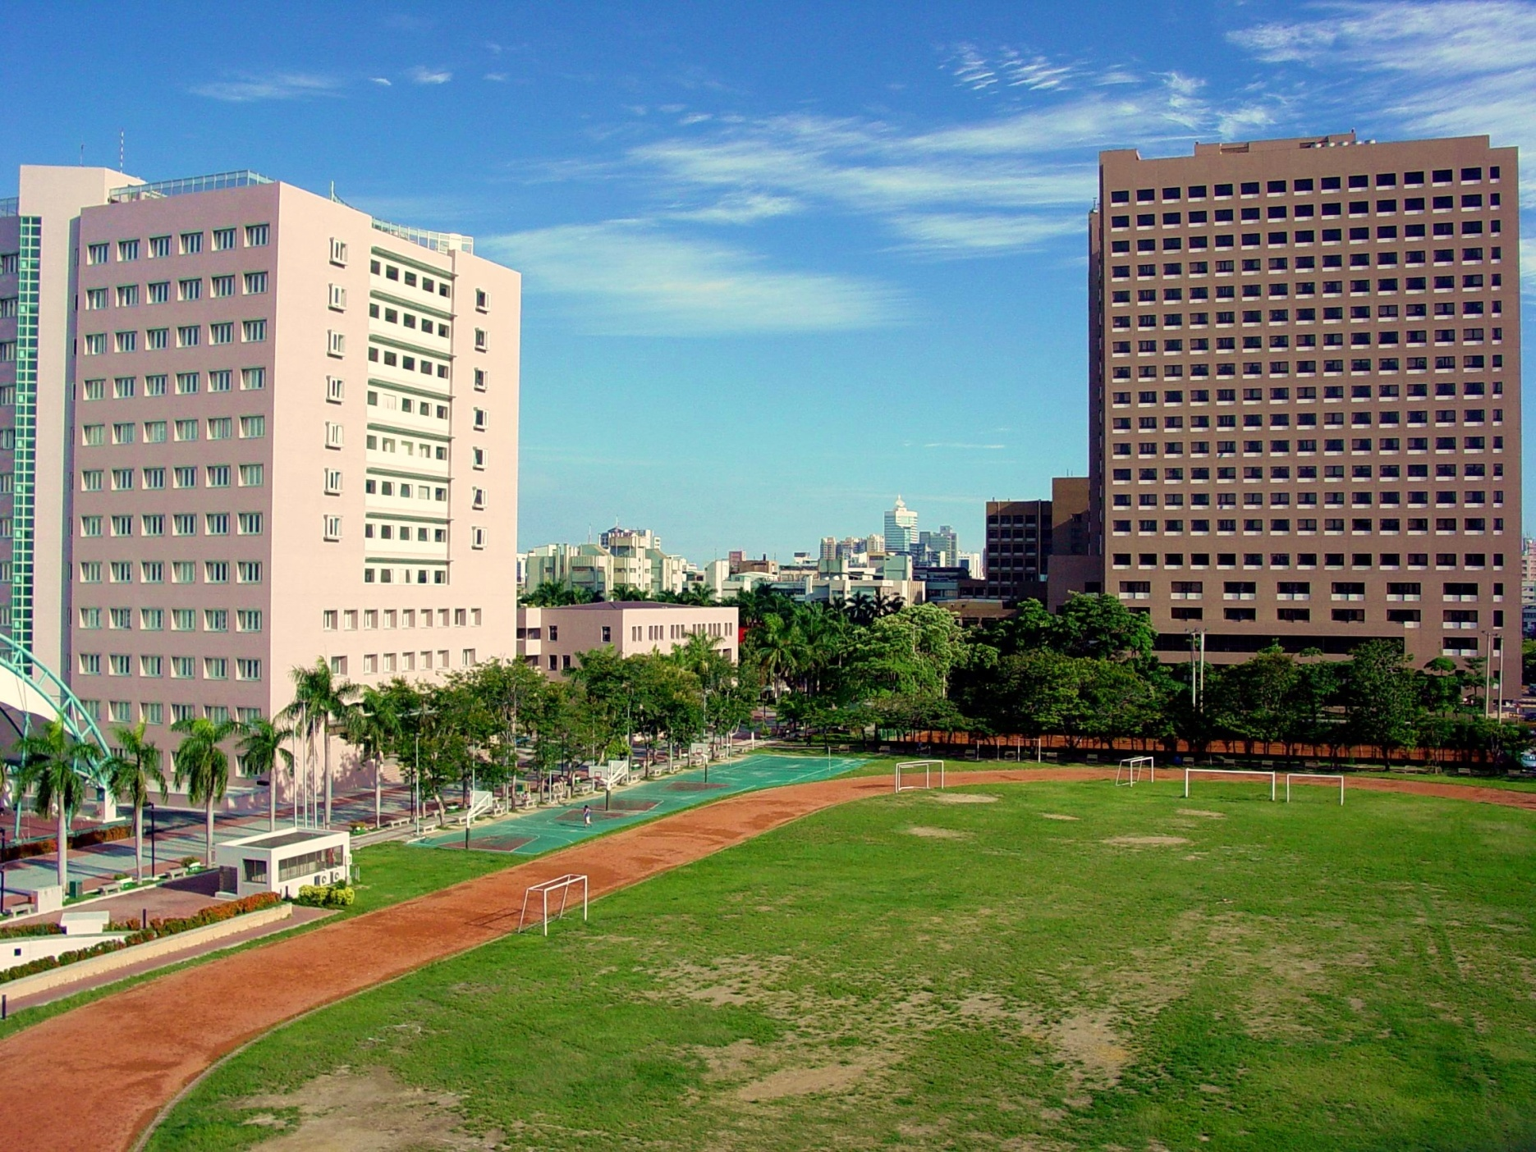
Thank you !
Acknowledgments
NSC /KMU/KMUH

