Slide 1

Aesthetic Evaluation of Facial Attractiveness in Children with Cleft Lip and Palate by Senior and Junior Health Professionals

Slide 2
Introduction
Cleft lip and palate can cause cognitive and psychological sequelae
Appearance of the nasolabial region is one of the most important area to evaluate the treatment
Difference exists between experienced professionals and society in general

Slide 3

So Far ~~~
Experienced
Professionals
Lay people
Plastic surgeons
Lay people
Orthodontists
Cleft patient himself
Psychologists
Cleft patient family
Others

Slide 4
There is no studies compare professionals experienced in the treatment of cleft lip and palate depending on the year of service

Slide 5




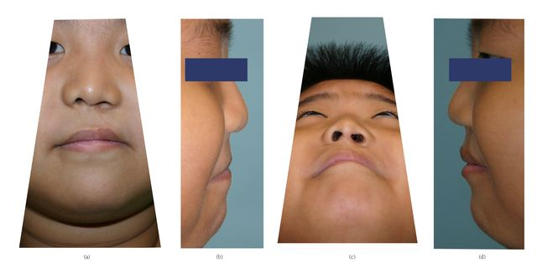


Material and Methods:
538 Standardized photographs
Plastic Surgeon x 4
Orthodontists x 2
Evaluated
(Patient with Cleft lip and palate )
Nurse x 4
Social worker x1 ; Speech therapist x 1

Slide 6
Standardized photographs
5-point scale based on the Asher-McDade method
(a) Front view. (b)Right lateral view. (c) Submental oblique view. (d) Left lateral view.

Slide 7
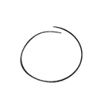

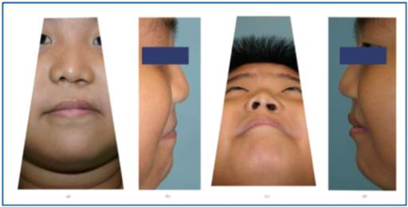
Evaluating ~~~
Lip
Bad Good
1 2 3 4 5
Nose
Bad Good
1 2 3 4 5
Nasolabial Region
Bad Good
1 2 3 4 5

Slide 8
Evaluator – Year of Service
Plastic surgeon
Speech Therapist
20
7
Nurse
20
Plastic surgeon
6
Nurse
Nurse
17
6
Orthodontists
10
Plastic surgeon
5
Plastic surgeon
Social worker
9
1
Orthodontists
Nurse
9
1
Senior group
Junior Group

Slide 9
Results - Interrater analysis
Regions assessed | Experienced evaluators | Mean ± SD rating | Cronbach’s alpha coefficient
Lip | 1 | 4.23 ± 0.59 | 0.62
 | 2 | 4.59 ± 0.48
 | 3 | 4.24 ± 0.68
 | 4 | 3.05 ± 0.32
 | 5 | 3.39 ± 0.39
 | 6 | 4.65 ± 0.45
Nose | 1 | 3.56 ± 0.64 | 0.65
 | 2 | 4.29 ± 0.49
 | 3 | 4.18 ± 0.67
 | 4 | 3.02 ± 0,41
 | 5 | 3.37 ± 0.38
 | 6 | 4.31 ± 0.43
NLR | 1 | 3.82 ± 0.56 | 0.67
 | 2 | 4.40 ± 0.47
 | 3 | 3.81 ± 0,62
 | 4 | 3.07 ± 0,28
 | 5 | 3.47 ± 0.39
 | 6 | 4.24 ± 0.39
* Cronbach's alpha 0.6 ≤ α < 0.7 ➔ “Acceptable” Internal consistency

Slide 10
Results - Interrater analysis
Regions assessed | Experienced evaluators | Mean ± SD rating | Cronbach’s alpha coefficient
Lip | 7 | 2.91 ± 0.70 | 0.66
 | 8 | 3.57 ± 0.60
 | 9 | 2.78 ± 0.49
 | 10 | 2.82 ± 0.43
 | 11 | 3.61 ± 0.48
 | 12 | 3.89 ± 0.75
Nose | 7 | 3.41 ± 0.54 | 0.7
 | 8 | 2.98 ± 0.62
 | 9 | 2.69 ± 0.68
 | 10 | 3.06 ± 0.33
 | 11 | 3.44 ± 0.56
 | 12 | 3.62 ± 0.57
NLR | 7 | 3.13 ± 0.40 | 0.65
 | 8 | 3.34 ± 0.51
 | 9 | 2.62 ± 0.59
 | 10 | 3.03 ± 0.14
 | 11 | 3.47 ± 0.50
 | 12 | 3.83 ± 0.45
* Cronbach's alpha 0.6 ≤ α < 0.7 ➔ “Acceptable” Internal consistency

Slide 11

Results - the differences between 2 groups
Variable pairs |  | Lip (Senior) | Lip (Junior) | Nose (Senior) | Nose (Junior) | NLR (Senior) | NLR (Junior)
Number |  | 538 | 538 | 538 | 538 | 538 | 538
mean rating |  | 4.03 | 3.26 | 3.79 | 3.19 | 3.8 | 3.24
SD |  | 0.26 | 0.36 | 0.29 | 0.36 | 0.24 | 0.27
minimum |  | 3 | 2.08 | 3.17 | 2.16 | 3.33 | 2.17
maximum |  | 4.667 | 4.25 | 4.5 | 4.17 | 4.5 | 4.08
P |  | P <0.001 |  | <0.001 |  | <0.001
Wilcoxon signed-rank post hoc test

Slide 12

Results - the differences between 2 groups
Variable pairs |  | Lip (Senior) | Lip (Junior) | Nose (Senior) | Nose (Junior) | NLR (Senior) | NLR (Junior)
Number |  | 538 | 538 | 538 | 538 | 538 | 538
mean rating |  | 4.03 | 3.26 | 3.79 | 3.19 | 3.8 | 3.24
SD |  | 0.26 | 0.36 | 0.29 | 0.36 | 0.24 | 0.27
minimum |  | 3 | 2.08 | 3.17 | 2.16 | 3.33 | 2.17
maximum |  | 4.667 | 4.25 | 4.5 | 4.17 | 4.5 | 4.08
P |  | <0.001 |  | P <0.001 |  | <0.001
Wilcoxon signed-rank post hoc test

Slide 13
Results - the differences between 2 groups
Variable pairs |  | Lip (Senior) | Lip (Junior) | Nose (Senior) | Nose (Junior) | NLR (Senior) | NLR (Junior)
Number |  | 538 | 538 | 538 | 538 | 538 | 538
mean rating |  | 4.03 | 3.26 | 3.79 | 3.19 | 3.8 | 3.24
SD |  | 0.26 | 0.36 | 0.29 | 0.36 | 0.24 | 0.27
minimum |  | 3 | 2.08 | 3.17 | 2.16 | 3.33 | 2.17
maximum |  | 4.667 | 4.25 | 4.5 | 4.17 | 4.5 | 4.08
P |  | <0.001 |  | <0.001 |  | P <0.001
Wilcoxon signed-rank post hoc test

Slide 14


Discussion
In our study
Junior professionals
is more Critical than Senior professionals
More Critical

Slide 15
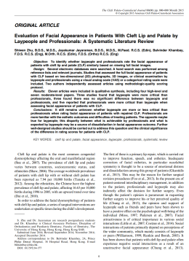
In The Literature
Evaluation of Facial Appearance in Patients With Cleft Lip and Palate by Laypeople and Professionals: A Systematic Literature Review
The Cleft Palate–Craniofacial Journal ,Month 2015
11 article
3 Studies : Laypeople were found to be more critical
3 Studies : No difference
5 Studies : Professionals were found to be more critical

Slide 16
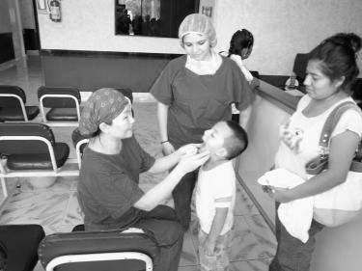
In our Study
4 professionals in Senior Group (4/6 ) have experience
of treating patients in other country ( 國際義診)

Slide 17
In our Study
4 professionals in Senior Group (4/6 ) have experience
of treating patients in other country ( 國際義診)
Only 1 professionals in Junior Group (1/6) have
experience of treating patients in other country(國際義診)

Slide 18
Conclusion
Senior professionals were more familiar with the esthetic outcomes and difficulties of treating patients with cleft lip and palate,
They rated less critically than Junior professionals

