Slide 1
Management and breast reconstruction for post-augmentation with “AMAZING GEL” (PAAG, Polyacrylamide Gel) deformity and herniation down to abdominal wall
Yi-Shin Lu, Yu-Hsien Lin, Hwang-Chi Lin,
Chu-Hsu Jeng, Cheng-Han Hsieh, Cha-Chun Chen
Department of Surgery, Division of plastic and reconstructive surgery
Shin Kong Wu Ho-Su memorial hospital, Taipei, Taiwan

Slide 2
The author have no commercial associations or financial disclosure
that might pose or create a conflict
of interest with information presented
in this article.
No funding was received for this work.

Slide 3
History
47-year-old female
shrinkage of R't breast with development of RUQ mass for 1 month.
bilateral breasts silicon injection(?) at China in 2002.
right breast swelling with pain with developed RUQ pain for 3 months.
==> admitted for surgical removal of the foreign body

Slide 4
2012/10/23-27
Laparoscope-assisted removal of preperitoneal prothesis and bilateral breast prothesis on 2012/10/24
2012/11/20-23
Removal of residual gel and granuloma at R’t breast and RUQ abdominal wall
2013/6/4-5
Bilateral breast deformity s/p Augmentation mammoplasty with cohesive gel

Slide 5
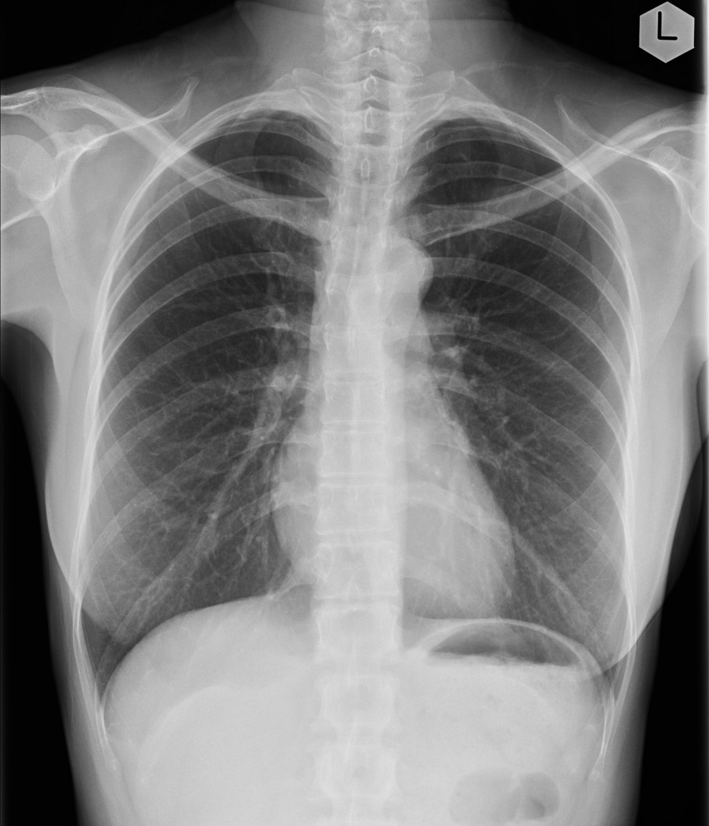
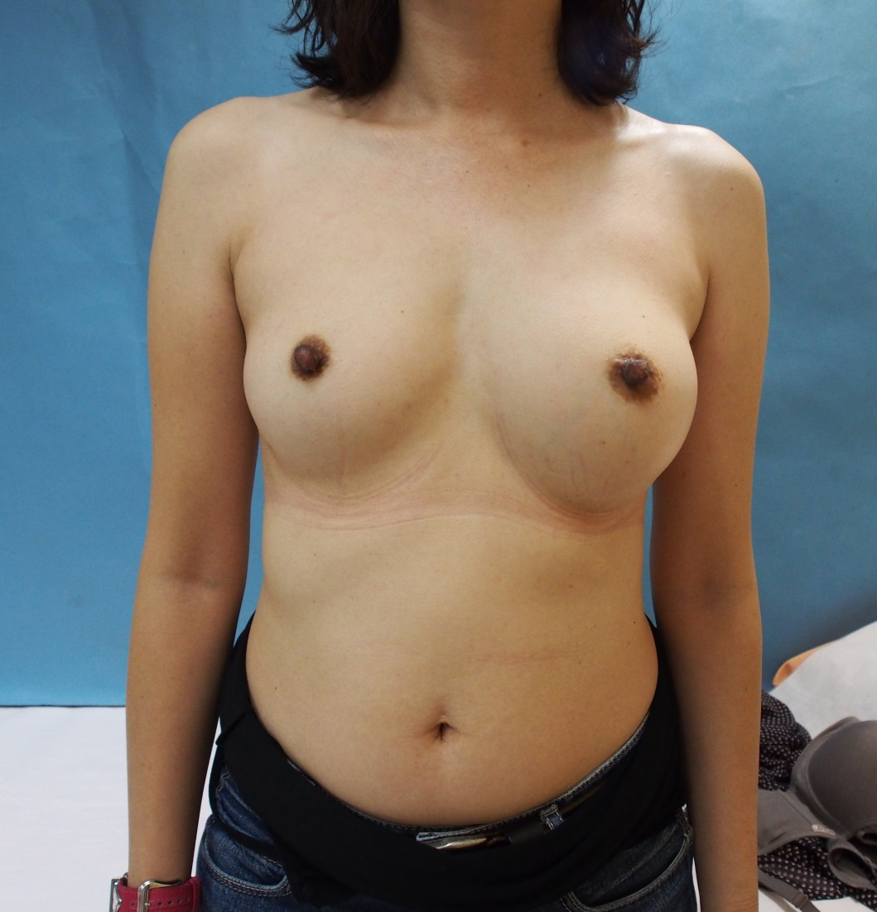

2012/10/22 photo

Slide 6
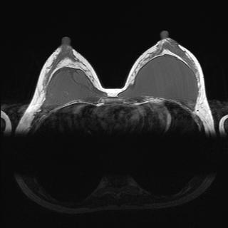
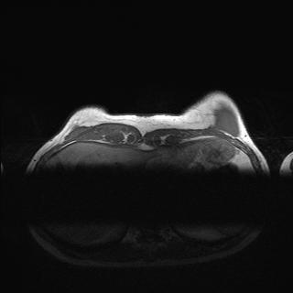
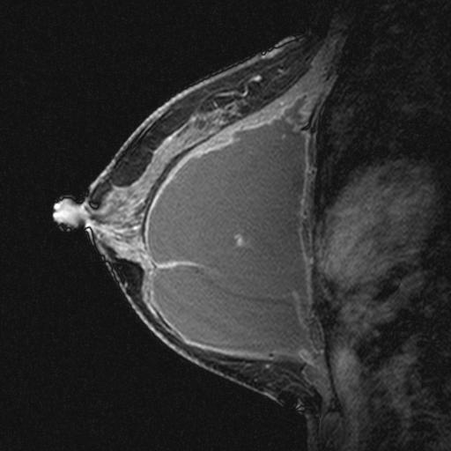
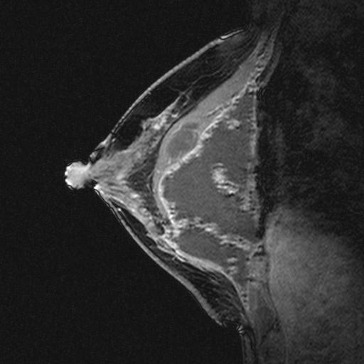
MRI
10/22

Slide 7
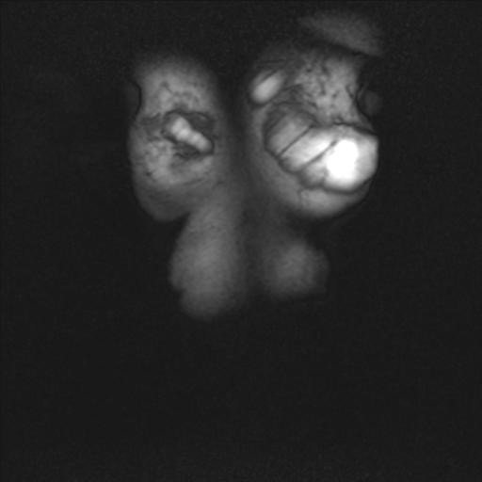
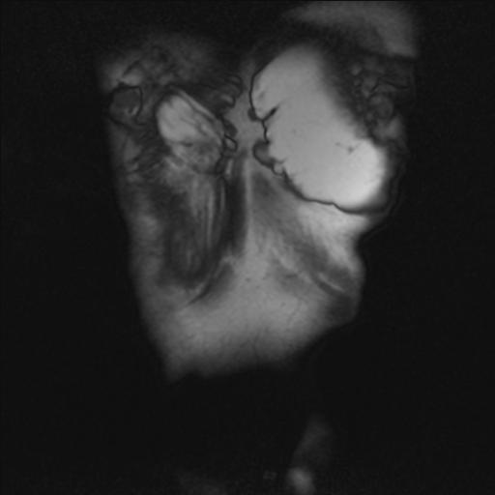
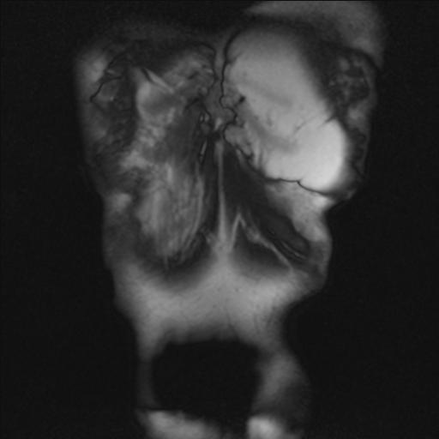
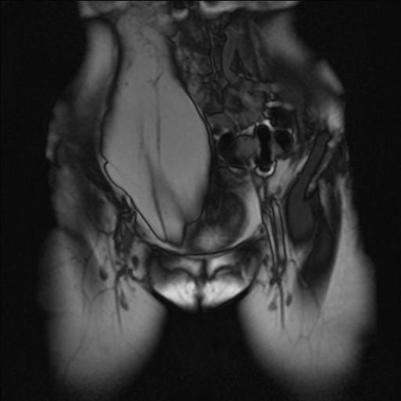
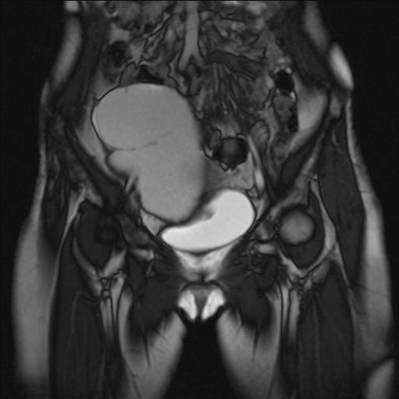
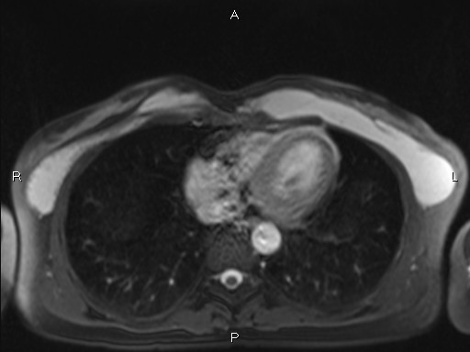
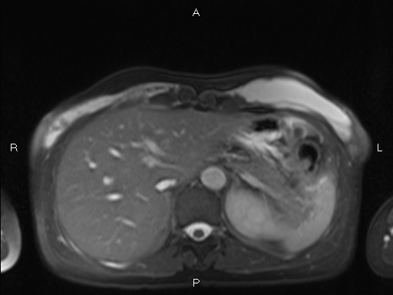
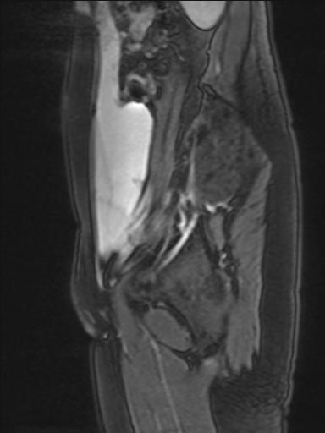
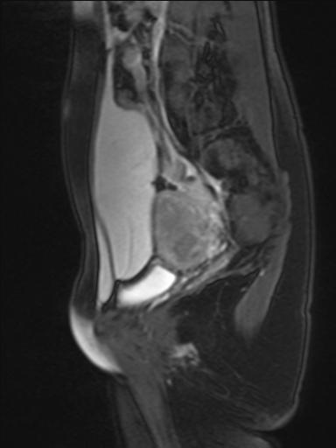
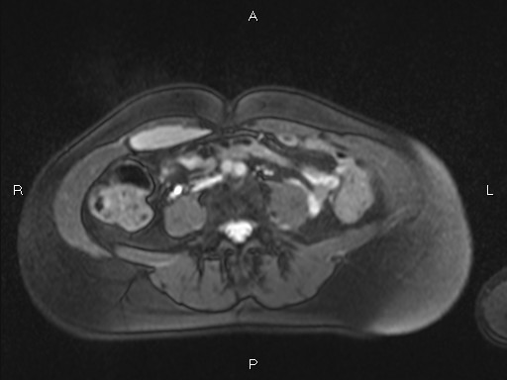
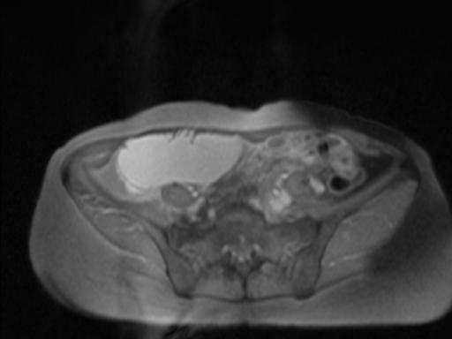
10/22

Slide 8
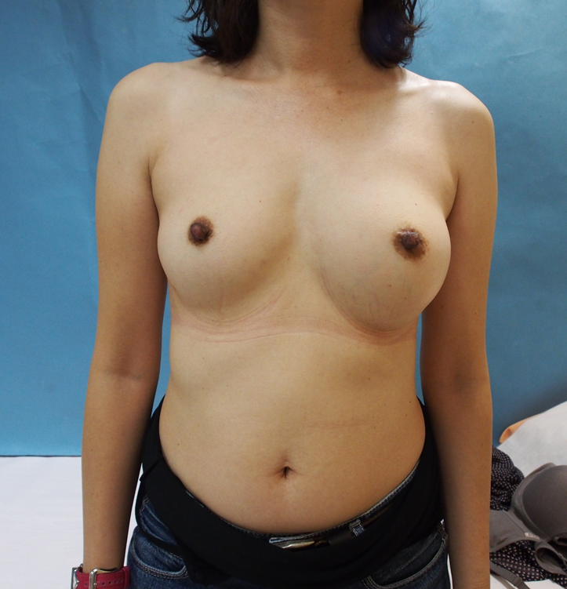
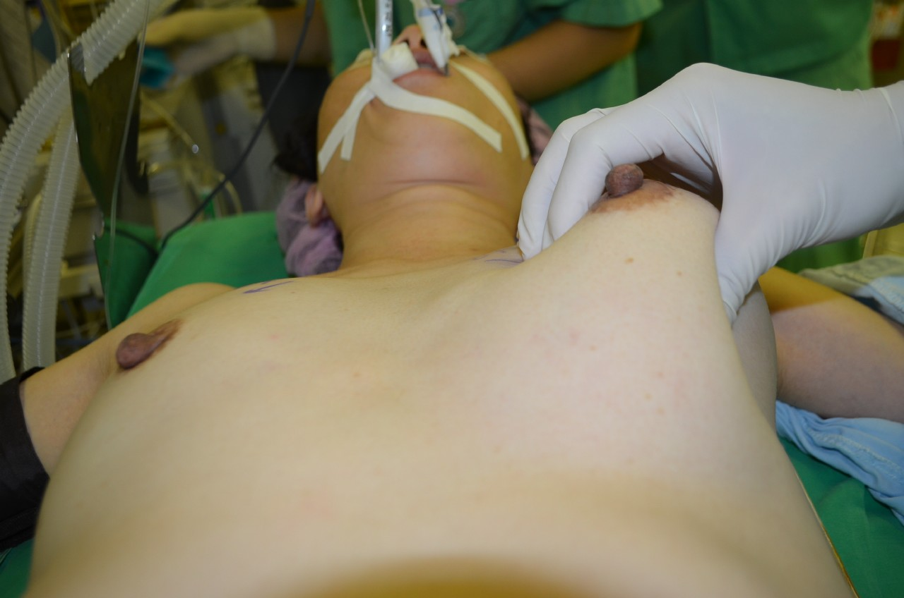
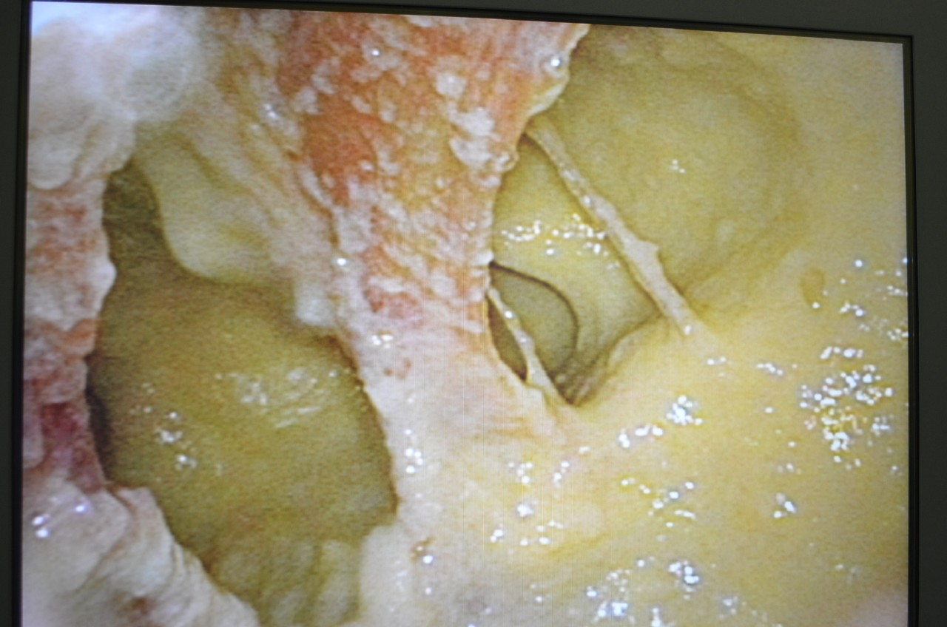
2012/10/24 op
PAAG

Slide 9
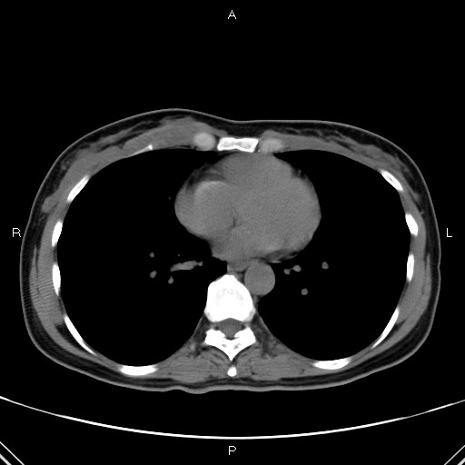
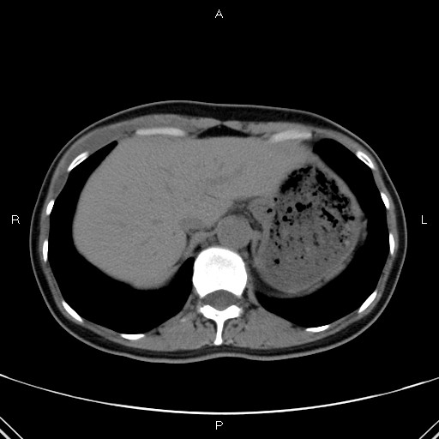
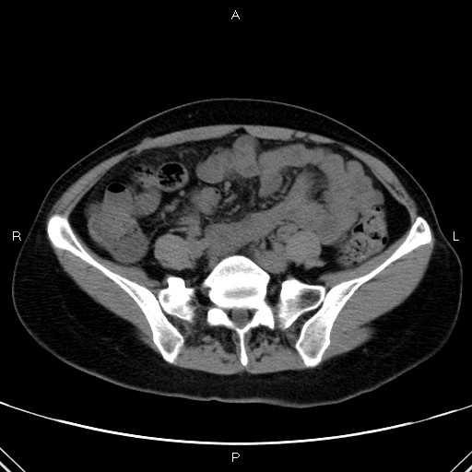
POD 32 F/U
11/20

Slide 10
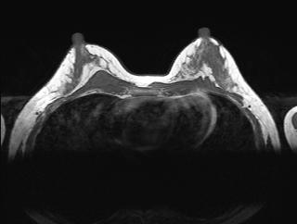
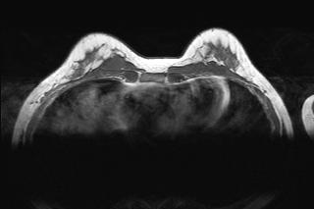
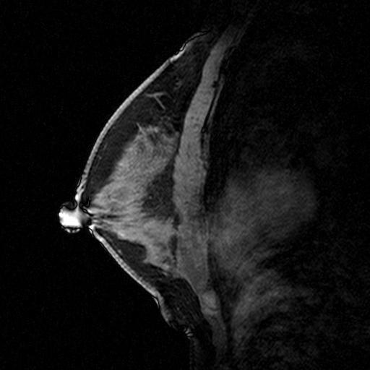
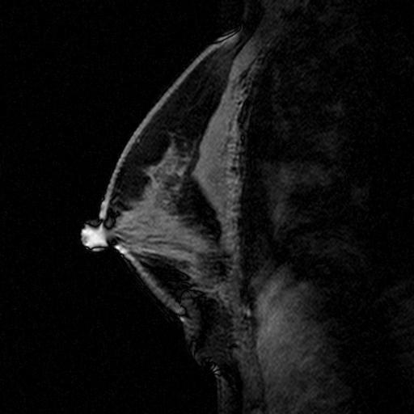
2013/5/28 F/U MRI

Slide 11
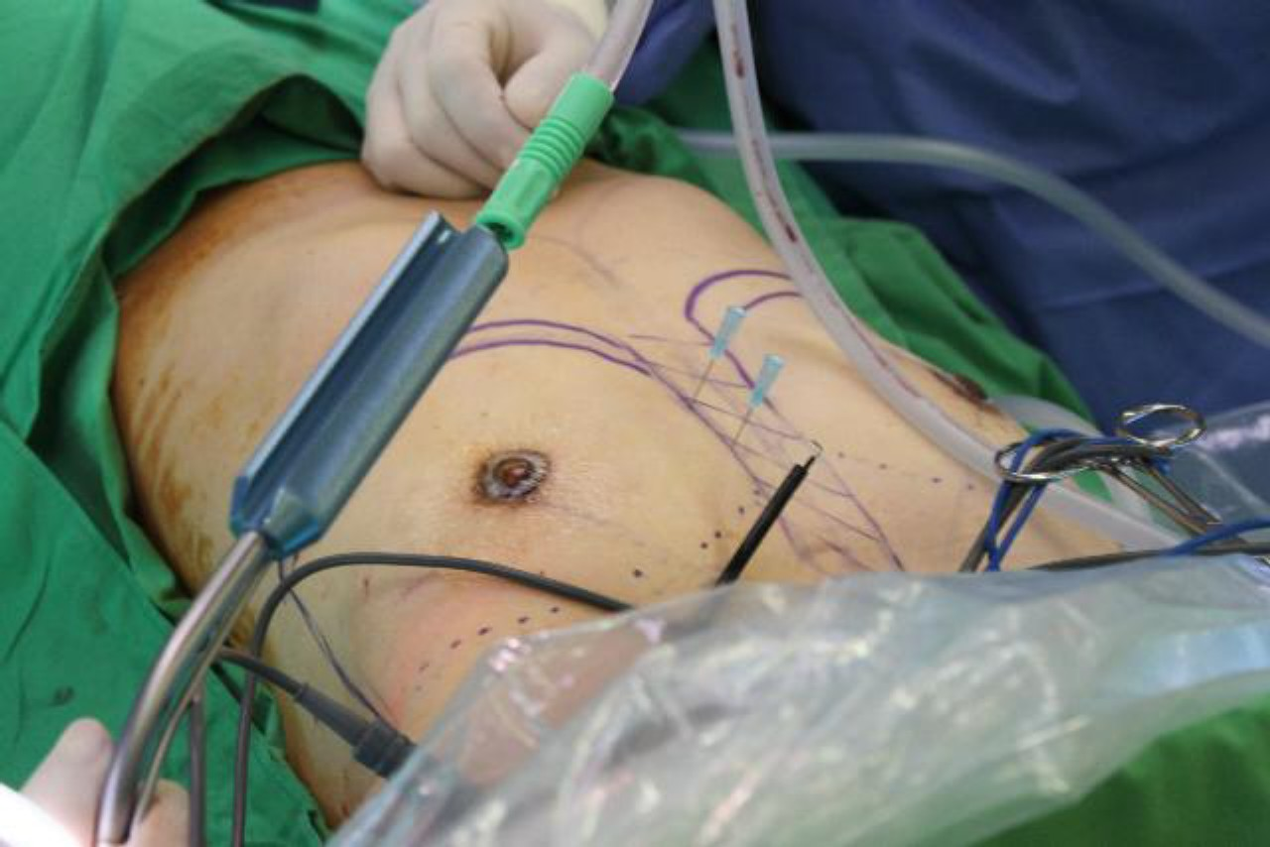
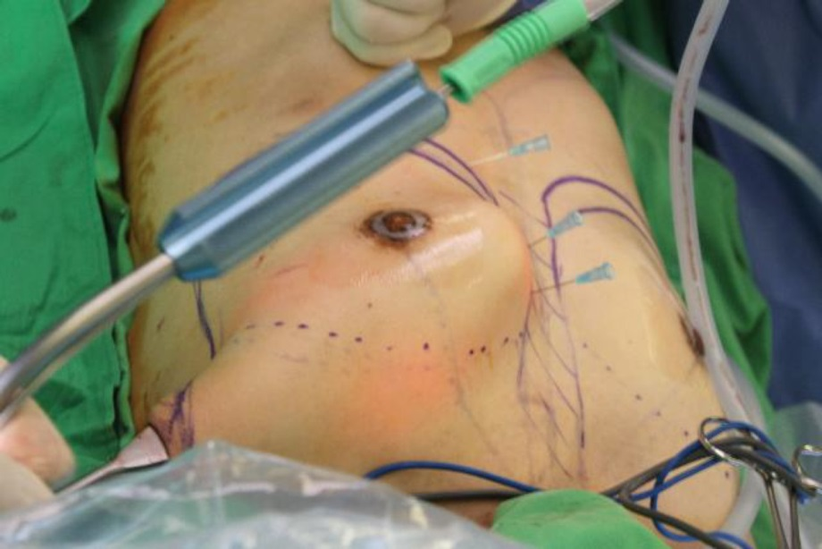
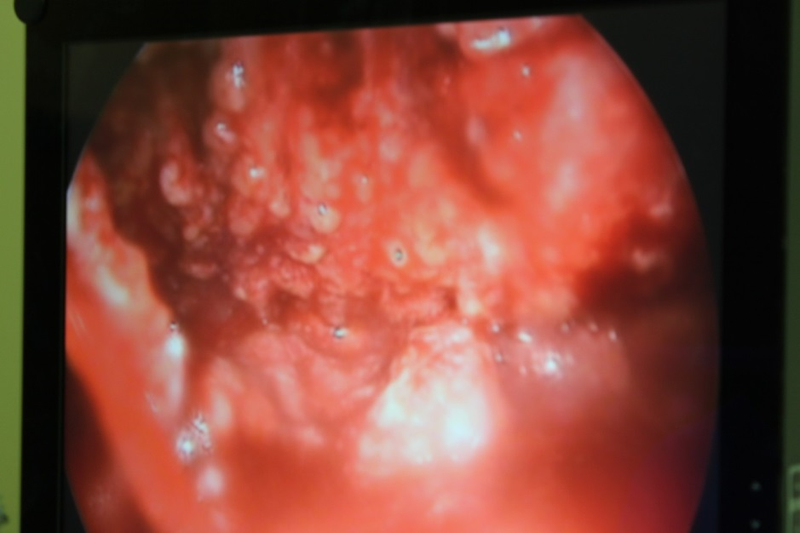
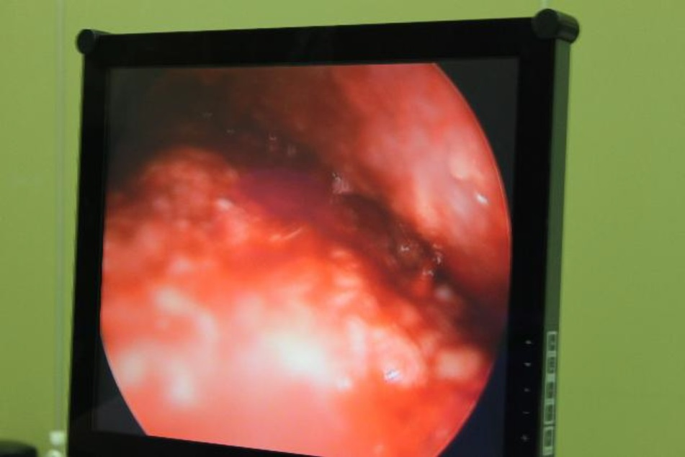
20130604 reconstruction with implant

Slide 12
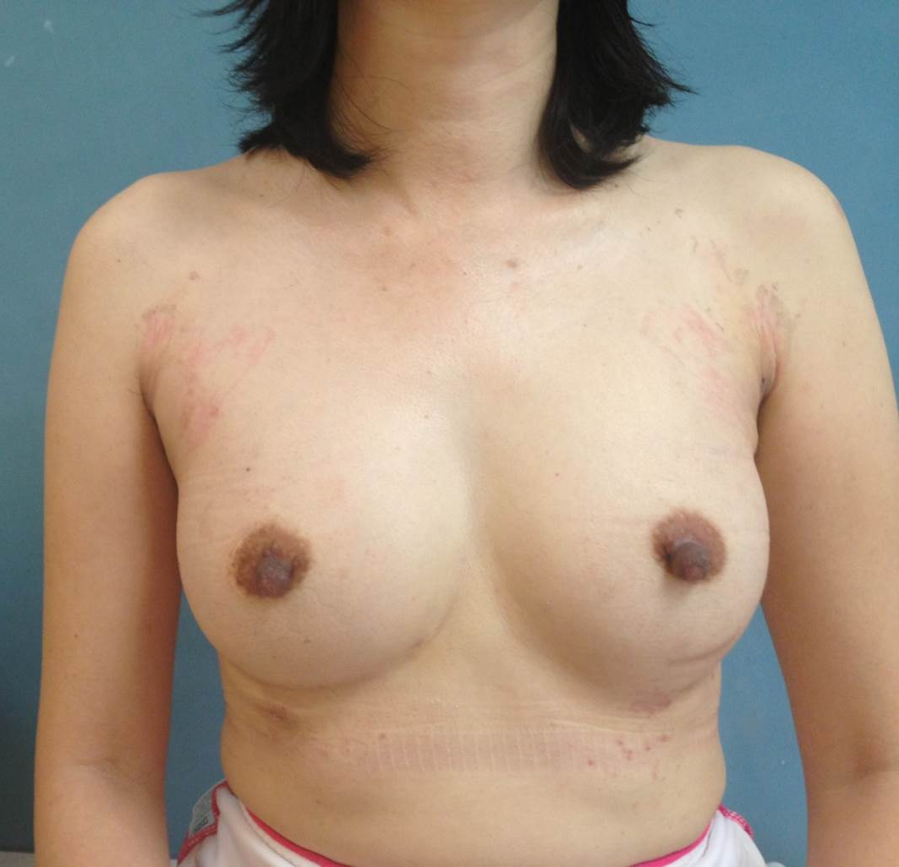
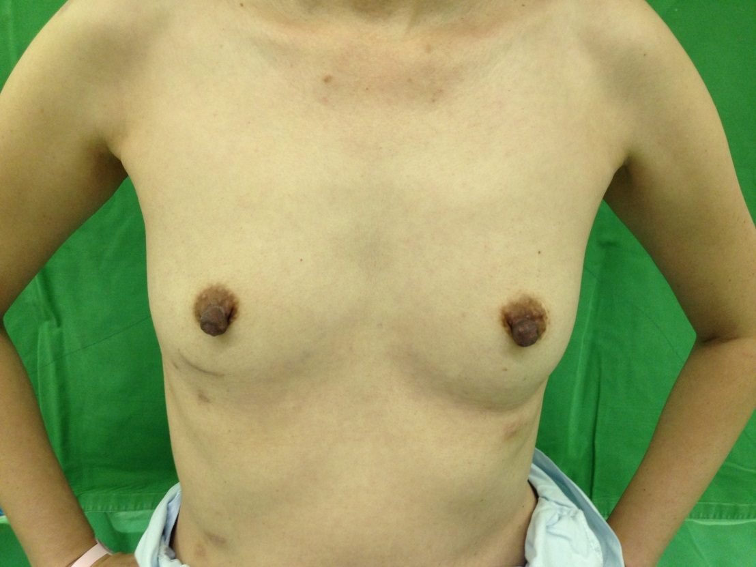
6/4
6/22

Slide 13
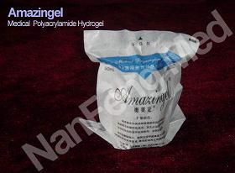
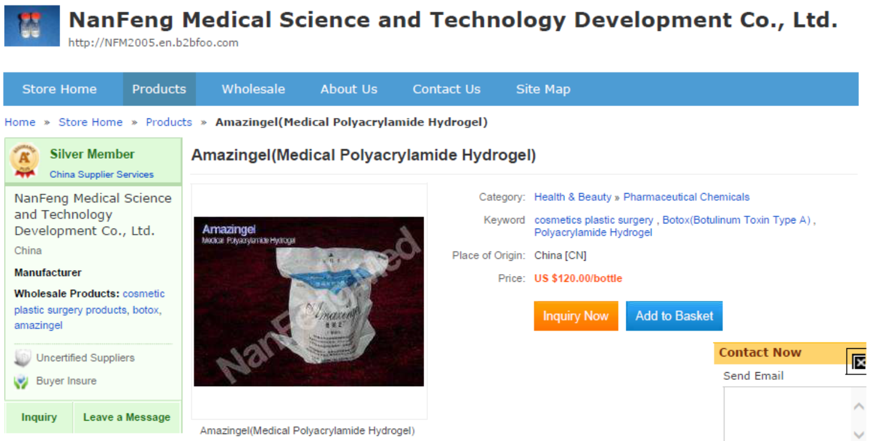
Discussion
PAAG is a transparent jelly-type material
consists of 2.5% cross-linked polyacrylamide
and 97.5% non-pyrogenic water.
PAAG is a nontoxic, non-allergenic synthetic biomaterial and is relatively safe for implants due to its hydrophilic and non-degradable characteristics.
PAAG was first introduced for aesthetic purposes in the Ukraine in the 1980s
In 1997, PAAG was approved by the Chinese FDA → China
Arch Plast Surg. 2012 May;39(3):267-269. English.

Slide 14
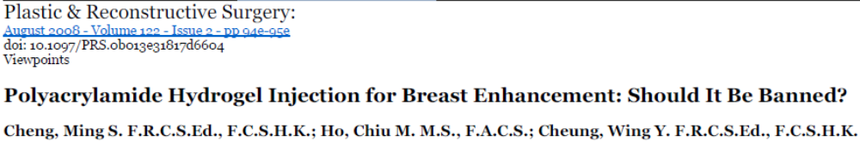
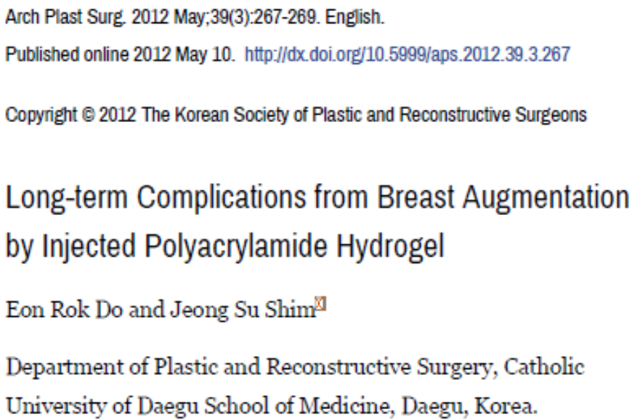
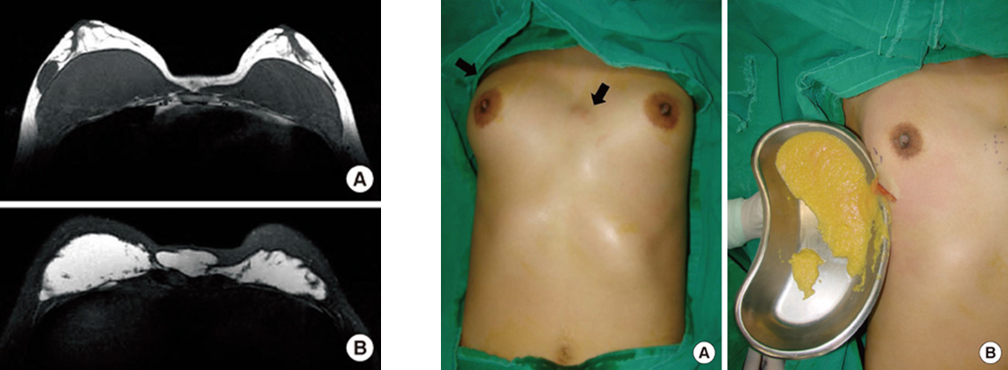
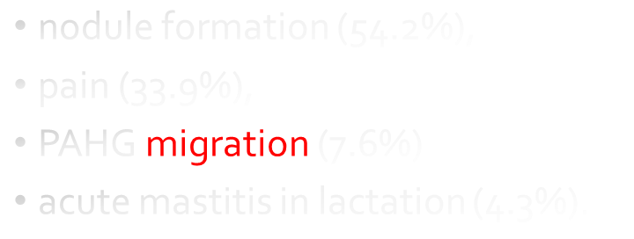
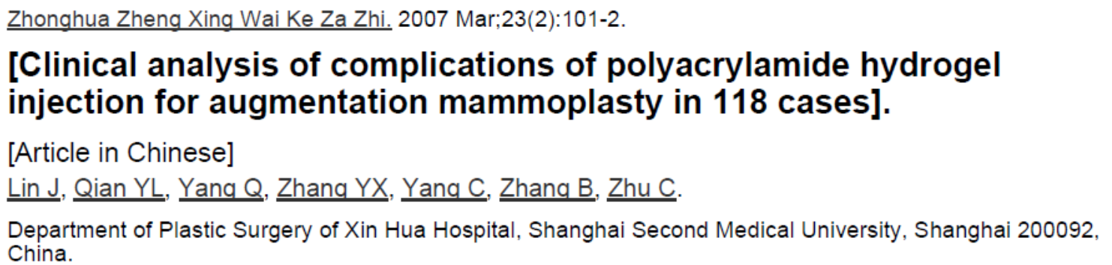

Slide 15
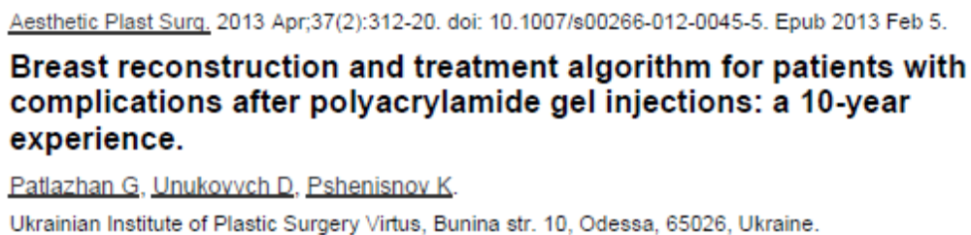
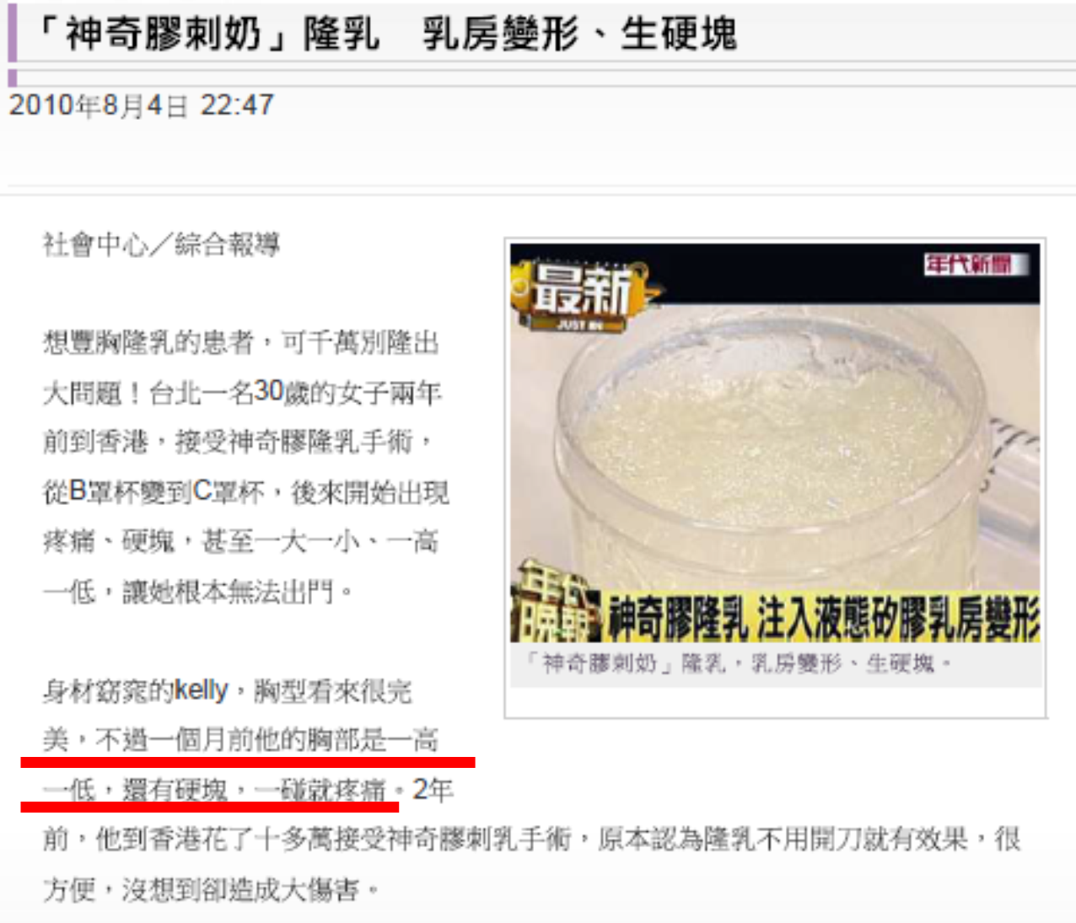
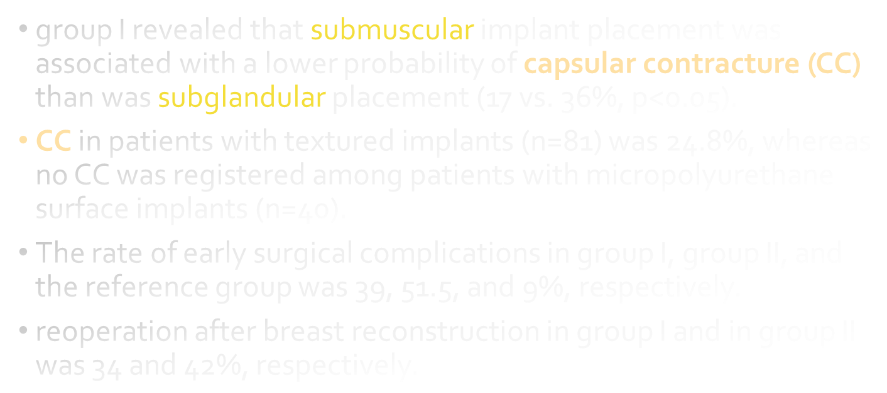
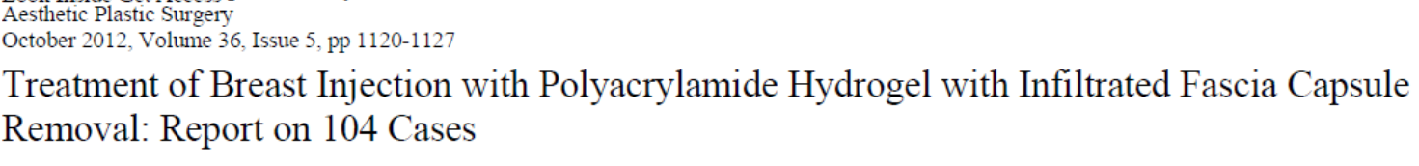

Slide 16

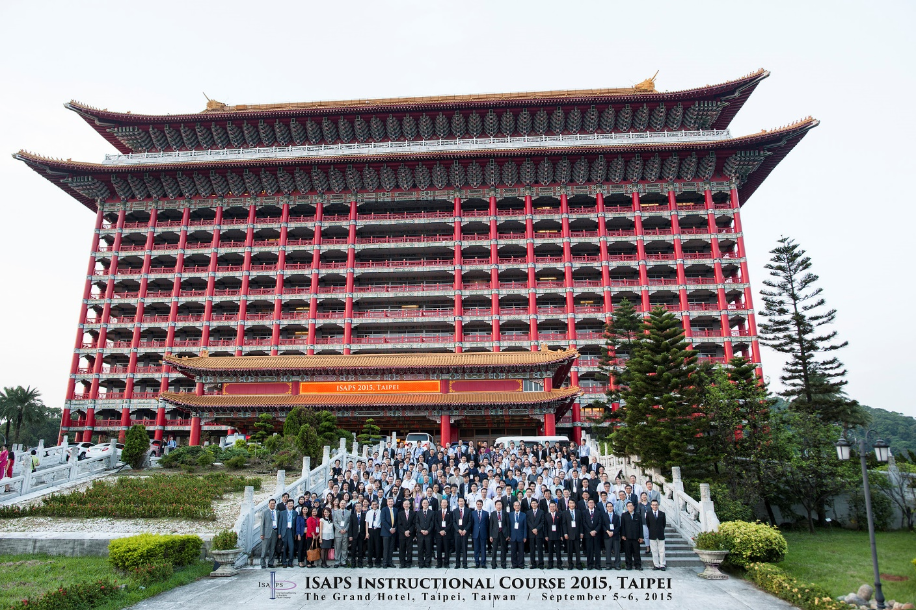
Thanks for your attentions! and Welcome to Taiwan ~^^~

