Slide 1
Upper blepharoplasty combined with preop forehead botulinum toxin A injection for aging eyelids with asymmetric eyebrows: Case report
Sung-Chuan Chao, MD¹, Yuan-Sung Kuo, MD, PhD²
Division of Plastic Surgery, Department of Surgery, National Taiwan University Hospital and College of Medicine, Hsin-Chu branch¹, Chu-Tong branch², Hsinchu, Taiwan
Nothing to disclose

Slide 2
Objective of the study
In addition of upper blepharoplasy, for those with associated saggy frontalis muscle, even asymmetric position of eyebrows, auxiliary operations such as browlift are necessary
We report a simple method to avoid postoperative asymmetric brow

Slide 3
Materials and methods
We inject botulinum toxin A (Botox®), evenly distributed into 8 to 10 points for entire forehead, at a dose of 3 IU per shot, one week before blepharoplasty for a 62-year-old male and a 64-year-old female who sought surgery for their saggy eyelids

Slide 4
Results(1)
One week following Botulinum toxin A injection, the forehead wrinkles disappeared and their eyelids became symmetric

Slide 5
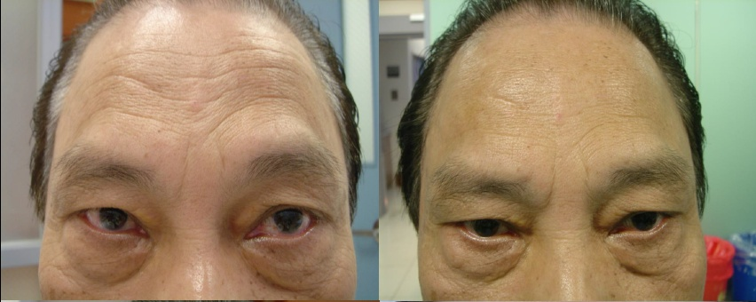
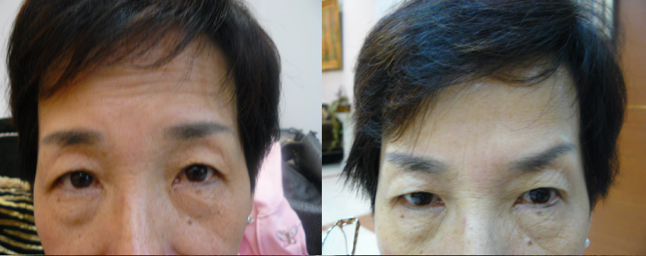

Slide 6
Results(II)
After blepharoplasty, the ptotic eyelids were also corrected
The two patients were satisfied and had an uneventful recovery in the one-year follow-up

Slide 7
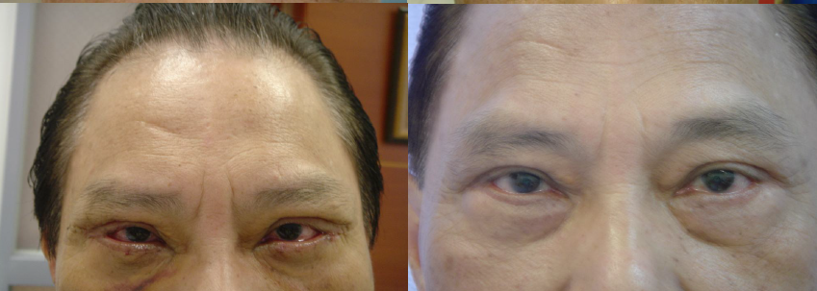
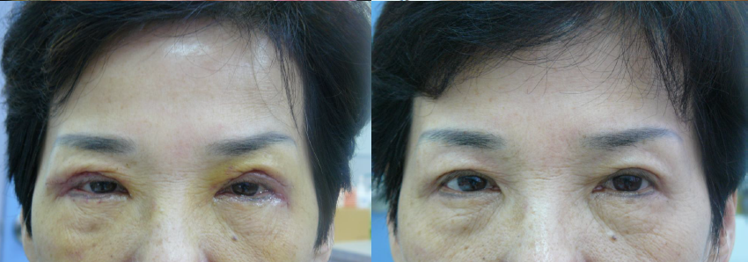

Slide 8
Conclusions
This method can be expanded to treat any aging eyelids associated with saggy forehead with no need of browlift surgery, regardless of the eyebrow positions

Slide 9
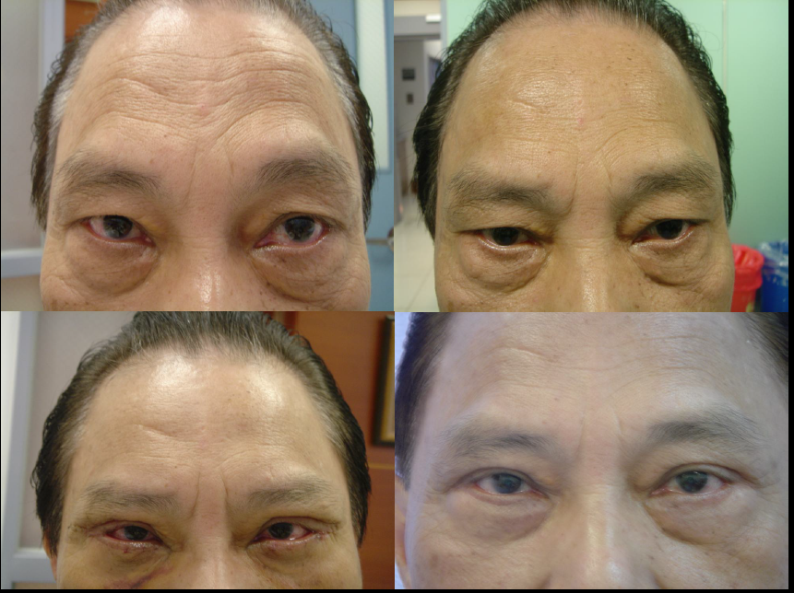
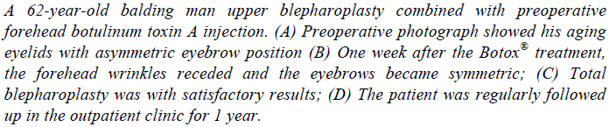
Significance of the findings

Slide 10
